Slide 1
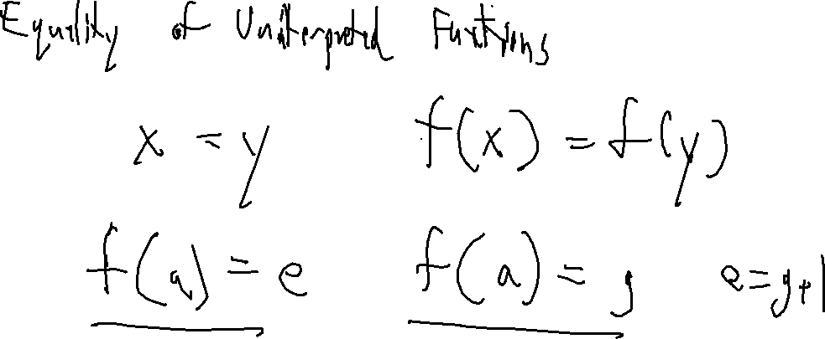
Exercise 33
SMT Solving Review
Write your name and answer the following on a piece of paper
To what theory does EUF refer in SMT Solving? How is EUF useful?

Slide 2
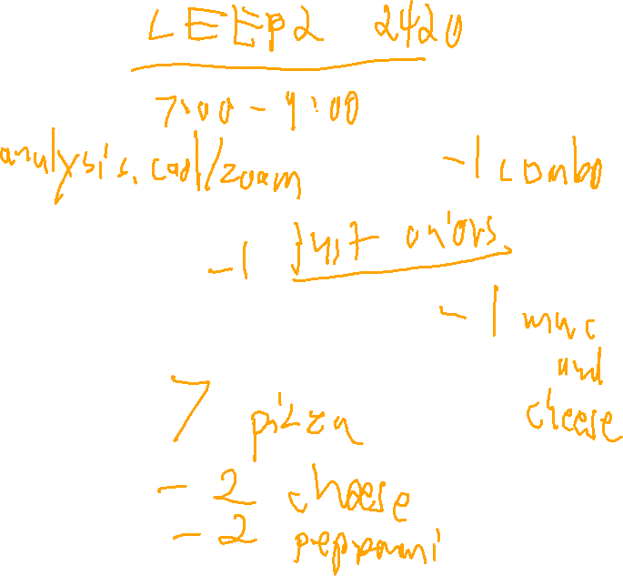
Administrivia and
Announcements
Review Session Tonight
(Pizza poll)

Slide 3
Web Security
EECS 677: Software Security Evaluation
Drew Davidson

Slide 4

Shifting Gears
Overview
On to a different topic: web security!

Slide 5
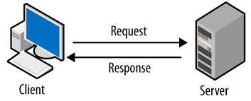
The Interconnected Web
Overview
Computers (largely) communicate in a client-server relationship
Request
(data)
Response
(data)

Slide 6
Static HTML Example
Overview
Computers (largely) communicate in a client-server relationship

Slide 7


Client/Server Code
Overview
vim Desktop/index.html
firefox Desktop/index.html
Static Content
Static Content
Client
Server
Client
Server
request
request
html div
html div
Hello
<html>
hello
</html>
draw
#0F0
square

Slide 8
Client/Server Code
Overview
Client Dynamic Content
Client
Server
request
html div
“Thursday”
v = getDate
return v

Slide 9
Client/Server Code
Overview
Client Dynamic Content
Client
Server
request
(run getDate())
Thursday
html div
return
<script>
getDate
</script>

Slide 10
Code vs Content
Overview
Where does the code get executed?
On the client?
On the server?

Slide 11
User Interaction
Overview
How can a user influence the code being run?
Client
Server
https://google.com?coolVar=2
print $_GET[‘coolVar’]

Slide 12
Code as Content
Overview
What happens when a user gives CODE in a content field?
Client
Server
https://google.com?coolVar=<script>alert(‘hello’)</script>
print $_GET[‘coolVar’]

Slide 13
Malicious Intent
Overview
The prior demo isn’t really “harmful”, but it is the basic concept underlying many problems on the internet
Victim client, malicious server
Malicious client, victim server
Malicious client 1, victim client 2, vector server

Slide 14
Why Attack via the web?
Overview
Spam
• Sent from legitimate IP address, less likely to be blocked
Denial of service
• Attack competitors, or seek ransom
Data theft
• Steal credentials, credit card numbers, intellectual property

Slide 15
Lecture Outline
Overview
Motivation

Slide 16
Ransomware
Overview

Slide 17
Cryptominers
Overview

Slide 18
Political Reasons
Overview

Slide 19
The Interconnected Web
Overview
additional links may exist, with a server acting as a client, forming a web

Slide 20
HTML Src and includes
Overview

Slide 21
Lecture END!
Described some of the issues and Fixes for dataflow in the presence of loops

