Slide 1
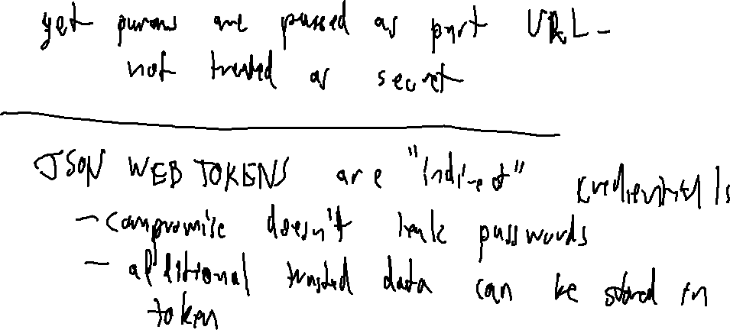
Exercise 35
Web Authentication Review
What are the disadvantages of sending passwords in a GET parameter? What is the advantage of using JWT?

Slide 2
Administrivia and Announcements

Slide 3
Web APPS
EECS 677: Software Security Evaluation
Drew Davidson

Slide 4
Last Time
Review: Web Resources
Authentication Security
Ensuring Database Integrity
Ensuring Credential Integrity

Slide 5
Today
Web Protections
Putting it all together
- Developing a react app and examining security aspects

Slide 6
A Modern Web-App
Full Stack Security
frontend
api
database
react
node
sqlite

Slide 7
React Frontend
Web Protections
npm create vite@latest
cd frontend
npm install axios
npm run dev
import { useState } from 'react'
import './App.css'
import { Login } from './Login.jsx'
export default function App() {
const [token, setToken] =
useState(window.sessionStorage.getItem("token"));
if (token === undefined || token === null){
return <Login tokenSetter={setToken} />
}
return (<p>{"I'm some content!!!!"}</p>)
}

Slide 8
Node Backend API
Web Protections
app.post('/login', (req, resp) => {
const name = req.body.name;
const pw = req.body.pw;
const Q = "SELECT name,id FROM accounts"
+ " WHERE pw = '" + pw
+ "' AND name = '" + name + "'";
db.get(Q, function(err, row){
if (!row){
resp.send(JSON.stringify({ok:false}));
return;
}
const creds = { "name":row[‘name’], "id":row['id’]}
const token = encodeJWT(creds, SECRET);
const res = {'ok':true,'token':token};
resp.send(JSON.stringify(res));
});
}
npm create
npm install express sqlite3

Slide 9
Lecture END!
Basic end-to-end scheme
Next Time: Filling out functionality

