Slide 1
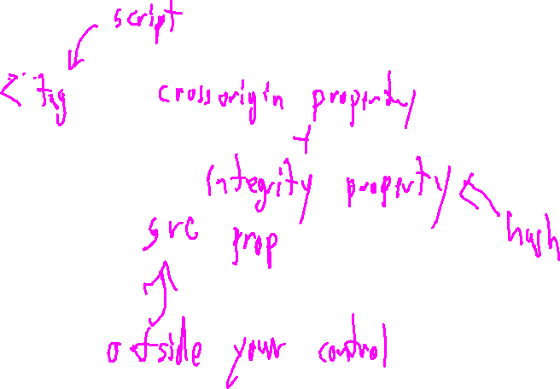
Exercise 34
Web Security Review
What is the threat model defeated by SRI? How is SRI implemented?

Slide 2
Administrivia and Announcements
Remember! Quiz 3 is Monday

Slide 3
Web Authentication
EECS 677: Software Security Evaluation
Drew Davidson

Slide 4
Last Time
Review: Web Resources
The various, distributed resources in a site
- The SOP
- SRI hash integrity

Slide 5
Today
Web Protections
Privileged operations
Data persistence
Authentication tokens

Slide 6
Token-Based Identity
Web Protections

Slide 7
Refresh and AUTH TOKENS
Web Protections

Slide 8
Data Persistence
Web Auth
npm install sqlite3
Command line:
sqllite3
CREATE TABLE accounts (
id INTEGER PRIMARY KEY,
name TEXT NOT NULL,
pw TEXT NOT NULL,
token TEXT NOT NULL)

Slide 9
Lecture END!
More data next Time

