Slide 1
Exercise 29
Dynamic Analysis Review
Write your name and answer the following on a piece of paper
What is the difference between unit testing and application testing?

Slide 2
Exercise 29 Solution
Dynamic Analysis Review

Slide 3
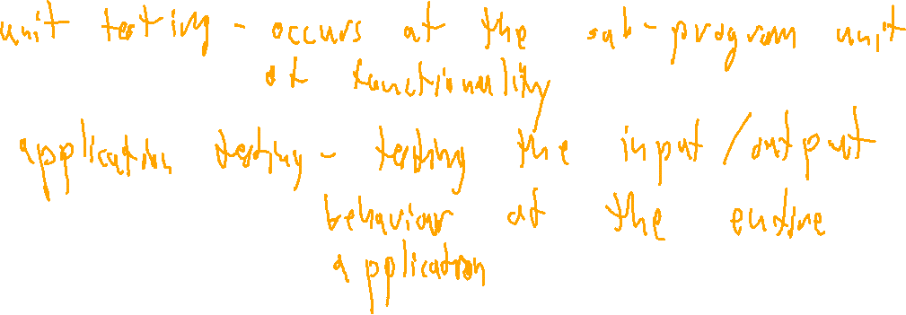
Exercise 29
Dynamic Analysis Review
Write your name and answer the following on a piece of paper
What is the difference between unit testing and application testing?

Slide 4
Exercise 29 Solution
Dynamic Analysis Review

Slide 5
Exercise 29
Fuzzing Review
Write your name and answer the following on a piece of paper
In fuzzing, it is easy to generate additional test cases for an analysis target. What are some of the strategies for prioritizing which test case to run next?

Slide 6
Administrivia and Announcements

Slide 7
Symbolic Execution
EECS 677: Software Security Evaluation
Drew Davidson

Slide 8
Where We’re At
Dynamic Analysis
Generating test cases

Slide 9

Previously: Fuzzing
Outline / Overview
Generating Random test cases
Surprisingly effective in practice
Main challenge is exploring “new” behavior
The random “fuzz” of white noise

Slide 10
This Lecture: Symbolic Execution
Outline / Overview
A methodical approach to “abstract” execution

Slide 11

Recall: Test case generation
Symbolic Execution
Test Suite
Test1
Program
Test1
Test1
Test1
Test1
Test1
Test1
Test1
Input_{n}
Actual_{n}
Test1
Test1
Match?
Test1
Test1
Expected_{n}

Slide 12

The problem of coverage
Symbolic Execution
1: #include “stdlib.h”
2: int main(){ 3: int c = getchar();
4: if (c == 12345){
5: blowUpTheOcean();
6: } else {
7: return 0;
8: }
9: }
A divergence, beyond which some behavior will be missed

Slide 13
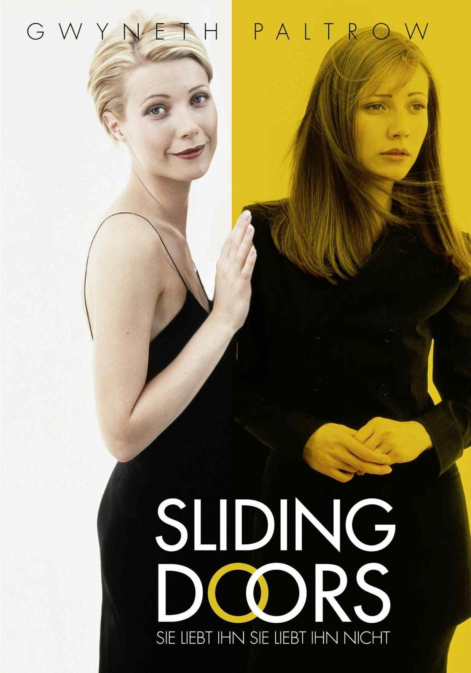
Big Idea: Explore BOTH Sides
Symbolic Execution
1: #include “stdlib.h”
2: int main(){ 3: int c = getchar();
4: if (c == 12345){
5: blowUpTheOcean();
6: } else {
7: return 0;
8: }
9: }

Slide 14
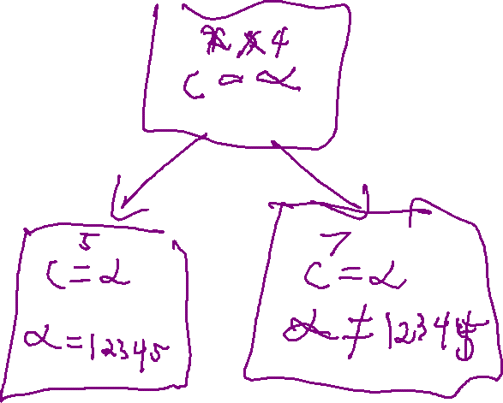
Technique #1: Symbolic Input
Symbolic Execution
1: #include “stdlib.h”
2: int main(){ 3: int c = getchar();
4: if (c == 12345){
5: blowUpTheOcean();
6: } else {
7: return 0;
8: }
9: }

Slide 15
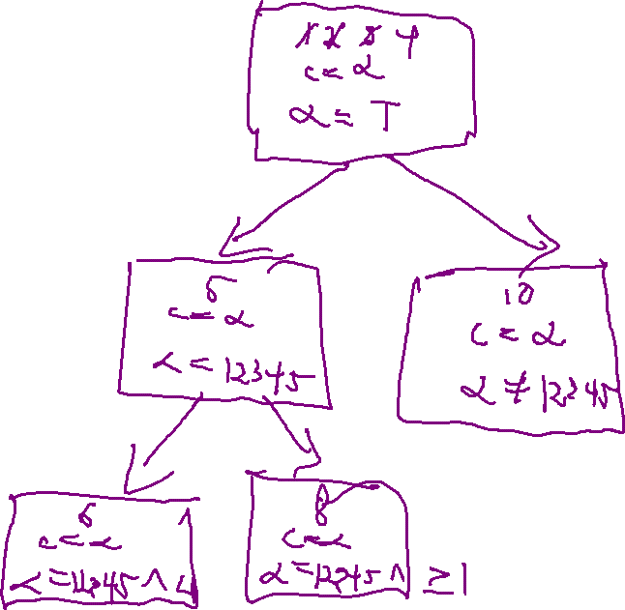
Path Feasibility
Symbolic Execution
1: #include “stdlib.h”
2: int main(){ 3: int c = getchar();
4: if (c == 12345){
5: if (c < 1){
6: blowUpTheOcean();
7: }
8 : } else {
10: return 0;
11: }
12: }

Slide 16

Big Idea #2: PATH Constraints
Symbolic Execution
1: #include “stdlib.h”
2: int main(){ 3: int c = getchar();
4: if (c == 12345){
5: if (c < 1){
6: blowUpTheOcean();
7: }
8 : } else {
10: return 0;
11: }
12: }

Slide 17

The magic of the solver
Symbolic Execution
Boolean
equation
SAT
Satisfying
assignment

Slide 18
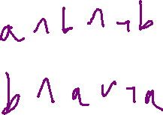
The magic of the solver
Symbolic Execution
Somewhat arbitrary
equation
SMT
Satisfying
assignment
Translation!
Boolean
equation
SAT
Satisfying
assignment

Slide 19
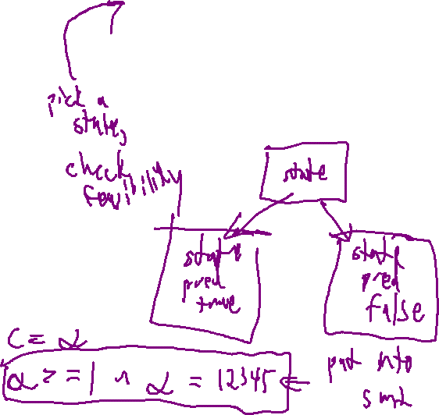
The symbolic execution Tree
Symbolic Execution
1: #include “stdlib.h”
2: int main(){ 3: int c = getchar();
4: if (c == 12345){
5: if (c < 1){
6: blowUpTheOcean();
7: }
8 : } else {
10: return 0;
11: }
12: }
At each line of the program:
Advance a symbolic program state
When you hit a branch split the symbolic state into 2 versions
1) a state that satisfies the predicate
2) a state that does not satisfy the predicate

Slide 20
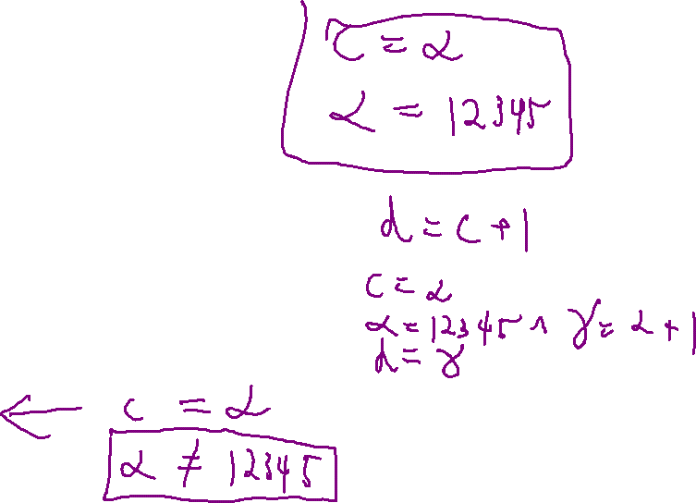
test suite Generation
Symbolic Execution
1: #include “stdlib.h”
2: int main(){ 3: int c = getchar();
4: if (c == 12345){
5: if (c < 1){
6: blowUpTheOcean();
7: }
8 : } else {
10: return 0;
11: }
12: }

Slide 21
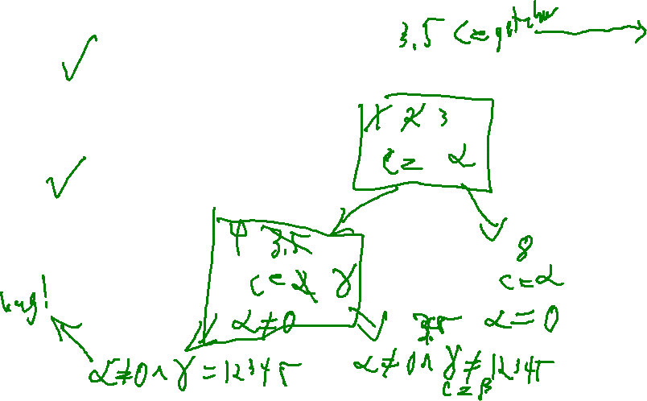
Soundness / Completeness
Symbolic Execution
1. int main(){
2. int c = getchar();
3. while ( c ){
4. if (c == 12345){
5. blowUpTheOcean();
6. }
7. }
8. return 4;
9. }
Soundness
Never generate a state that is unreachable
Completeness
Never miss a state
Termination
Maybe not!

Slide 22
Soundness / Completeness
Symbolic Execution
1. int main(){
2. int c = getchar();
3. while ( c ){
4. if (c == 12345){
5. blowUpTheOcean();
6. }
7. }
8. return 4;
9. }
Termination
Maybe not!

Slide 23
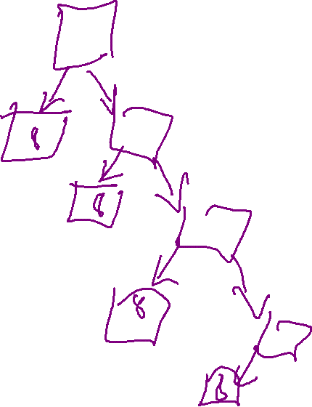
Limitation: Coverage
Symbolic Execution
1. int main(){
2. int c = getchar();
3. while ( c ){
4. if (c == 12345){
5. blowUpTheOcean();
6. }
7. }
8. return 4;
9. }

Slide 24
Limitation: Environment input
Symbolic Execution
1. int main(){
2. int c = getchar();
3. c = ioctl(0x92);
4. return 4;
5. }

Slide 25
Summary
Symbolic execution
A simple, elegant idea

Slide 26

Next Time
Concolic Execution
An extension to symbolic execution
Give up on completeness AND soundness to increase practical coverate

