Slide 1
Exercise #7
Computability Review
Write your name and answer the following on a piece of paper
Consider a simple bug-finding analysis that looks for null pointer deferences in C programs. The analysis raises an alert on any program that has ANY pointer operation, and does not raise an alert on any other program.
Is this analysis sound, complete, neither, or both? Justify your answer.

Slide 2
Static Analysis
EECS 677: Software Security Evaluation
Drew Davidson

Slide 3
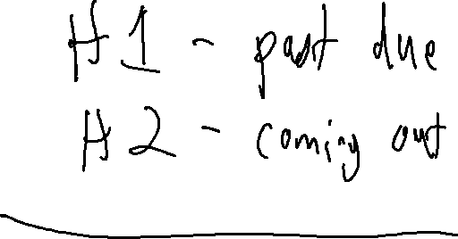
Administrivia and Announcements

Slide 4

Last Time: Analysis Definitions
Review: Computability
Analysis Target – The system being analyzed
For us this will usually be a software program
Analysis Engine – The system doing analysis
For us this will usually be a software program
Analysis Goal – The phenomenon we are detecting
The existence of a certain (program) behavior?
The absence of a certain (program) behavior?

Slide 5
Last Time: Analysis Limits
Review: Computability
The limits of computability
The Halting Problem: No decision procedure for halting
Rice’s Theorem: The Halting Problem implies no decision procedure for any reachability problem
Analysis without decision procedures
Approximation
How do we approximate? Soundness / Completeness

Slide 6

Last Time: Analysis Design
Review: Computability
NO analysis can be both sound and complete
Building an analysis that is either sound or complete is trivial
Complete – Always report positive, no false negatives
Sound – Always report negative, no false positives

Slide 7


This Time: Working With Constraints
Today’s Lecture
Given the limitations of analysis, how might we still provide useful tools for software security evaluation?
Static Analysis, get it?

Slide 8
Lecture Outline
Contextualizing Rice’s Theorem
Program Guarantees
Analysis Specificity
Dataflow analysis

Slide 9

Rice’s Theorem (Non)assertions
Contextualizing Rice’s Theorem
Excludes properties that are true or false for every program
Excludes properties that do not regard program's behavior
Notably, the theorem ignores syntactic properties
All non-trivial semantic properties of programs are undecidable.
j/k: Rice’s Theorem is named
after Dr. Henry Gordon Rice

Slide 10
Syntactic Static Analysis
Contextualizing Rice’s Theorem
Some troubling behavior of a program may be discoverable via simply observing its text
int main(int argc, const char * argv[]){
const char * password = argv[1];
int good;
if (password == “supersecret”){
good = 1;
} else {
good = 0;
}
authenticate(good);
}

Slide 11
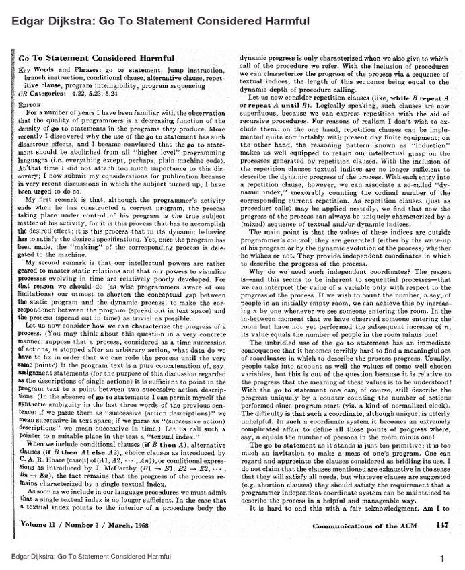
Insights
Contextualizing Static Analysis
Software engineering “code smells” / stats
Use of the forbidden / arcane constructs
Cyclomatic complexity
Long functions

Slide 12

Rice’s Theorem (Non)assertions
Contextualizing Rice’s Theorem
Excludes properties that are true or false for every program
Excludes properties that do not regard program's behavior
Notably, the theorem ignores syntactic properties
All non-trivial semantic properties of programs are undecidable.
No decision procedure: that’s a high bar!
We can design analyses that work perfectly in some cases, but admit uncertainty in others
j/k: Rice’s Theorem is named
after Dr. Henry Gordon Rice

Slide 13
Lecture Outline
Contextualizing Rice’s Theorem
Program Guarantees
Preciseness vs Efficiency
Dataflow analysis

Slide 14

STATIC Analysis - Opportunities
Static Analysis Philosophy
For security analysis, we want to lock out “bad” programs
(even at the cost of locking out some “good” programs)
Provide assurances about what a program will NEVER or ALWAYS do
Static analysis might report EVERY program that (possibly) has a problem
Static analysis might certify EVERY program that (definitely) has no problem

Slide 15

STATIC Analysis - Opportunities
Static Analysis Philosophy
Provide assurances about what a program will NEVER or ALWAYS do
Static analysis might report EVERY program that (possibly) has a problem
Static analysis might certify EVERY program that (definitely) has no problem
Definitely Good
Complete bug finder – no flag
Target Program
Analysis
¯\_(ツ)_/¯
Complete bug finder - flag
Definitely Bad
lump “unsure” into “bad”

Slide 16
STATIC Analysis - Opportunities
Static Analysis Philosophy
Definitely Good
Complete bug finder – no flag
Target Program
Analysis
¯\_(ツ)_/¯
Complete bug finder - flag
Definitely Bad
lump “unsure” into “bad”
Goal: minimize the uncertainty

Slide 17
Lecture Outline
Contextualizing Rice’s Theorem
Program Guarantees
Analysis over CFG
Preciseness vs Efficiency

Slide 18
STATIC Analysis - Opportunities
Static Analysis Philosophy
Definitely Good
Complete bug finder – no flag
Target Program
Analysis
¯\_(ツ)_/¯
Complete bug finder - flag
Definitely Bad
lump “unsure” into “bad”
Goal: minimize the uncertainty
(comes in part from reachability)
Key idea: Build the Control-Flow Graph,
explore routes through the graph to
(over)approximate reachability

Slide 19

Building the CFG
Control Flow Graph Analysis
In general, an iterative process:
Pass over instructions, mark leaders/ terminators
Might create new leaders / terminators, so keep doing passes until no more found
Build basic blocks by boundaries
Connect control source to control destination
Refine based on analyses
For LLVM Bitcode, even easier
All blocks (except possibly entry) have labels
Connect control source to control destination
One deviation from LLVM: split after a call!
Refine based on analyses

Slide 20
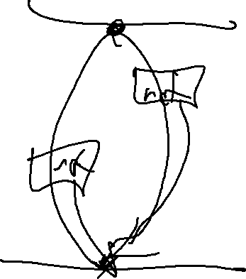
CFG Notation
Static Analysis Philosophy
We’ll enforce a couple of constraints on the CFG
It must be a hammock –
One entry point, one exit block
Call sites and return points are connected via a special link edge

Slide 21
Visualizing the CFG: DOT
Control Flow Graph Analysis
Flow-sensitive analysis relies heavily on the Control-Flow Graph concept
It’s pretty helpful to have a CFG in hand
Good news! You know how to automatically induce the CFG structure
Gooder news! There’s a format to visualize CFGs
File graph.dot
cmdline
output
digraph name { nodeA […];
nodeB […];
nodeA -> nodeB […];
}
dot –Tpdf graph.dot –o graph.pdf

Slide 22
Existing CFG Tools
Control Flow Graph AnalySiS
Good news! You know how to automatically induce the CFG structure
Gooder news! There’s a format to visualize CFGs
Goodest news! llvm can output a dot-format CFG for .ll-format code
opt -dot-cfg prog.ll > /dev/null
opt -passes=dot-cfg prog.ll > /dev/null

Slide 23
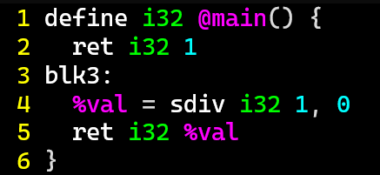
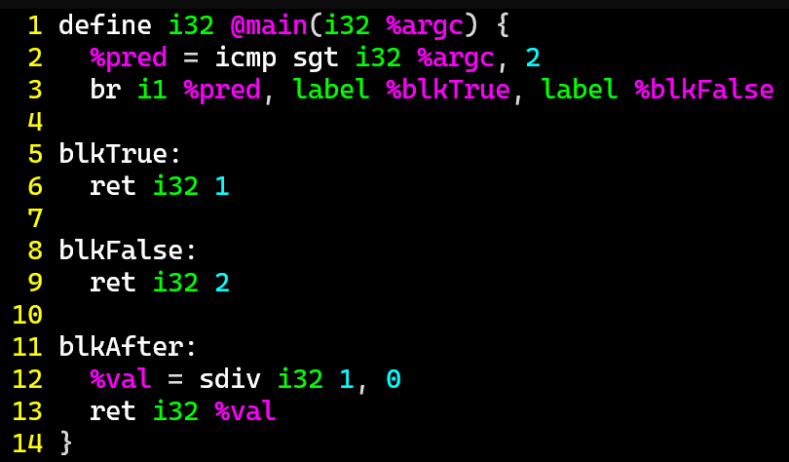
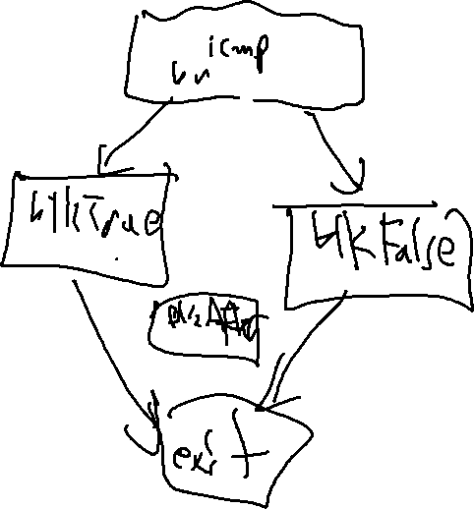
Overapproximating Reachability
Static Analysis Philosophy

Slide 24
Lecture Outline
Contextualizing Rice’s Theorem
Program Guarantees
Analysis over CFG
Preciseness vs Efficiency

Slide 25
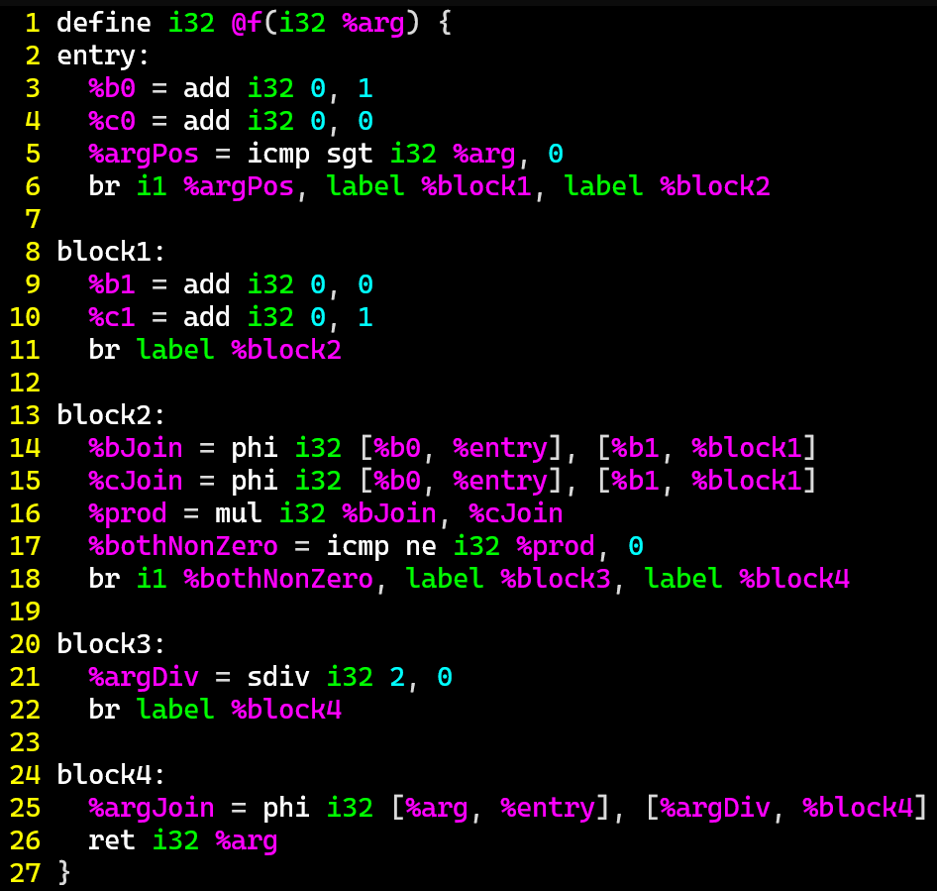
Infeasible Paths
Static Analysis: Dataflow
Is this program buggy?
Just check every path(?!?!?!)
entry
int f(int arg) {
int b = 1;
int c = 0;
if (arg > 0){
b = 0;
c = 1;
}
if (b && c) {
arg = 2 / 0;
}
return arg;
}
block1
block2
block3
block4

Slide 26

Wrasslin’ With State Space
Preciseness vs Efficiency
State space: the set of all possible configurations of the target model
Naïve state space representation:
Consider each path separately

Slide 27
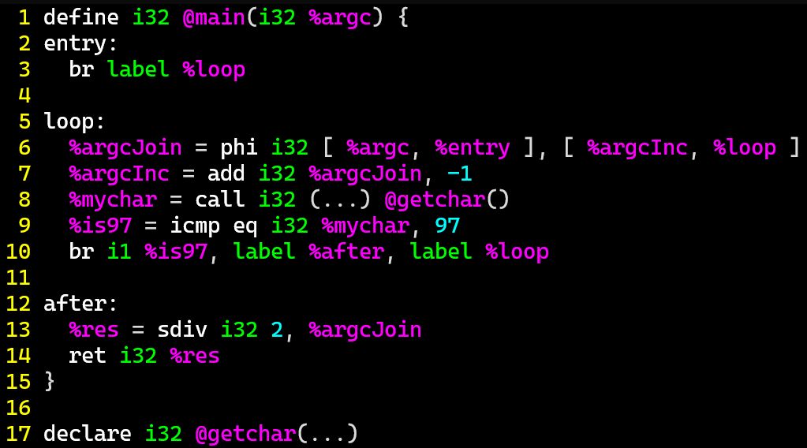
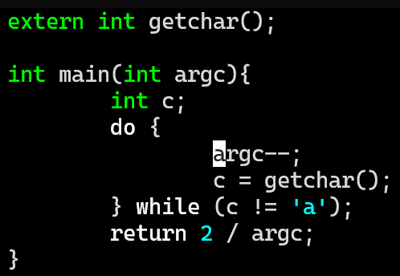
Path-Sensitive Dataflow Analysis
Static Analysis: Dataflow
entry:
br label %loop
How many paths are there in this program?
false
Loop:
%argcJoin = phi i32 [%argc, %entry] , [%argcInc, %loop]
%argcInc = add i32 %argcJoin, -1
%mychar = call i32 (…) @getchar();
%is97 = icmp eq i32 %mychar, 97
Br i1 %is97, label %after, label %loop
true
after:
%res = sdiv i32 2, %argcJoin %argcJoin
ret i32 %res

Slide 28


Wrasslin’ With State Space
PRECISENESS vs Efficiency
State space: the set of all possible configurations of the analysis target
Naïve state space representation: enumerate all configurations of a program
For n bits of memory: 2^{n} states
Practical state space representation: Summarize sets of configurations of a program

Slide 29

The Power of Static Analysis
Analysis Specificity
The power of static analysis:
You can see beyond the code that is executed in an individual trace
The responsibility of static analysis:
You need to consider the conditions/circumstances/context in which code would be executed while keeping state space small

Slide 30

Overapproximating Reachability
Static Analysis Philosophy

Slide 31
Next TiME
Flow-Sensitive AnalysIs

