Slide 1
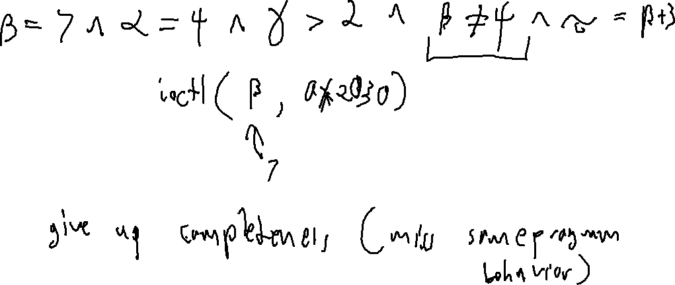
Exercise 31
Concolic Execution Review
What is the benefit of concolic execution over symbolic execution? How does it compare in terms of soundness / completeness of vulnerability finding?

Slide 2
Exercise 31 Solution
Concolic Execution Review

Slide 3
Exercise 31
Concolic Execution Review
Write your name and answer the following on a piece of paper
What is the benefit of concolic execution over symbolic execution? How does it compare in terms of soundness / completeness of vulnerability finding?

Slide 4

Administrivia and Announcements
Quiz 3 is on Friday

Slide 5
Boolean Satisfiability
EECS 677: Software Security Evaluation
Drew Davidson

Slide 6
Where We’re At
Tools / Techniques underlying Symbolic Execution

Slide 7

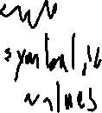
Previously: Enhancing Symbolic Execution
Outline / Overview
Generating test cases
Prioritizing states in the symbolic execution tree
Pruning Duplicate states
Concretizing (some) input to make progress

Slide 8

This Time: Satisfiability
Outline / Overview
The magic that made Symbolic execution work was the solver
Determines if a path constraint is feasible
Induces a test case that satisfies the path constraint
Allows for consistent concretization

Slide 9


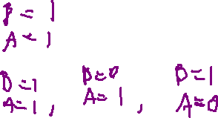

Boolean Satisfiability
SAT and SMT
At the root of the solver is a mechanism for solving a hard problem:
Given a Boolean expression, provide a satisfying assignment to its variables or indicate no such assignment is possible
The search for a solution
requires a lot of computation
Constant time
Linear time
$$B ∧A$$
n log n time
Search scales rapidly with
the size of the problem
polynomial time
$$B ∨A$$
Exponential time
$$¬A∧A$$

Slide 10
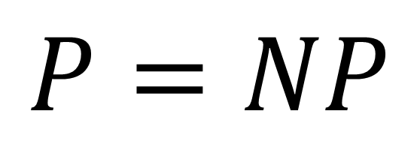
NP
SAT and SMT
The class of problems where…
A solution can be generated in polynomial time by a nondeterministic Turing machine
?
A solution can be verified in polynomial time by a deterministic Turing machine
$$P=NP$$

Slide 11
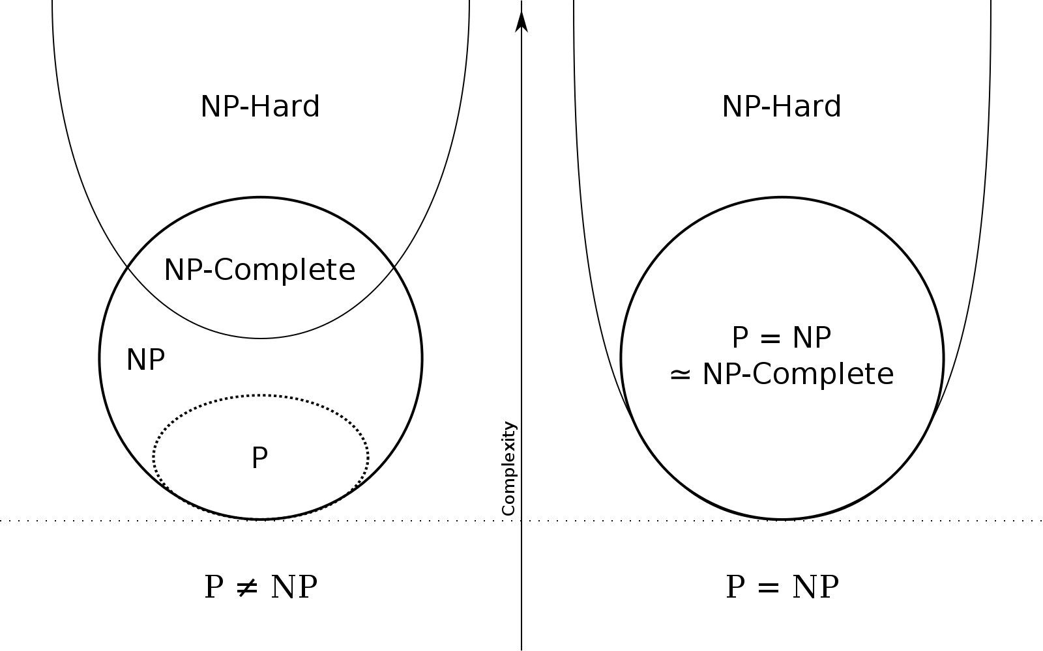
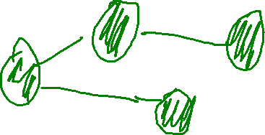
NP-Completeness
SAT and SMT
The class of problems where…
A solution could be used as a solver for any problem in NP
The “most difficult problems in NP”
SAT is the canonical example of an NP-Complete problem

Slide 12

The marvel of engineering
SAT and SMT
NP Reductions once were used to to show that a problem was difficult, now they are used to show that a problem is do-able

Slide 13
How do sat Solvers work?
SAT and SMT
Naïve Solution: Exponential time 2^n
(a) ∧ (b ∨ c) ∧ (¬a ∨ c ∨ d) ∧ (¬c ∨ d) ∧ (¬c ∨ ¬d ∨ ¬a) ∧ (b ∨ d)

Slide 14

Solver Strategies
SAT and SMT
We “often” can do better than the worst case

Slide 15

Conjunctive Normal FOrm
SAT and SMT
A Conjunction of clauses
Each clause may include 1 or more literals, 0 or more negations, 0 or more disjunctions

Slide 16
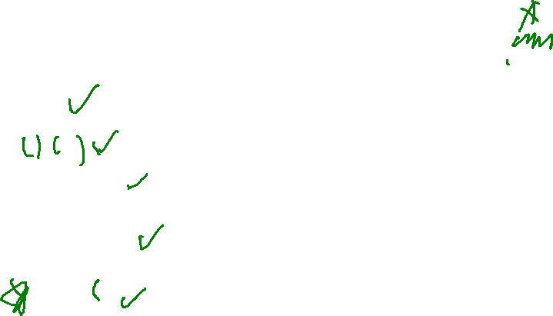
Conjunctive Normal FOrm
SAT and SMT
A Conjunction of clauses
Each clause may include 1 or more literals, 0 or more negations, 0 or more disjunctions
P
P ∧ Q
P ∧ (Q ∨ R)
P ∧ (¬Q ∨ R)
X
P ∨ Q ∨ R)

Slide 17
Conjunctive Normal FOrm
SAT and SMT
Any Boolean expression can be represented as a conjunction of disjunctions using the standard Boolean transformations
Boolean transformations:
¬(P ∨ Q) ⇐⇒ ¬P ∧ ¬Q
¬(P ∧ Q) ⇐⇒ ¬P ∨ ¬Q
¬¬P ⇐⇒ P
(P ∧ (Q ∨ R)) ⇐⇒ ((P ∧ Q) ∨ (P ∧ R))
(P ∨ (Q ∧ R)) ⇐⇒ ((P ∨ Q) ∧ (P ∨ R))

Slide 18
Conjunctive Normal Form: Strategy
SAT and SMT
EVERY clause must be satisfied
(P ∨ Q) ∧ (P ∨ R)

Slide 19

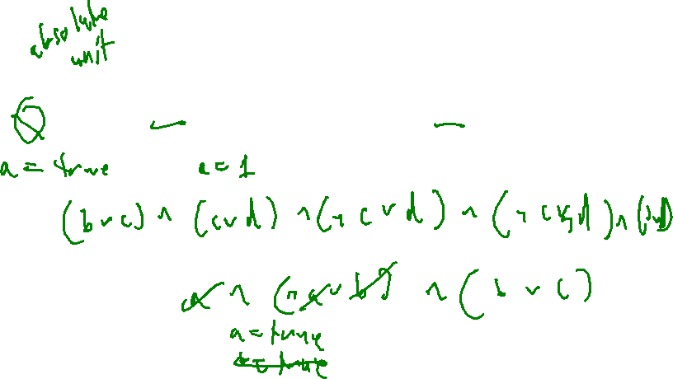
Unit Propagation
SAT and SMT
a literal that exists all alone in a clause with only one literal is a unit
(a) ∧ (b ∨ c) ∧ (¬a ∨ c ∨ d) ∧ (¬c ∨ d) ∧ (¬c ∨ ¬d ∨ ¬a) ∧ (b ∨ d)

Slide 20
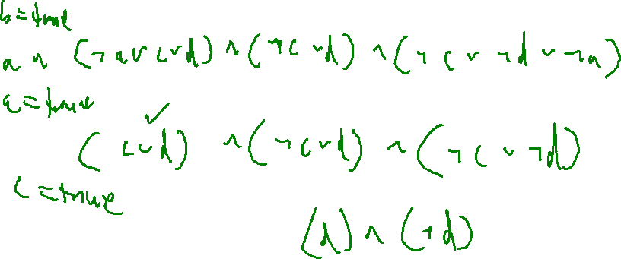
Pure literal Elimination
SAT and SMT
a literal that occurs only positively, or only negatively, in a formula is pure
(a) ∧ (b ∨ c) ∧ (¬a ∨ c ∨ d) ∧ (¬c ∨ d) ∧ (¬c ∨ ¬d ∨ ¬a) ∧ (b ∨ d)

Slide 21
DPLL
SAT and SMT
(a) ∧ (b ∨ c) ∧ (¬a ∨ c ∨ d) ∧ (¬c ∨ d) ∧ (¬c ∨ ¬d ∨ ¬a) ∧ (b ∨ d)
function DPLL(φ)
if φ = true then
return true
end if
if φ contains a false clause then
return false
end if
for all unit clauses l in φ do
φ ← UNIT-PROPAGATE(l, φ)
end for
for all literals l occurring pure in φ do
φ ← PURE-LITERAL-ASSIGN(l, φ)
end for
l ← CHOOSE-LITERAL(φ)
return DPLL(φ ∧ l) ∨ DPLL(φ ∧ ¬l)
end function

Slide 22

No Magic Bullet
Outline / Overview
We know some constraints are computationally hard to unpack
int main(){ char s[80];
scanf(“%s”, s);
if (sha256sum(s) == c01b39c7a35ccc3b081a3e83d2c71fa9a767ebfeb45c69f08e17dfe3ef375a7b
}

Slide 23
No Magic Bullet
Outline / Overview
We know some constraints are computationally hard to unpack
int main(){ char s[80];
scanf(“%s”, s);
if (sha256sum(s) == c01b39c7a35ccc3b081a3e83d2c71fa9a767ebfeb45c69f08e17dfe3ef375a7b){
return 1 / 0;
}
}

Slide 24
From SAT to SMT
Outline / Overview
Next Time…
Symbolic execution requires path constraints far more complex than Boolean expressions.
Although a naïve reduction is somewhat straightforward, naivety does not gel well with NP-completeness

