Slide 1
Exercise 32
Boolean Satisfiability Review
Write your name and answer the following on a piece of paper
Apply DPLL to determine if there is a satisfying assignment to the following Boolean formula
$$\left(a∨b\right)∧\left(a ∨c\right)∧\left(¬b ∨¬c\right)∧\left(¬d ∨¬c\right)∧\left(¬d ∨¬b\right)∧\left(c\right)$$

Slide 2
Exercise 32 Solution
Boolean Satisfiability Review

Slide 3
Exercise 32
Boolean Satisfiability Review
Write your name and answer the following on a piece of paper
Apply DPLL to determine if there is a satisfying assignment to the following Boolean formula
$$\left(a∨b\right)∧\left(a ∨c\right)∧\left(¬b ∨¬c\right)∧\left(¬d ∨¬c\right)∧\left(¬d ∨¬b\right)∧\left(c\right)$$

Slide 4
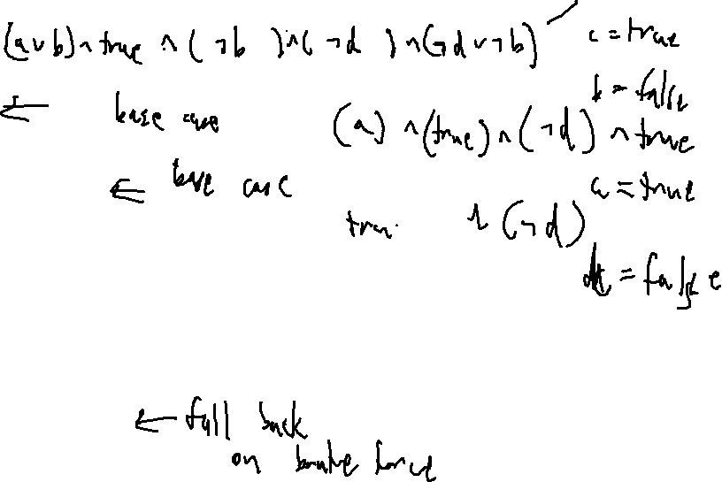
Exercise 32
Solution
Boolean Satisfiability Review
$$\left(a∨b\right)∧\left(a ∨c\right)∧\left(¬b ∨¬c\right)∧\left(¬d ∨¬c\right)∧\left(¬d ∨¬b\right)∧\left(c\right)$$
function DPLL(φ)
if φ = true then
return true
end if
if φ contains a false clause then
return false
end if
for all unit clauses l in φ do
φ ← UNIT-PROPAGATE(l, φ)
end for
for all literals l occurring pure in φ do
φ ← PURE-LITERAL-ASSIGN(l, φ)
end for
l ← CHOOSE-LITERAL(φ)
return DPLL(φ ∧ l) ∨ DPLL(φ ∧ ¬l)
end function

Slide 5
Administrivia and Announcements
Quiz 3 on 11/17
Review Session on 11/10 7:00 PM
Room TBA

Slide 6
SMT solving
EECS 677: Software Security Evaluation
Drew Davidson

Slide 7
Where We’re At
Tools / Techniques underlying Symbolic Execution

Slide 8

previously : Satisfiability
Outline / Overview
The magic that made Symbolic execution work was the solver
A computationally hard problem
Famously NP-complete (the progenitor of that complexity class!)
Obvious exponential loose upper bound (brute force)

Slide 9

This lecture
SMT Solving
Satisfiability beyond simple Boolean expressions
Gets us (closer) to the real programs that we want to analyze
Key principles
Individual theory solvers
Formulating constraints modularize a concern to a theory

Slide 10
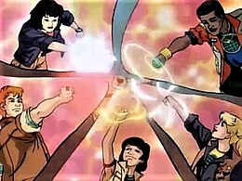
Theory Solvers
SMT Solving
Some example theories
Theory of linear integer arithmetic
Theory of bitvectors
Theory of arrays
Theory of strings
Theory of equality on uninterpreted (mathematical) functions
Often possible (+ convenient / necessary)
to abstract away the actual behavior of
a function

Slide 11

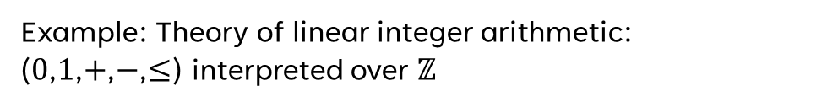
Theory Signatures
SMT Solving
The set of (non-logical) symbols and their meanings defined by that theory
Example: Theory of linear integer arithmetic:
($0$,$1$,$+$,$−$,$≤$) interpreted over $ℤ$
Once we have a set of signatures, we’ll try to get our formula (i.e. path constraint) to separate concerns into theories

Slide 12
Separating concerns
SMT Solving
Note: we will only deal with constraints in Quantifier-Free First-Order Logic
Goal: break down the constraint system to match our core (logical) theory at the top level, with individual clauses potentially in our theory signatures
Logical symbols
– Parentheses: (, )
– Propositional connectives: ∨, ∧, ¬, →, ↔
– Variables: v1, v2, . . .
– Quantifiers: ∀, ∃
Non-logical symbols
– Equality: =
– Functions: +, -, %, bit-wise &, f(), concat, …
– Predicates: ·, is_substring, …
– Constant symbols: 0, 1.0, null`

Slide 13
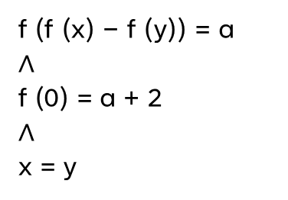
Example
SMT Solving
f (f (x) − f (y)) = a
$$∧$$
f (0) = a + 2
$$∧$$
x = y
Credit: this example due to Oliveras and Rodriguez-Carbonell, additional work by Aldrich

Slide 14
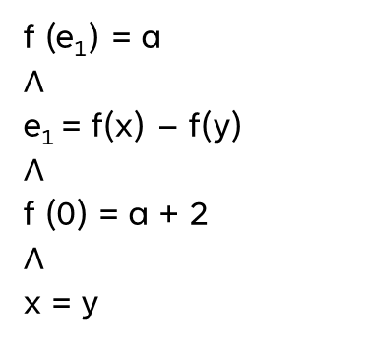

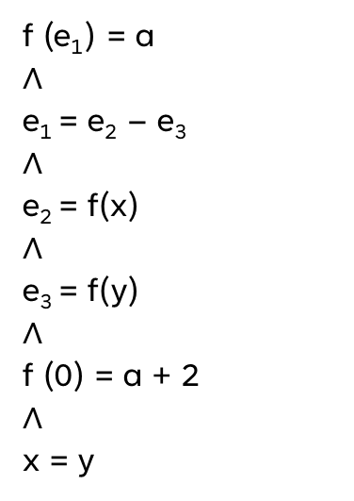
Example
SMT Solving
Step 1: Nelson-Oppen procedure to separate theories
f (f (x) − f (y)) = a
$$∧$$
f (0) = a + 2
$$∧$$
x = y
f (e₁) = a
$$∧$$
e₁ = f(x) – f(y)
$$∧$$
f (0) = a + 2
$$∧$$
x = y
f (e₁) = a
$$∧$$
e₁ = e₂ – e₃
$$∧$$
e₂ = f(x)
$$∧$$
e₃ = f(y)
$$∧$$
f (0) = a + 2
$$∧$$
x = y

Slide 15
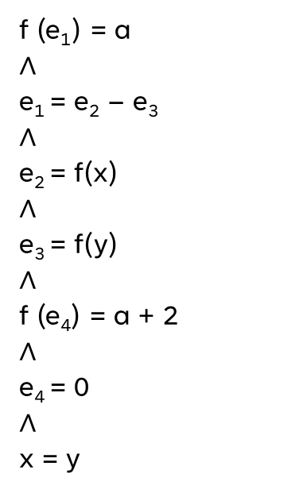
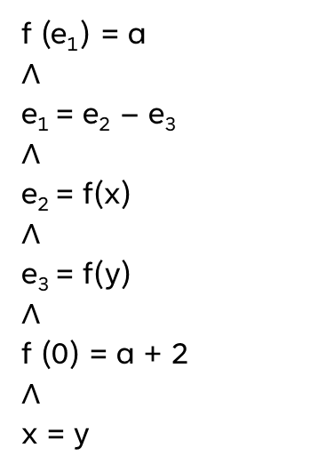

Example
SMT Solving
Step 1: Nelson-Oppen procedure to separate theories
f (e₁) = a
$$∧$$
e₁ = e₂ – e₃
$$∧$$
e₂ = f(x)
$$∧$$
e₃ = f(y)
$$∧$$
f (0) = a + 2
$$∧$$
x = y
f (e₁) = a
$$∧$$
e₁ = e₂ – e₃
$$∧$$
e₂ = f(x)
$$∧$$
e₃ = f(y)
$$∧$$
f (e₄) = a + 2
$$∧$$
e₄ = 0
$$∧$$
x = y
f (e₁) = a
$$∧$$
e₁ = e₂ – e₃
$$∧$$
e₂ = f(x)
$$∧$$
e₃ = f(y)
$$∧$$
f (e₄) = e₅
$$∧$$
e₄ = 0
$$∧$$
e₅ = a + 2
$$∧$$
x = y

Slide 16

Example
SMT Solving
f (e₁) = a
$$∧$$
e₁ = e₂ – e₃
$$∧$$
e₂ = f(x)
$$∧$$
e₃ = f(y)
$$∧$$
f (e₄) = e₅
$$∧$$
e₄ = 0
$$∧$$
e₅ = a + 2
$$∧$$
x = y
Theory of EUF
Theory of integer arithmetic
Theory of EUF
Theory of EUF
Theory of EUF
Theory of integer arithmetic
Theory of integer arithmetic
Theory of EUF
AND
Theory of integer arithmetic

Slide 17
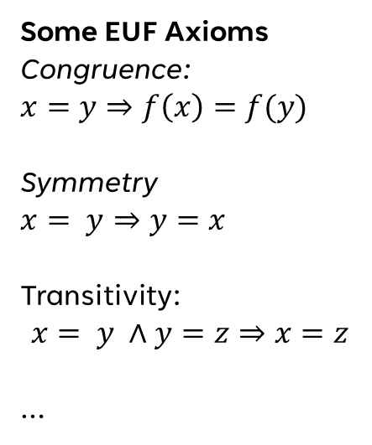
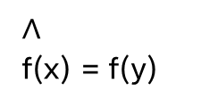
Example
SMT Solving
f (e₁) = a
$$∧$$
e₁ = e₂ – e₃
$$∧$$
e₂ = f(x)
$$∧$$
e₃ = f(y)
$$∧$$
f (e₄) = e₅
$$∧$$
e₄ = 0
$$∧$$
e₅ = a + 2
$$∧$$
x = y
Some EUF Axioms
Congruence:
$$x=y⇒f\left(x\right)=f(y)$$
Symmetry
$$x= y⇒y=x$$
Transitivity:
$$x= y ∧y=z⇒x=z$$
…
$$∧$$
f(x) = f(y)

Slide 18

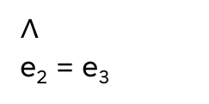
Example
SMT Solving
f (e₁) = a
$$∧$$
e₁ = e₂ – e₃
$$∧$$
e₂ = f(x)
$$∧$$
e₃ = f(y)
$$∧$$
f (e₄) = e₅
$$∧$$
e₄ = 0
$$∧$$
e₅ = a + 2
$$∧$$
x = y
Some EUF Axioms
Congruence:
$$x=y⇒f\left(x\right)=f(y)$$
Symmetry
$$x= y⇒y=x$$
Transitivity:
$$x= y ∧y=z⇒x=z$$
…
$$∧$$
f(x) = f(y)
$$∧$$
e₂ = e₃

Slide 19
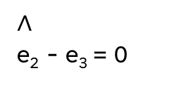
Example
SMT Solving
f (e₁) = a
$$∧$$
e₁ = e₂ – e₃
$$∧$$
e₂ = f(x)
$$∧$$
e₃ = f(y)
$$∧$$
f (e₄) = e₅
$$∧$$
e₄ = 0
$$∧$$
e₅ = a + 2
$$∧$$
x = y
$$∧$$
e₂ - e₃ = 0
Some EUF Axioms
Congruence:
$$x=y⇒f\left(x\right)=f(y)$$
Symmetry
$$x= y⇒y=x$$
Transitivity:
$$x= y ∧y=z⇒x=z$$
…
$$∧$$
f(x) = f(y)
$$∧$$
e₂ = e₃

Slide 20
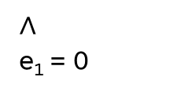
Example
SMT Solving
f (e₁) = a
$$∧$$
e₁ = e₂ – e₃
$$∧$$
e₂ = f(x)
$$∧$$
e₃ = f(y)
$$∧$$
f (e₄) = e₅
$$∧$$
e₄ = 0
$$∧$$
e₅ = a + 2
$$∧$$
x = y
$$∧$$
e₂ - e₃ = 0
Some EUF Axioms
Congruence:
$$x=y⇒f\left(x\right)=f(y)$$
Symmetry
$$x= y⇒y=x$$
Transitivity:
$$x= y ∧y=z⇒x=z$$
…
$$∧$$
e₁ = 0
$$∧$$
f(x) = f(y)
$$∧$$
e₂ = e₃

Slide 21
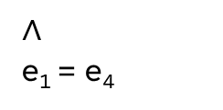

Example
SMT Solving
f (e₁) = a
$$∧$$
e₁ = e₂ – e₃
$$∧$$
e₂ = f(x)
$$∧$$
e₃ = f(y)
$$∧$$
f (e₄) = e₅
$$∧$$
e₄ = 0
$$∧$$
e₅ = a + 2
$$∧$$
x = y
$$∧$$
e₂ - e₃ = 0
Some EUF Axioms
Congruence:
$$x=y⇒f\left(x\right)=f(y)$$
Symmetry
$$x= y⇒y=x$$
Transitivity:
$$x= y ∧y=z⇒x=z$$
…
$$∧$$
e₁ = 0
$$∧$$
e₁ = e₄
$$∧$$
f(x) = f(y)
$$∧$$
e₂ = e₃

Slide 22
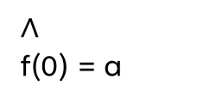
Example
SMT Solving
f (e₁) = a
$$∧$$
e₁ = e₂ – e₃
$$∧$$
e₂ = f(x)
$$∧$$
e₃ = f(y)
$$∧$$
f (e₄) = e₅
$$∧$$
e₄ = 0
$$∧$$
e₅ = a + 2
$$∧$$
x = y
$$∧$$
e₂ - e₃ = 0
Some EUF Axioms
Congruence:
$$x=y⇒f\left(x\right)=f(y)$$
Symmetry
$$x= y⇒y=x$$
Transitivity:
$$x= y ∧y=z⇒x=z$$
…
$$∧$$
e₁ = 0
$$∧$$
e₁ = e₄
$$∧$$
f(0) = a
$$∧$$
f(x) = f(y)
$$∧$$
e₂ = e₃

Slide 23
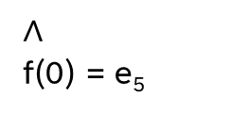
Example
SMT Solving
f (e₁) = a
$$∧$$
e₁ = e₂ – e₃
$$∧$$
e₂ = f(x)
$$∧$$
e₃ = f(y)
$$∧$$
f (e₄) = e₅
$$∧$$
e₄ = 0
$$∧$$
e₅ = a + 2
$$∧$$
x = y
$$∧$$
e₂ - e₃ = 0
Some EUF Axioms
Congruence:
$$x=y⇒f\left(x\right)=f(y)$$
Symmetry
$$x= y⇒y=x$$
Transitivity:
$$x= y ∧y=z⇒x=z$$
…
$$∧$$
e₁ = 0
$$∧$$
e₁ = e₄
$$∧$$
f(0) = a
$$∧$$
f(0) = e₅
$$∧$$
f(x) = f(y)
$$∧$$
e₂ = e₃

Slide 24
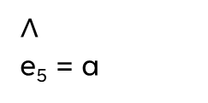
Example
SMT Solving
f (e₁) = a
$$∧$$
e₁ = e₂ – e₃
$$∧$$
e₂ = f(x)
$$∧$$
e₃ = f(y)
$$∧$$
f (e₄) = e₅
$$∧$$
e₄ = 0
$$∧$$
e₅ = a + 2
$$∧$$
x = y
$$∧$$
e₂ - e₃ = 0
Some EUF Axioms
Congruence:
$$x=y⇒f\left(x\right)=f(y)$$
Symmetry
$$x= y⇒y=x$$
Transitivity:
$$x= y ∧y=z⇒x=z$$
…
$$∧$$
e₁ = 0
$$∧$$
e₁ = e₄
$$∧$$
f(0) = a
$$∧$$
f(0) = e₅
$$∧$$
e₅ = a
Arithmetic
Contradiction
$$∧$$
f(x) = f(y)
$$∧$$
e₂ = e₃

Slide 25
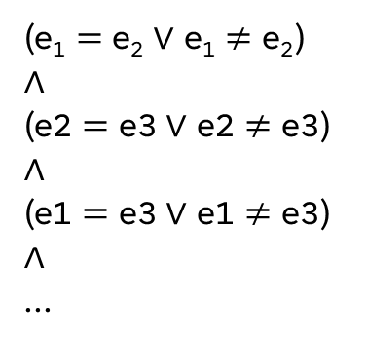
“Convenient” Equalities
SMT Solving
f (e₁) = a
$$∧$$
e₁ = e₂ – e₃
$$∧$$
e₂ = f(x)
$$∧$$
e₃ = f(y)
$$∧$$
f (e₄) = e₅
$$∧$$
e₄ = 0
$$∧$$
e₅ = a + 2
$$∧$$
x = y
$$∧$$
e₂ - e₃ = 0
The lynchpin of our success was the existence of some
useful equalities. What if they aren’t in the original
constraints?
$$∧$$
e₁ = 0
$$∧$$
e₁ = e₄
Case split!
Can add logical predicates for all possible equalities…
$$∧$$
f(0) = a
(e₁ $=$ e₂ ∨ e₁ $≠$ e₂)
∧
(e2 $=$ e3 ∨ e2 $≠$ e3)
∧
(e1 $=$ e3 ∨ e1 $≠$ e3)
∧
...
$$∧$$
f(0) = e₅
$$∧$$
e₅ = a
$$∧$$
f(x) = f(y)
and start making guesses
$$∧$$
e₂ = e₃

Slide 26
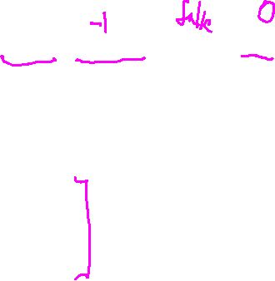
“Convenient” Equalities
SMT Solving
The lynchpin of our success was the existence of some
useful equalities. What if they aren’t in the original
constraints?
x ≥ 0 ∧ y = x + 1 ∧ (y > 2 ∨ y < 1 )
Abstract all non-logical clauses
Case split!
p1 ∧ p2 ∧ (p3 ∨ p4 )
Can add logical predicates for all possible equalities…
DPLL
(e₁ $=$ e₂ ∨ e₁ $≠$ e₂)
∧
(e2 $=$ e3 ∨ e2 $≠$ e3)
∧
(e1 $=$ e3 ∨ e1 $≠$ e3)
∧
...
p1:true
p2:true
p3:false
p4: true
Linear Solver: contradiction!
Add information and start over
and start making smart guesses
p1 ∧ p2 ∧ (p3 ∨ p4) ∧ (¬p1 ∨ ¬p2 ∨ ¬p3)

Slide 27
Arithmetic Constraints
SMT Solving
We kinda danced around how the arithmetic solver works
Basic answer: Linear Algebra.
Also, something something Linear Optimization and the simplex algorithm

Slide 28
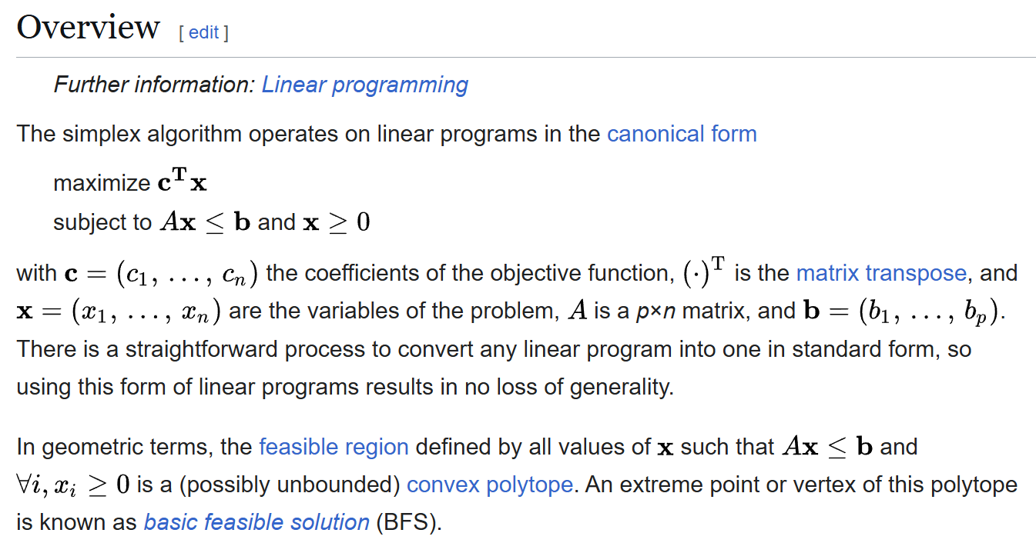
Something Something Linear Optimization and the SimpleX algorithm
SMT Solving

Slide 29
Something Something Linear Optimization and the SimpleX algorithm
SMT Solving

Slide 30
Wrap-Up
SMT Solvers
Hopefully I’ve convinced you that Solvers can be implemented
Not strictly magic, but they do employ some very clever techniques

