Slide 1
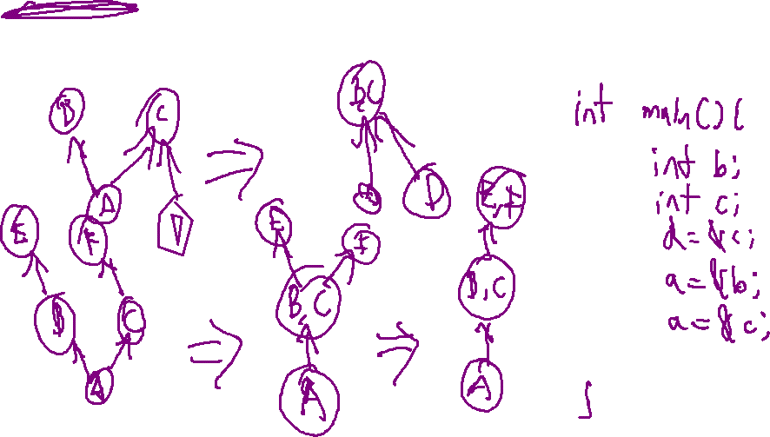
Exercise #22
Program Instrumentation Review
Write your name and answer the following on a piece of paper
Give an example of a program where Steensgard’s analysis will indicate a false- positive points-to relationship that Andersen’s would avoid

Slide 2
AnnouncEments
Administrivia

Slide 3
Quiz 2 Review
EECS 677/777: Software Security Evaluation
Drew Davidson

Slide 4
Topics
Quiz 2 Review
Computability
Static Analysis
Control Flow
Fixpoints
Lattices
Abstract Interpretation
Information Flow
Side Channels
Dependency Analysis
Program Slicing
Interprocedural Analysis
Summary Functions
Class Hierarchy Analysis

Slide 5
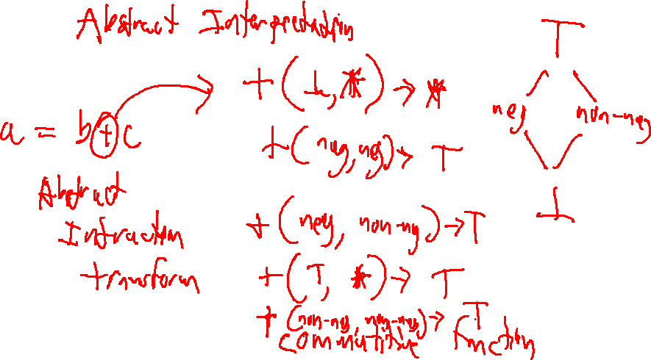
Review
Quiz 2 Review

Slide 6
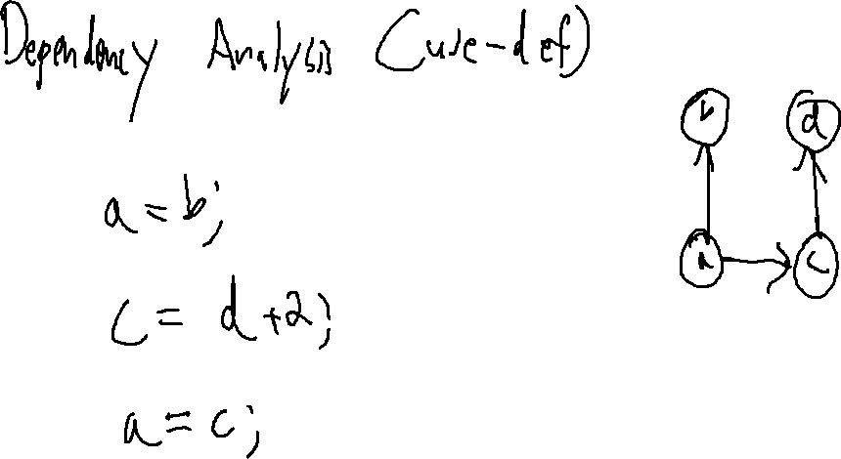
Review
Quiz 2 Review

Slide 7
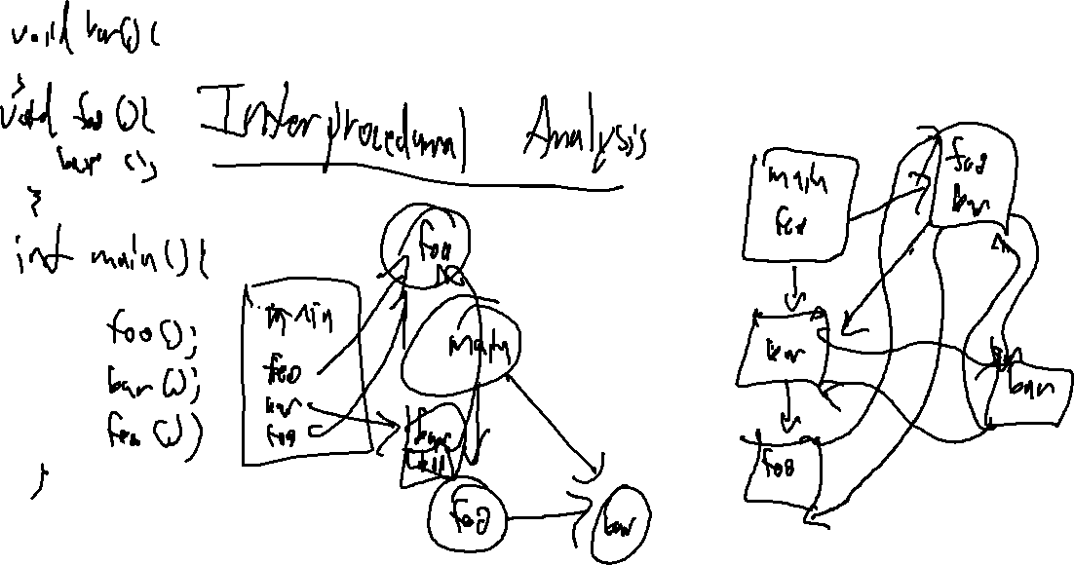
Review
Quiz 2 Review

Slide 8
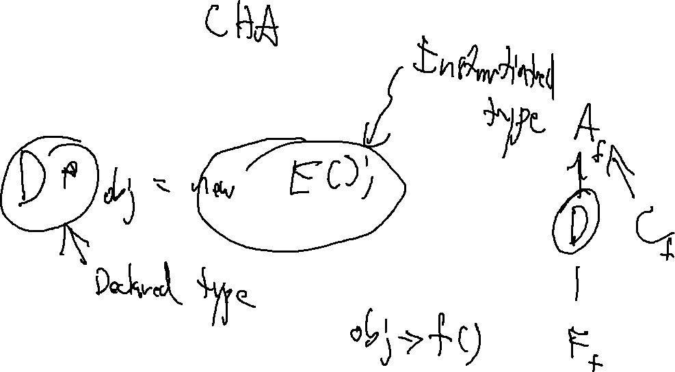
Review
Quiz 2 Review

Slide 9
Review
Quiz 2 Review

Slide 10
Review
Quiz 2 Review

Slide 11
Review
Quiz 2 Review

Slide 12
Review
Quiz 2 Review

Slide 13
Review
Quiz 2 Review

Slide 14
Review
Quiz 2 Review

Slide 15
Review
Quiz 2 Review

Slide 16
Review
Quiz 2 Review

Slide 17
Review
Quiz 2 Review

Slide 18
Review
Quiz 2 Review

Slide 19
Review
Quiz 2 Review

