Slide 1
Secure Software Evaluation:
Quiz 1 Review

Slide 2
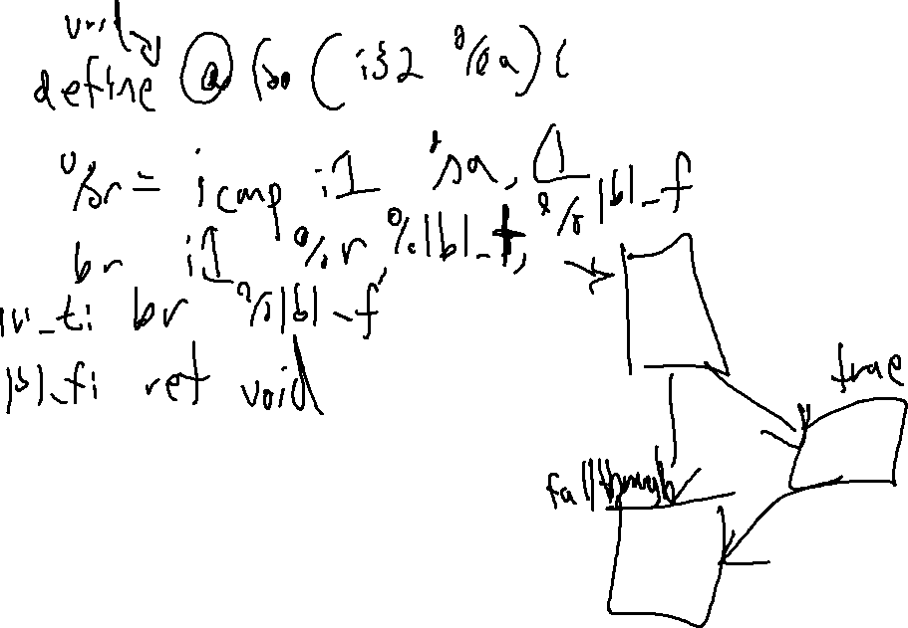

Slide 3
