Slide 1
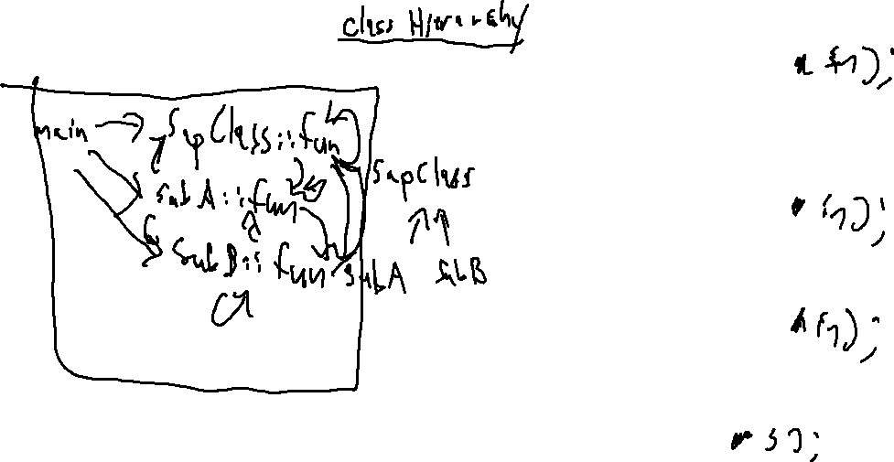
Exercise 20
Call Target Analysis Review
Write your name and answer the following on a piece of paper
Draw the call graph of the following program
according to CHA
1: class SupClass{
2: public:
3: virtual int fun(SupClass * in){
4: in->fun();
5: }
6: };
7:
8: class SubA : public SupClass {
9: virtual int fun(SupClass * in){
10: in->fun();
11: }
12: };
13: class SubB : public SupClass {
14: virtual int fun(SupClass * in){
15: in->fun();
16: }
17: };
18: int main(){
19: SupClass * s = new SubA();
20: s->fun();
21: }

Slide 2
Exercise 20 SOLUTION
Call Target Analysis Review

Slide 3
Administrivia and Announcements

Slide 4
Points-To Analysis
EECS 677: Software Security Evaluation
Drew Davidson

Slide 5
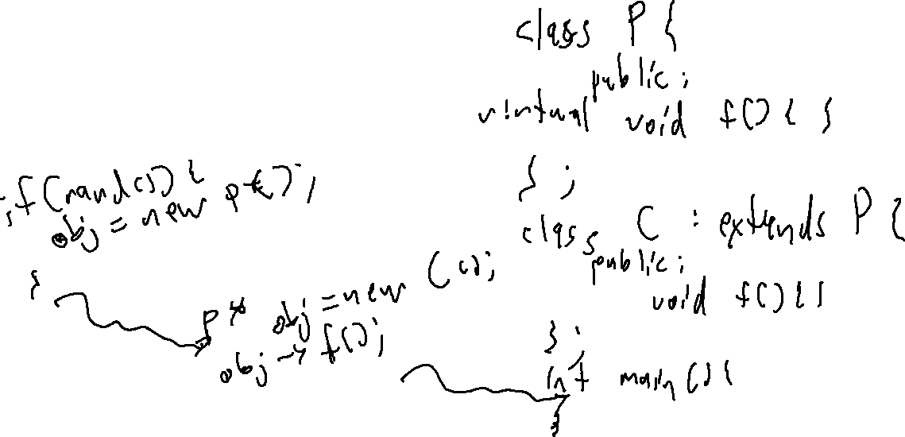
Last Time: Call Resolution Analysis
Review: Call Targets
Where might a call target?
Easy for static dispatch
Hard for dynamic dispatch

Slide 6
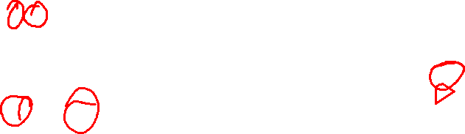
Last Time: Call Resolution Analysis
Review: Call Targets
1: class A{
2: public A f(){ return new C(); }
3: public String g(){ return "A"; }
4: };
5: class B : public A{
6: public String g(){ return "B"; }
7: };
8: class C : public A{
9: public String g(){ return "C"; }
10: };
11: class D : public A{
12: public String g(){ return "D"; }
13: };
14: class Driver {
15: public void main(String[] args){
16: A[] aArr = {new A(), new B()};
17: for (A a : aArr){
18: A res = a.f();
19: print(a.g());
20: print(res.g());
21: }
22: }
23: };
Class Hierarchy Analysis
Inheritance implies a constraint over call targets
Object
Driver
A
main
f, g
B
C
D
g
g
g

Slide 7
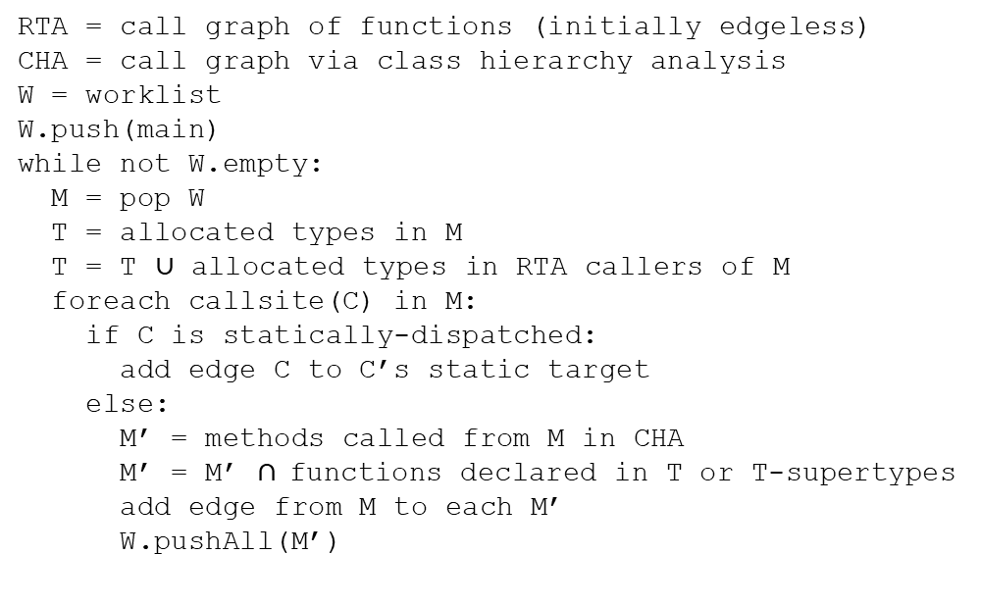
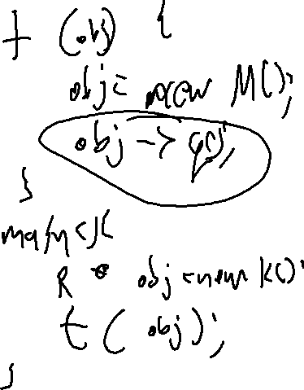
Rapid Type Analysis (RTA)
A history of Computing
RTA = call graph of functions (initially edgeless)
CHA = call graph via class hierarchy analysis
W = worklist
W.push(main)
while not W.empty:
M = pop W
T = allocated types in M
T = T $∪$ allocated types in RTA callers of M
foreach callsite(C) in M:
if C is statically-dispatched:
add edge C to C’s static target
else:
M’ = methods called from M in CHA
M’ = M’ $∩$functions declared in T or T-supertypes
add edge from M to each M’
W.pushAll(M’)

Slide 8
Rapid Type Analysis (RTA)
A history of Computing
An incomplete analysis!
1: public static Object gbl;
2:
3: public static void main(String[] args){
4: foo();
5: bar();
6: }
7:
8: public static void foo(){
9: Object o = new A();
10: gbl = o;
11: }
12:
13: public static void bar(){
14: gbl.toString();
15: }
Call edge to A’s toString missing!
Neither bar or its callers (main) allocated a type of A
RTA will not include an edge from bar to toString because neither bar or its callers (main) allocated any instance that toString could be called on

Slide 9
Overview
We’ve seen the necessity of multi-function analysis in real-world programs
Time to consider how it is done

Slide 10
Lecture Outline
Aliases & Points-to
Andersen’s Analysis
Steensgard’s Analysis

Slide 11
Pointers: Love to Hate ‘EM
Aliases and Points-To sets
z
a
b
int z = 4;
int * a = &z;
int * b = a;
int * c = &z;
*b = 2;
addr 0x2040
addr 0x2090
addr 0x2090
4
0x2040
0x2040

Slide 12

Alias Relationships
Aliases and Points-To sets
Create aliasing relationships
int z = 4;
int * a = &z;
int * b = a;
int * c = &z;
*b = 2;
z
*a
*b
*c

Slide 13
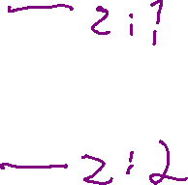
Aliases and Dataflow
Aliases and Points-To sets
These relationships can really mess with the soundness of program verification!
int z = 4;
int * a = &z;
int * b = a;
int * c = &z;
*b = 2;

Slide 14

Safety in the Presence of Aliases
Aliases and Points-To sets
may-point(p): the set of locations to which p might point
must-point(p): the set of locations to which p must point
Which of these is the “safe” set to track depends on the analysis
For us, we’ll usually over-approximate bad behavior, hence track may-point sets

Slide 15

Scalable May-Point Computation
Aliases and Points-To sets
Determining points-to sets is expensive
- Interprocedural analysis somewhat out-of-scope
- Flow-sensitive analysis somewhat out-of-scope
We’ll talk about 2 flow-insensitive algorithms

Slide 16
Lecture Outline
May-point v Must-point
Andersen’s Analysis
Steensgard’s Analysis

Slide 17
Subset Constraints
Andersen’s Analysis
A Flow-insensitive Algorithm
Each statement adds a constraint over the points-to sets
End up with a (solvable) system of constraints
Program
p = &a;
q = p;
p = &b;
r = p;

Slide 18
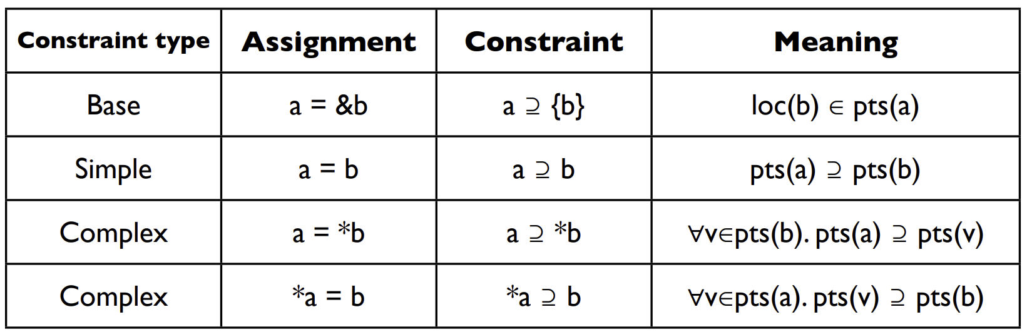
Subset Constraints
Andersen’s Analysis

Slide 19
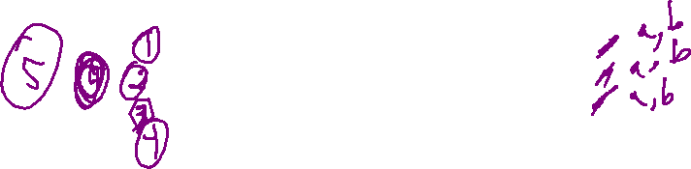
Subset Constraints
Andersen’s Analysis
A Flow-insensitive Algorithm
Each statement adds a constraint over the points-to sets
End up with a (solvable) system of constraints
Program
Constraints
Initial
Final
p = &a;
q = p;
p = &b;
r = p;
p ⊇ {a}
q ⊇ p
p ⊇ {b}
r ⊇ p
pts(p) = ∅
pts(q) = ∅
pts(r) = ∅
pts(a) = ∅
pts(b) = ∅
pts(p) = {a,b}
pts(q) = {a,b}
pts(r) = {a,b}
pts(a) = ∅
pts(b) = ∅

Slide 20

Another Example
Andersen’s Analysis
A Flow-insensitive Algorithm
Each statement adds a constraint over the points-to sets
End up with a (solvable) system of constraints
Program
Constraints
Initial
Final
p = &a
q = &b
*p = q;
r = &c;
s = p;
t = *p;
*s = r;
p ⊇ {a}
q ⊇ {b}
*p ⊇ q
r ⊇ {c}
s ⊇ p
t ⊇ *p
*s ⊇ r
pts(p) = { a }
pts(q) = { b }
pts(r) = { c }
pts(s) = ∅
pts(t) = ∅ pts(a) = ∅
pts(b) = ∅
pts(c) = ∅
pts(p) = { a }
pts(q) = { b }
pts(r) = { c }
pts(s) = { a }
pts(t) = { b, c }
pts(a) = { b, c }
pts(b) = ∅
pts(c) = ∅

Slide 21
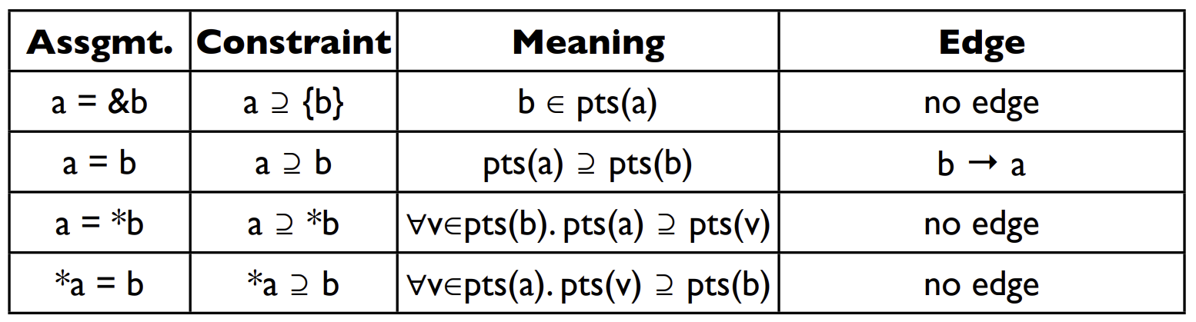
Solving Constraints
Andersen’s Analysis
Graph closure on the subset relation

Slide 22
Overhead
Andersen’s Analysis
Worst Case: Cubic Time
That’s not great
Optimization: Cycle elimination
Detect and collapse SCCs in the points-to relation

Slide 23
Lecture Outline
May-point v Must-point
Andersen’s Analysis
Steensgard’s Analysis

Slide 24
An alternative Approach
STeensGard’s Analysis
Aim for Near-Linear-time points-to Analysis
Going to require us to reduce our search-space somewhat
Intuition: Equality constraints
Do away with the notion of subsets

Slide 25
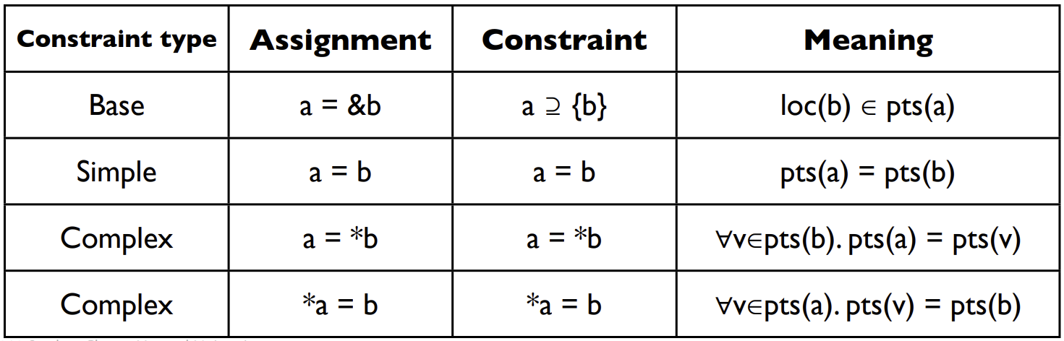
Equality Constraints
Steensgard’s Analysis

Slide 26
Equality Constraints
Steensgard’s Analysis
p = &a
p
a
p = &b
p
a,b
m = &p
m
p
a,b
r = *m
m
p
a,b
r
q = &c
m
p
a,b
r
q
c
m = &q
m
p,q
a,b,c
r

Slide 27
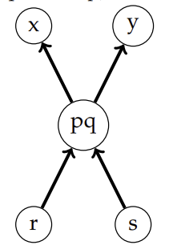
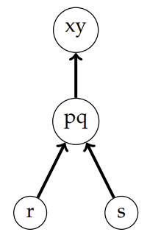
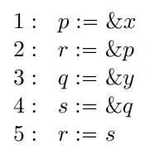
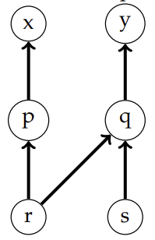
Equality Constraints
Steensgard’s Analysis
Andersen’s
Steensgard’s

Slide 28
Wrap-up

