Slide 1
Exercise 4
LLVM Register Operation Reviews
Write your name and answer the following on a piece of paper
Write out the corresponding LLVM bitcode program for the following:
int main(int argc){
int i = 0;
while (i < argc){
i = i + 1;
}
return i;
}

Slide 2
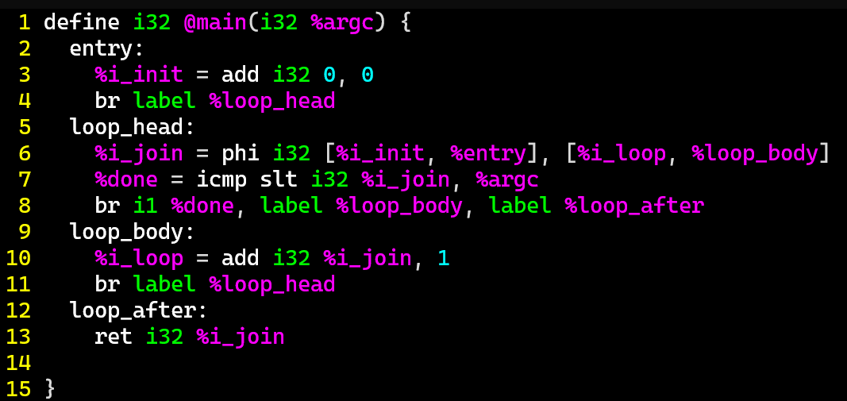

Exercise 4
LLVM Register Operation Reviews
Write your name and answer the following on a piece of paper
Write out the corresponding LLVM bitcode program for the following:
int main(int argc){
int i = 0;
while (i < argc){
i = i + 1;
}
return i;
}

Slide 3
Administrivia and
Announcements

Slide 4
Class Progress
We’re Gearing up to build our own program analyses
Working through a good program representation
LLVM Bitcode is a nice “Generic” target

Slide 5
LLVM BITCODE Memory
EECS 677: Software Security Evaluation
Drew Davidson

Slide 6
Last Time: LLVM BitCode & Registers
Review: Last Lecture
Low-Level Language
Targets an abstract machine
Uses a system of (infinite) named registers to perform computation
Registers must be in SSA format

Slide 7
SSA Format
Review: Last Lecture
Static single assignment
A variable may be assigned at only one program point

Slide 8
Phi instructions
Review: Last Lecture
dest = phi <type> [val1, pred1], [val2, pred2] …
Resolve the need to unify registers
Each argument is a pair [V,B] where
  B is a predecessor basic block to the current block containing the phi instruction
  V is a value to assign when block B is the dynamic predecessor

Slide 9
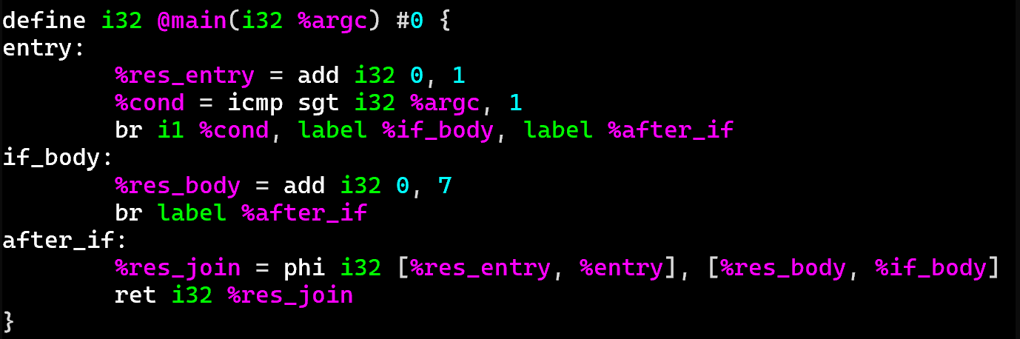
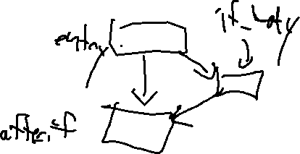
Phi instructions
Review: Last Lecture
Let’s implement
this code:
int main(int argc){
int res = 1;
if (argc > 1){
res = 7;
}
return res;
}

Slide 10
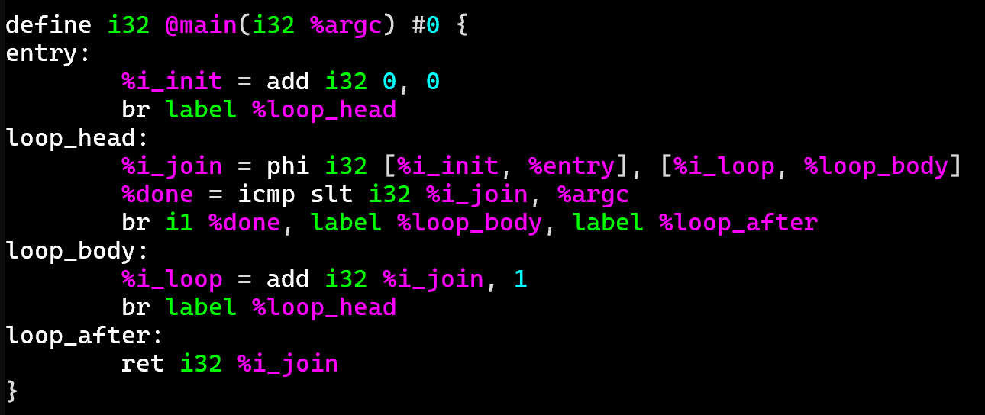
Phi instructions
Review: Last Lecture
Let’s implementation this code:
int main(int argc){
int i = 0;
while (i < argc){
i = i + 1;
}
return i;
}

Slide 11
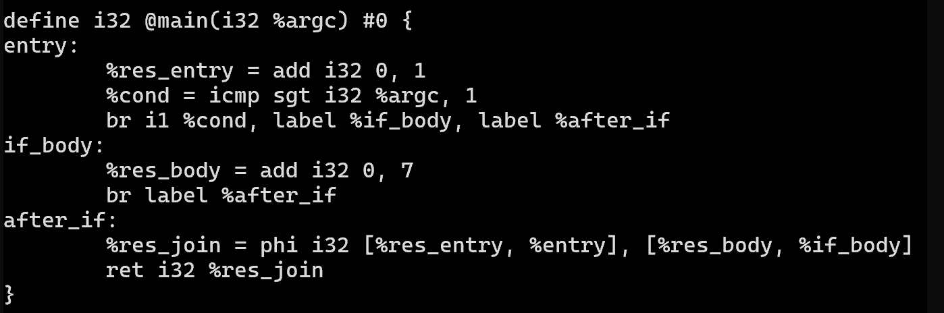
Aside: Fancy Syntax Highlighting
Drew’s Cool Tools
TIRED:
WIRED:

Slide 12
Aside: Fancy Syntax Highlighting
Drew’s Cool Tools
Turns out syntax highlighters are available for several editors
vim (my personal choice)
emacs
vscode
TIRED:
Files are in the git repo
https://github.com/llvm/llvm-project
Under the directory llvm/utils
WIRED:
If you don’t want to download all that code, check
https://analysis.cool/llvm-syntax.tgz

Slide 13
This Time: LLVM memory
Lecture Overview
Thnks
Fr th
MMRS
Dealing with memory
Ultimately we’ll need to consider storage other than the infinite virtual register abstraction

Slide 14
Lecture Outline
LLVM Memory
Load/Store
The dreaded GEP

Slide 15

Concrete memory
LLVM memory
LLVM Bitcode attempts to represent commonalities of memory on real architectures
So, what is computer memory like
(from the CS perspective)?
A 1-D array of cells
Numeric addresses (of some size)
Cells contain numeric values (of some size)

Slide 16

Ascribed Meaning
LLVM memory
3GL Language Notions are Simulated Through Convention
Functions
Variables
Complex data types (arrays, structs, classes)
0x1
0x2
0x3
0x4

Slide 17
Abstracting memory
LLVM memory
Encodes the Concepts of Local and Global memory
Local memory: within a function activation
Global memory: static in the data section
Notably absent: heap memory
With infinite registers,
Why have local memory?
Because we might take the address of a local
int main(){
int a;
int * p;
p = &a;
}
(p points to a)

Slide 18
Allocation
LLVM Memory
Allocating Global Memory
@glb1 = global i32 2
, align 4
@cnst2 = constant i32 3
, align 4
Allocating Local Memory
%reg = alloca i64
, align 8
Note: some architectures either require or suggest (for speed)
that memory be type aligned, e.g.:
A 4-byte type (like i32) is allocated in a memory address that is a multiple of 4
An 8-byte type (like i64) is allocated in a memory address that is a multiple of 8
To enforce this requirement, allocation can use the align <Num> argument

Slide 19
Lecture Outline
LLVM Memory
Load/Store
The dreaded GEP

Slide 20
Pointer Types
LLVM Memory
Memory locations are accessed through pointers
Numeric types whose values are memory addressed
A pointer to a 32-bit integer has type i32*
A pointer to an 8-bit integer has type i8*
A pointer to an 8-bit integer has type i8*
%reg = alloca i32, align 4
Here, %reg has type i32* : a pointer type (a pointer that points at an i32)
Note, there is a “generic pointer” type that leaves the type being pointed to out

Slide 21
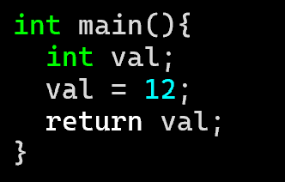
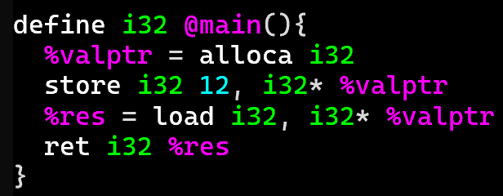
LLVM MEMORY: Load and STORE
LLVM Memory
Store
store <srcType> <srcOpd>, <dstType> <dstOpd>, align <align>
store i32 1 , i32* %var1ptr, align 4
Load
<dstOpd> = load <dstType>, <srcType> <srcOpd>, align <align>
%reg = load i32, i32* %var1ptr, align 4

Slide 22
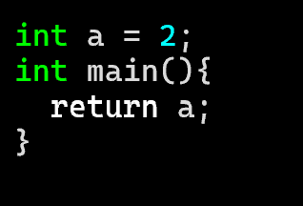
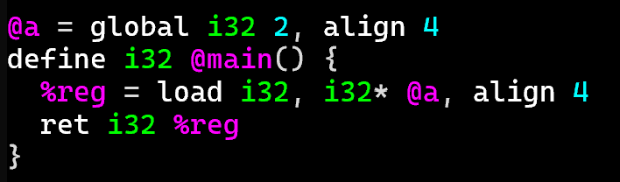
LLVM MEMORY: Global Memory Example
LLVM Memory

Slide 23
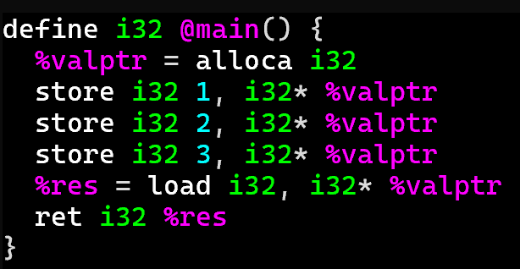

LLVM MEMORY: LoOK, NO SSA!
LLVM Bitcode
The VALUE OF the register doesn’t change
The VALUE AT the register is what changes!

Slide 24

LLVM MEMORY: LoOK, NO SSA!
LLVM Bitcode
%valptr:
0x4080
Address
0x4080
Address
0x4081
Address
0x4080
Address
0x4081
00
00
00
34

Slide 25
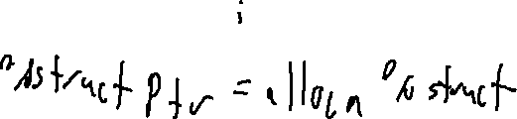
LLVM MEMORY: Aggregate Types
LLVM Bitcode
Recall that bitcode is a Typed language
Declare an aggregate type (think struct)
Allocate an array
%Point = type { i32, i32 }
%arrayptr = alloca [8 x i32], align 16
Allocate an aggregate type
Allocate a struct with an array in it
%ptr = alloca %Point, align 4
%ArrSize8 = type [8 x 32]
%struct = type {i32, %ArrSize8}

Slide 26

LLVM MEMORY: Accessing Aggregate memory
LLVM Bitcode
At this point, we need to discuss how to read an array index or Field
There is a powerful, but somewhat complicated instruction to do it, called getelementptr (GEP)
GEP never actually reads memory, it just computes what the offset from a base location would be

Slide 27
Lecture Outline
LLVM Memory
Load/Store
The dreaded GEP

Slide 28

GetElementPtr
The Dreaded GEP
Here is the Basic format of a GEP
<result> = getelementptr <ty>, ptr <ptrval>{, [inrange] <ty> <idx>}*
Here is a snippet of the documentation of the syntax:
The first argument is always a type used as the basis for the calculations. The second argument is always a pointer or a vector of pointers, and is the base address to start from. The remaining arguments are indices that indicate which of the elements of the aggregate object are indexed. The interpretation of each index is dependent on the type being indexed into. The first index always indexes the pointer value given as the second argument, the second index indexes a value of the type pointed to (not necessarily the value directly pointed to, since the first index can be non-zero), etc. The first type indexed into must be a pointer value, subsequent types can be arrays, vectors, and structs. Note that subsequent types being indexed into can never be pointers, since that would require loading the pointer before continuing calculation.

Slide 29
GetElementPtr
The Dreaded GEP
Let me (maybe?) Simplify this a bit with a slight reformat of GEP
base
array index
Field traversal
<result> = getelementptr <ty_{work}>, <ty_{src}> <src>, <idxtype> <siblingidx>, [<idxtype> <fieldidx>]+
Here is my explanation of this version of GEP:
Assume base is a pointer into some array of somethings (possibly a nested data structure)
- Arg 1: <ty_{work}>: Specify the type of the somethings
- Arg 2: <ty_{src}> <src>: base address to start your computation
- Arg 3: <idxtype> <siblingidx>: array index to jump forward from the base address
(end of optional arguments)
- Arg 4+: <idxtype> <fieldidx>: field traversal to index into the fields of the nested data structure

Slide 30

GetElementPtr
The Dreaded GEP
Let me (maybe?) Simplify this a bit with a slight reformat of GEP
base
array index
Field traversal
<result> = getelementptr <ty_{work}>, <ty_{src}> <src>, <idxtype> <siblingidx>, [<idxtype> <fieldidx>]+
Answer:
Very generic format to capture the large variety of ways that you need to index into memory
Basic GEP invocations handle simple cases
Complex GEP invocations handle complex cases

Slide 31
GetElementPtr
The Dreaded GEP
Let me (maybe?) Simplify this a bit with a slight reformat of GEP
base
array index
Field traversal
<result> = getelementptr <ty_{work}>, <ty_{src}> <src>, <idxtype> <siblingidx>, [<idxtype> <fieldidx>]+
Answer:
7
7
7
Very generic format to capture the large variety of ways that you need to index into memory
Basic GEP invocations handle simple cases
getelementptr %T2, ptr @ptr_n1, i64 0, i64 0
Complex GEP invocations handle complex cases

Slide 32
GetElementPtr: Pictorially
The Dreaded GEP
Can be helpful to walk through memory as a tree
%T1 = type { i32, i32, i32 }
ptr_n1
%T2 = type [ 2 x %T1 ]
@ptr_n1 = global %T2 [ { i32 1, i32 2, i32 3 }, { i32 4, i32 5, i32 6} ]
n1
“base addr”
“sibling 0”
“field 0”
ptr_n2 =
getelementptr %T2, ptr @ptr_n1, i64 0, i64 0
n2
n3
ptr_n2
a₀
b₀
c₀
a₁
b₁
c₁

Slide 33
GetElementPtr: Pictorially
The Dreaded GEP
Can be helpful to walk through memory as a tree
%T1 = type { i32, i32, i32 }
ptr_n1
%T2 = type [ 2 x %T1 ]
@ptr_n1 = global %T2 [ { i32 1, i32 2, i32 3 }, { i32 4, i32 5, i32 6} ]
n1
ptr_n2 =
getelementptr %T2, ptr @ptr_n1, i64 0, i64 0
“base addr”
“sibling 1”
“field 1”
ptr_b1 =
getelementptr %T1, ptr @ptr_n2, i64 1, i64 1
n2
n3
ptr_n2
a₀
b₀
c₀
a₁
b₁
c₁
ptr_b1

Slide 34
GetElementPtr: Pictorially
The Dreaded GEP
Can be helpful to walk through memory as a tree
%T1 = type { i32, i32, i32 }
ptr_n1
%T2 = type [ 2 x %T1 ]
@ptr_n1 = global %T2 [ { i32 1, i32 2, i32 3 }, { i32 4, i32 5, i32 6} ]
n1
ptr_n2 =
getelementptr %T2, ptr @ptr_n1, i64 0, i64 0
“base addr”
“sibling 1”
“field 1”
ptr_b1 =
getelementptr %T1, ptr @ptr_n2, i64 1, i64 1
n2
n3
ptr_n2
a₀
b₀
c₀
a₁
b₁
c₁
ptr_b1

Slide 35
GetElementPtr: Ya Gotta Handle C
The Dreaded GEP
My Theory: GEP is designed to accommodate the needs of C source code
struct Inner {
int32_t a;
int8_t b;
char c;
};
struct Outer{
int32_t k;
struct Inner m;
}
struct Outer v[3];
int main(){
v[2].m.c = ‘X’;
}

Slide 36
Wrap-up

Slide 37
Next Time
A couple more bitcode featureS

