Slide 1
Exercise 28
Control Flow Integrity Review
Write your name and answer the following on a piece of paper
Of the various CFI solutions we explored, none were calling-context sensitive. Why not?

Slide 2
Testing
EECS 677: Software Security Evaluation
Drew Davidson

Slide 3
Administrivia and Announcements
Midpoint Survey Live: https://analysis.cool/midpoint

Slide 4
Last Time: Control-Flow Integrity
Review: Computability
Instrument the program to prevent “illegal” jumps
Intel CET
Microsoft control-flow guard
Clang instruction injection

Slide 5
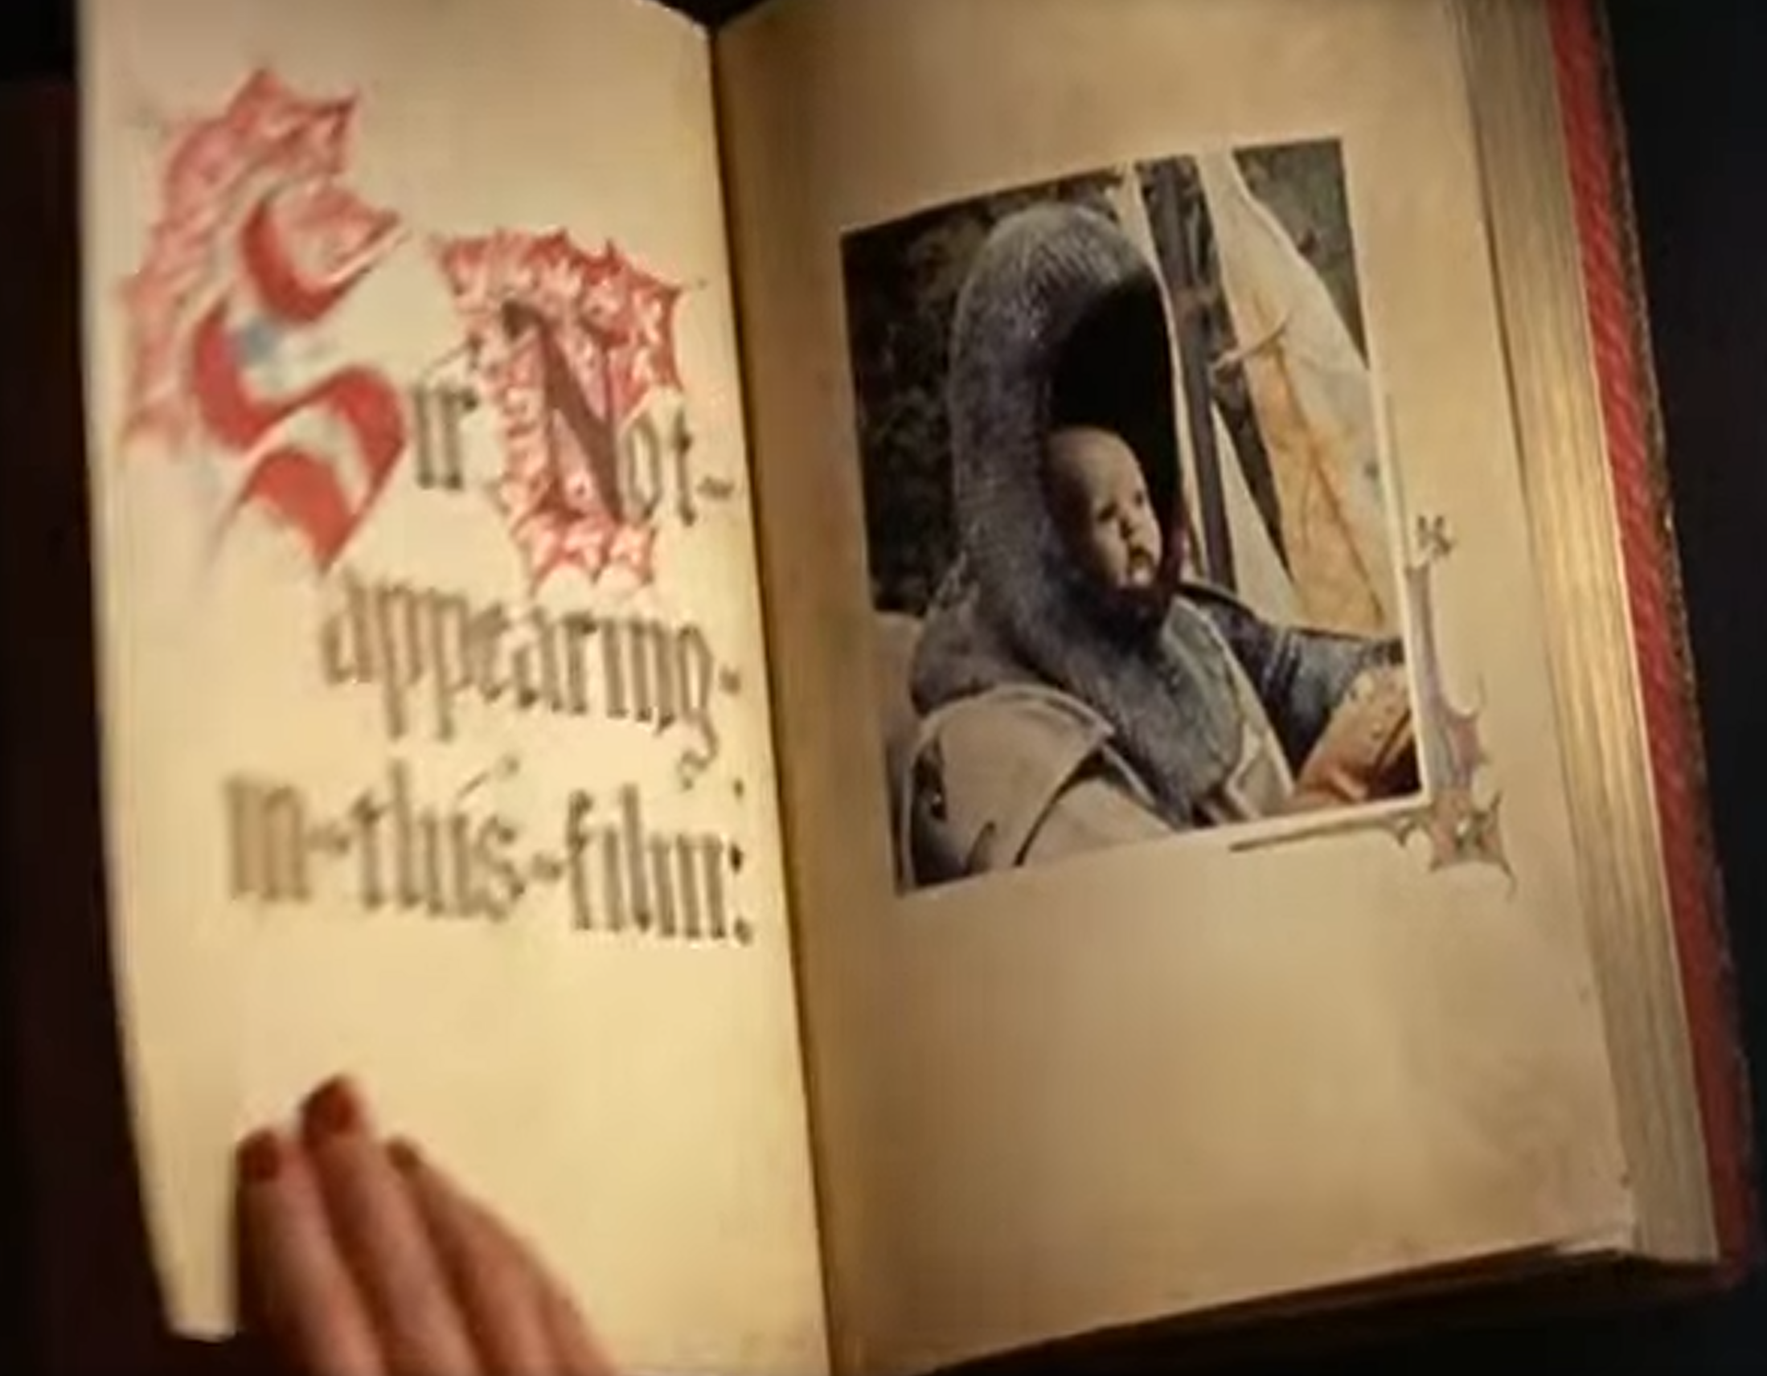
Turning the page on this class
Next topic
Hopefully, you’ve got a taste of the challenges / benefits of instrumentation and mediation
Static cost/benefit
Runtime cost/benefit

Slide 6

Turning the page on this class
Next topic
Dynamic Analysis
Running the program to see what happens
Uses of dynamic analysis
Program comprehension
Bug elimination

Slide 7
Lecture Outline
The Testing Perspective
Test Generation
Fuzzing

Slide 8
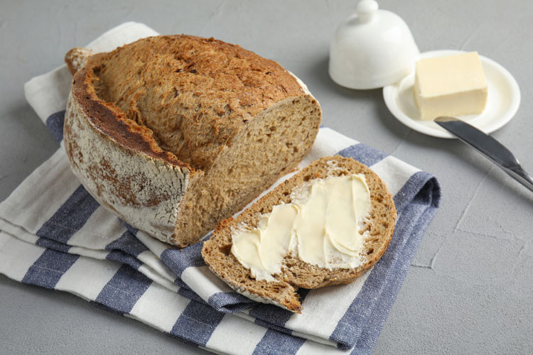
A formulation of dynamic Analysis
Testing
Input/expected output pairs
Does the program do what it’s supposed to do?

Slide 9
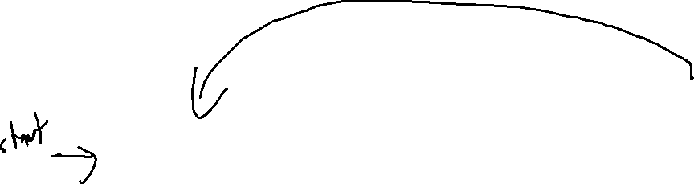
Test Suites
Testing
Ideally, we’ll capture a variety of behaviors
We’ll refer to the collection of test cases as our test suite
Regression suite
Capturing sufficient behavior enables capture of breaking changes
Generate Test Suite
Pass the Test Suite?
Release the System
Update the System

Slide 10
Non-determinism
Testing
Factor out external details into the environment
Time is an input
Random seed is an input
Network response is an input

Slide 11
Testing scope
Testing
Unit testing
Testing at the submodule level (e.g. function i/o)
Integration testing
Testing at the boundary between modules (e.g. library interfaces)
Application testing
Testing at the whole-program level

Slide 12

Program Visibility
CATEGORIZING ANALYSIS
White box
Testing with “complete” information about the analysis target (typically means source code)
Black box
Testing with “no” information about how the analysis target is architected (typically means binary only)
Grey box
Testing with “some” information about how the analysis target is architected (binary + some static analysis / probing)

Slide 13
Lecture Outline
The Testing Perspective
Test Generation
Fuzzing

Slide 14
Classic Limitations of Testing
Test Generation
It’s hard to predict what might go wrong (presumably you’d have fixed it in this first place)

Slide 15

“FiXing” Testing
Test Generation
It’s hard to predict what might go wrong (presumably you’d have fixed it in this first place)
Could try to make a more intentional correspondence (TDD)
Could try to leverage tools (Fuzzing)

Slide 16
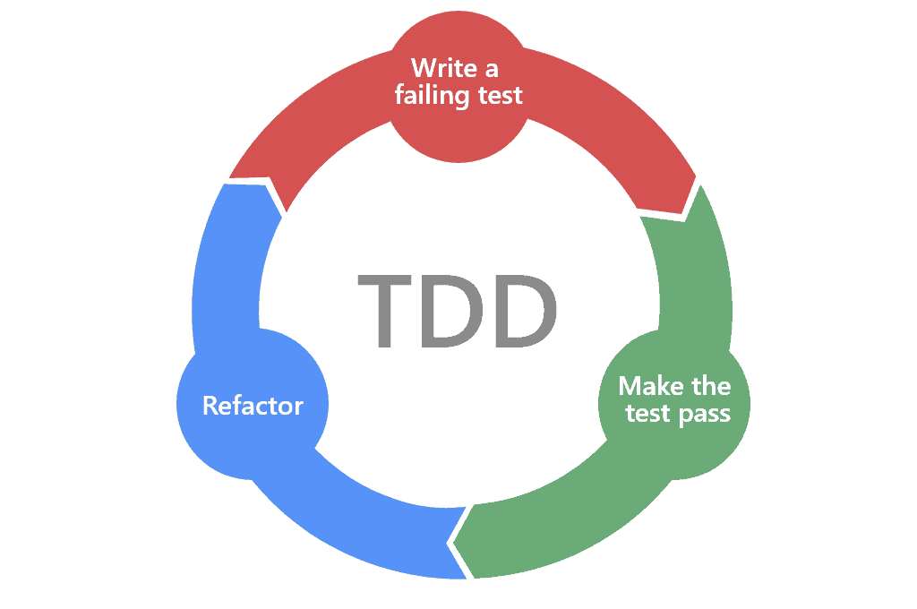
Test-Driven Development
CATEGORIZING ANALYSIS
1. Write a test case (expecting it to fail)
2. Implement enough functionality to pass the test case
3. Fix up the program
(repeat)

Slide 17
Testing vs Static Analysis
Test Generation
A fight (I guess?) in the software engineering community
Ask yourself why we are trying to plug defects with language features. The answer ought to be obvious. We are trying to plug these defects because these defects happen too often.
Now, ask yourself why these defects happen too often. If your answer is that our languages don’t prevent them, then I strongly suggest that you quit your job and never think about being a programmer again; because defects are never the fault of our languages. Defects are the fault of programmers. It is programmers who create defects – not languages.
And what is it that programmers are supposed to do to prevent defects? I’ll give you one guess. Here are some hints. It’s a verb. It starts with a “T”. Yeah. You got it. TEST!
The clean code blog
“The Dark Path”, 1/2017
“Tools are not the Answer”, 10/2017
I think that good software tools make it easier to write good software. However, tools are not the answer to the “Apocalypse”.
Nowhere in the article did the author examine the possibility that programmers are generally undisciplined.

Slide 18

Some difficulties of unit testing
Test Generation
Integrating testing into a workflow
googletest
apt install googletest
apt install libgtest-dev
What to do about a function’s “environment”?

Slide 19
Lecture Outline
The Testing Perspective
Test Generation
Fuzzing

Slide 20

Fuzzing
CATEGORIZING ANALYSIS
Generating good test cases
Cases that increase coverage of program behaviors
Cases that exercise unexpected behavior
Previous stabs at this topic
Consider testing as an intrinsic part of the SSDLC methodology
Test-driven development
Post-hoc evaluation via coverage metrics
Today: Just guess
The random “fuzz” of white noise

Slide 21



History of Fuzzing
Fuzzing
1988: It was a Dark and Stormy Night
Professor Bart Miller attempts to work from home…
noise
Telnet
Connection
Program
Crash!
Well-formed
Commands
Nonsense
Commands

Slide 22

breaking circular logic
Fuzzing
Automated test case generation resolves a fundamental conflict in testing…
Tautologically impossible to predict unpredictable behavior
Apply a technique that obviated the need for expectations

Slide 23

Graceful Failure
Fuzzing
Any error should be anticipated and handled by the system, with an informative error message should recovery become impossible
A key principle in the validity of fuzzing
“The user should never see a seg fault”

Slide 24

Exploring unexpected Behavior
Fuzzing
Random input is surprisingly effective
Numerous bugs found in practice via fuzzing…
Busybox utilities
Windows bugs
Linux Kernel bugs
Benefits of fuzzing
Very easy to run
Instant results
Highly scalable

Slide 25
The Simplest Fuzzer
Fuzz testing
The Most Basic Form of Fuzzing
cat /dev/random | program
A study in the 90s basically did this, finding bugs in…
adb, as, bc, cb, col, diction, emacs, eqn, ftp, indent, lex, look, m4, make, nroff, plot, prolog, ptx, refer!, spell, style, tsort, uniq, vgrind, vi

Slide 26
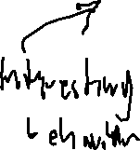
Prioritizing Input
Fuzzing
The challenge of fuzzers is (usually) getting past the first validation check
if (!sane_input()){
exit 1;
}
//The rest of the program

Slide 27


Simple Testing Strategy
Fuzzing
Consider “Interesting” Input
Values close to the maximum, minimum, middle, etc
Case Study: Card reader input: [Frisby et al., 2012]

Slide 28
Mutation-Based Fuzzers
Fuzzing
Explore deviations from known input
Example mutations:
Binary input
– Bit flips
- Byte flips
- Change random bytes
- Insert random byte chunks
- Delete random byte chunks
- Set randomly chosen byte chunks to interesting values e.g. INT_MAX, INT_MIN, 0, 1, -1, … §
Text input
- Insert random symbols or keywords from a dictionary

Slide 29

Black-Box Fuzzing
Fuzzing
Throw random input at the application interface

Slide 30
Representative Tool: zzuf
Black-box Fuzzing
The “Multipurpose fuzzer”
zzuf cat /dev/zero | hd -vn 32
zzuf -r 0.05 hd -vn 32 /dev/zero

Slide 31

White-Box Fuzzing
Fuzzing
Throw random input at the unit interface

Slide 32
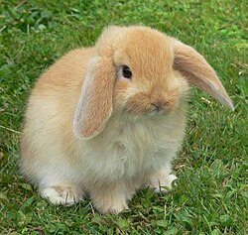
Representative Tool: AFL
Fuzzing
AFL (American Fuzzy Lop)
Maintained by Google
State of the art
Generally considered the best, state-of-the-art fuzzer

Slide 33
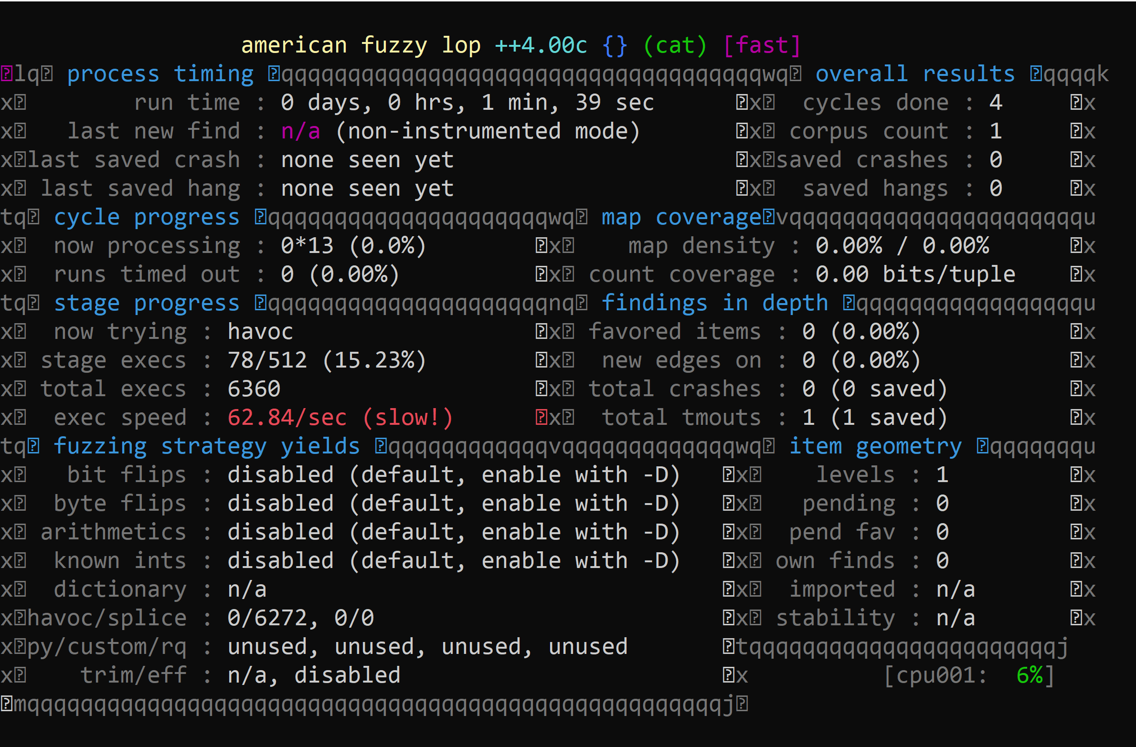
Representative Tool: AFL
Fuzzing
Example command
“traditional Fuzzing”
mkdir in_dir
echo “hello” > in_dir/hello
afl-fuzz -n -i in_dir -o out_dir cat

Slide 34
Representative Tool: AFL
Fuzzing
Instrumentation mode
Compile the program with coverage probes
Attempt to prioritize / mutate test cases that extend coverage
afl-clang++ <build command>

Slide 35
Generation-Based Fuzzing
Fuzzing
Attempt to discern patterns / Alternatives in Input
Potentially with the help of some guide of guide / input grammar

Slide 36
Fuzzing Oracles
Fuzzing
Beyond graceful Failure
In C/C++ there are a lot of violations of proper behavior that are invisible
“Seems fine until it’s a huge problem”
Sanitizers
UBSan – Undefined behavior sanitizer
ASan – Address sanitizer
TSan – Thread sanitizer

Slide 37
Research Direction: “Gunking”
Fuzzing
Fuzzing as adversarial recon
Fuzzing is so good at finding bugs that even the bad guys do it
Perhaps a program should deploy Anti-Fuzzing tech
What would that look like?

