Slide 1
Exercise 30
Symbolic Execution Review
How many states are in the symbolic execution tree for the following program?
1: int main(int argc){
2: if (argc > 2){
3: if (argc < 1){
4: return 1;
5: } else if (argc > 3){
6: return 2;
7: }
8: }
9: return argc;
10: }
11:

Slide 2
Exercise 30 Solution
Symbolic Execution Review

Slide 3
Administrivia and
Announcements

Slide 4
Concolic Execution
EECS 677: Software Security Evaluation
Drew Davidson

Slide 5
Where We’re At
(Beyond?) Dynamic Analysis
- generating test cases

Slide 6
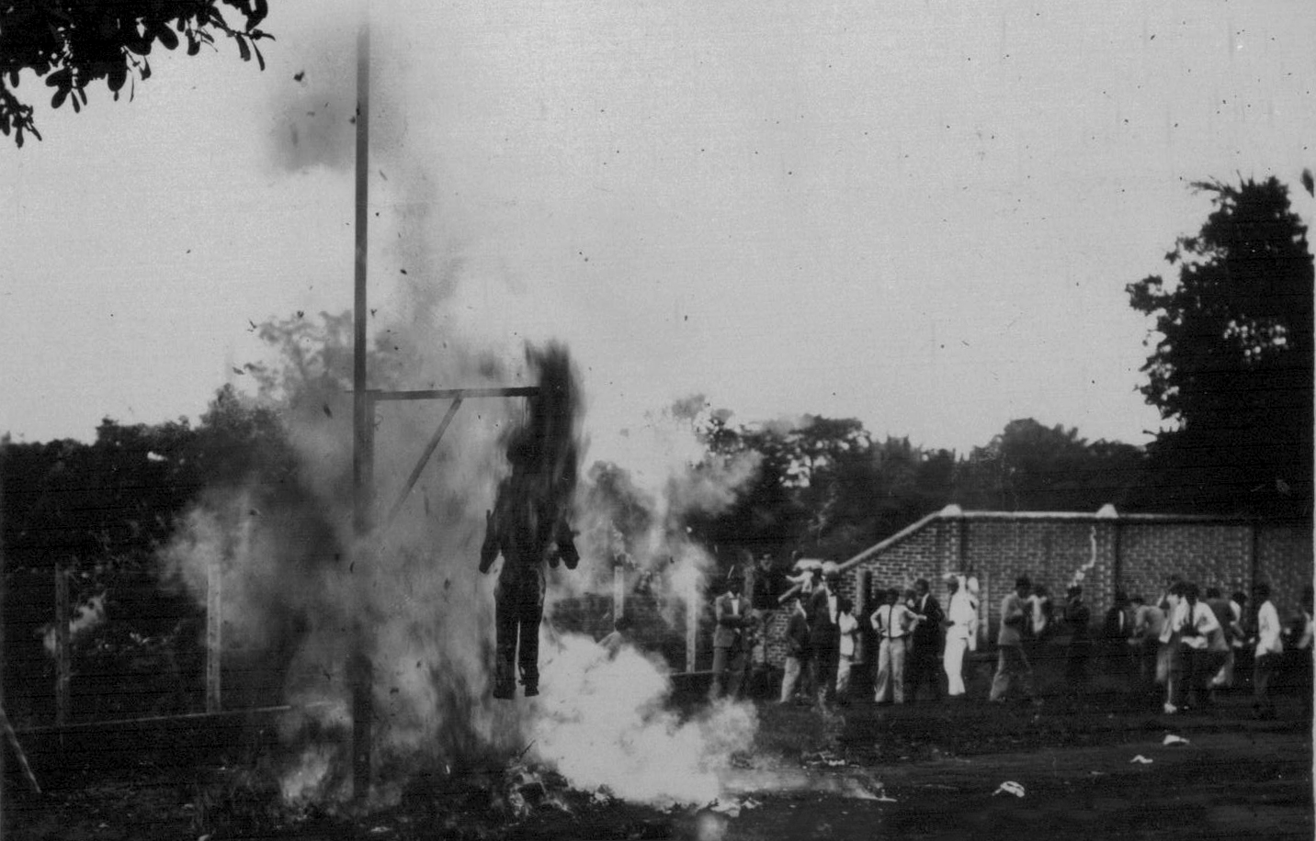
Previously: Symbolic Execution
Outline / Overview
Advance Abstract States across the program
Split abstract states according to predicates to enhance coverage
Use an SMT Solver to determine if the path constraint is feasible
Sound and Complete modulo termination
Stealth limitation of testing as dynamic analysis as well
Symbolic Execution =/= Burning in Effigy

Slide 7
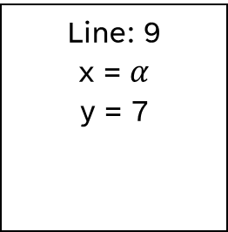

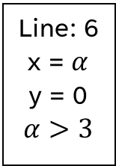









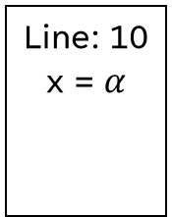


The Symbolic State Tree
Outline / Overview
Line: 2
3
4
5
x = $α$
y = 0
1: #include "stdio.h"
2: int main(){
3: int x = getchar();
4: int y = 0;
5: if (x > 3){
6: y = 7;
7: if (x == 4){
8: x++;
9: }
10: } else {
11: y = 2;
12: }
13: return y;
14: }
Line: 6
x = $α$
y = 0
$$α>3$$
7
Line: 10
x = $α$
11
12
13
7
y = 0
2
$α$ $≤$ 3
Line: 9
x = $α$
y = 7
Line: 8
x =$α$
y = 7
13
9
13
$$β$$
$α$ > 3
$α$ = 4
$α \text{>}$3
$α$ $≠$ 4
$$∧$$
$$∧$$
$β$= $α$ + 1
$$∧$$

Slide 8

This Time: Enhancing Symbolic Execution
Outline / Overview
Turning the symbolic execution concept into a usable tool
Limitations / Improvements of the analysis technique

Slide 9
Lecture Outline
Generating test cases
Analysis Termination
Concolic Execution

Slide 10

Generating Test Cases
Concolic execution
Wait a minute… We’re supposed to be building a test suite!
1: #include "stdio.h"
2: int main(){
`3: int x = getchar();
4: int y = 0;
5: if (x > 3){
6: y = 7;
7: if (x == 4){
8: x++;
9: }
10: } else {
11: y = 2;
12: }
13: return y;
14: }

Slide 11


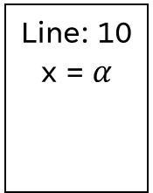
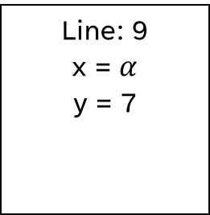

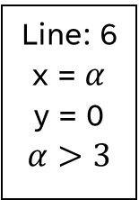









Generating Test Cases
Concolic execution
Line: 2
3
4
5
Wait a minute… We’re supposed to be building a test suite!
x = $α$
y = 0
… instead, we generated a symbolic execution tree
Line: 6
x = $α$
y = 0
$$α>3$$
7
Line: 10
x = $α$
11
12
13
1: #include "stdio.h"
2: int main(){
`3: int x = getchar();
4: int y = 0;
5: if (x > 3){
6: y = 7;
7: if (x == 4){
8: x++;
9: }
10: } else {
11: y = 2;
12: }
13: return y;
14: }
7
y = 0
2
$α$ $≤$ 3
Line: 9
x = $α$
y = 7
Line: 8
x =$α$
y = 7
13
9
13
$$β$$
$α$ > 3
$α$ = 4
$α \text{>}$3
$α$ $≠$ 4
$$∧$$
$$∧$$
$β$= $α$ + 1
$$∧$$

Slide 12
From trees to Tests
Concolic execution
Line: 2
3
4
5
Wait a minute… We’re supposed to be building a test suite!
x = $α$
y = 0
… instead, we generated a symbolic execution tree
consider a program trace
Line: 6
x = $α$
y = 0
$$α>3$$
7
Line: 10
x = $α$
11
12
13
7
y = 0
2
$α$ $≤$ 3
Line: 9
x = $α$
y = 7
Line: 8
x =$α$
y = 7
13
9
13
$$β$$
$α$ > 3
$α$ = 4
$α \text{>}$3
$α$ $≠$ 4
$$∧$$
$$∧$$
$β$= $α$ + 1
$$∧$$

Slide 13



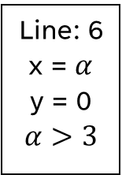





From trees to Tests
Concolic execution
Line: 2
3
4
5
Wait a minute… We’re supposed to be building a test suite!
x = $α$
y = 0
… instead, we generated a symbolic execution tree
consider a program trace
Line: 6
x = $α$
y = 0
$$α>3$$
7
The trace shows us exactly which inputs were symbolic
7
The path constraint gives us bounds on the input
Line: 8
x =$α$
y = 7
9
13
$$β$$
$α$ > 3
$α$ = 4
$$∧$$
$β$= $α$ + 1
$$∧$$

Slide 14
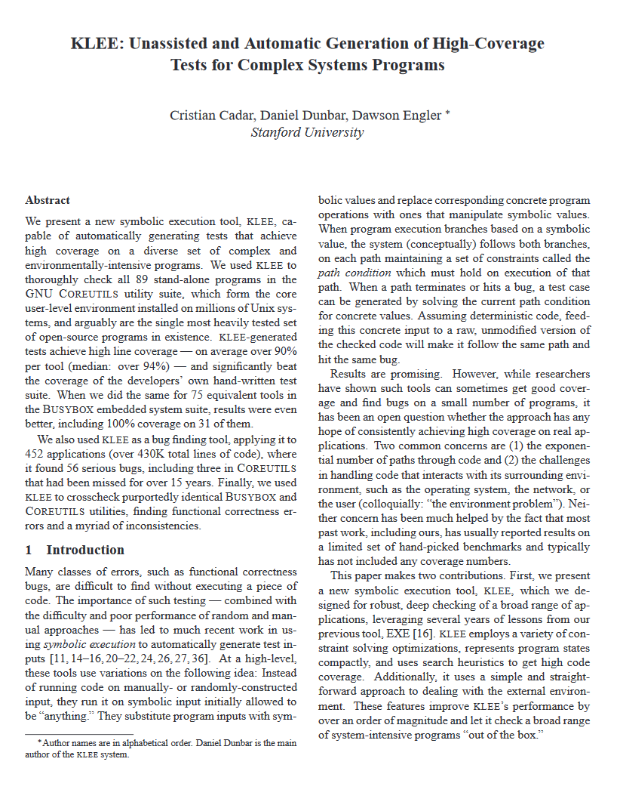

Representative Tool: KLEE
Concolic execution
A state-of-the-art symbolic execution engine
http://klee.doc.ic.ac.uk/

Slide 15
Lecture Outline
Generating test cases
Analysis Termination
Concolic Execution

Slide 16

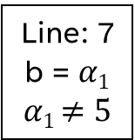


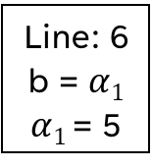






Termination
Outline / Overview
One advantage of symbolic execution:
Line: 2
3
4
5
b = $α1$
Partial credit
We can guarantee termination at the expense of completeness
Line: 6
b = $α1$
$α1$ = 5
Line: 7
b = $α1$
$α1$ $≠5$
3
4
5
$$α2$$
Quit after a threshold is met (Tree size? Clock time?)
1: #include "stdio.h"
2: int main(){
3: while(true){
4: int b = getchar();
5: if (b == 5){
6: return 5;
7: }
8: }
9: }
Line: 6
b = $α$₁
$α1$ $≠$5
Line: 7
b = $α$₂
$α1$ $≠5$
3
4
5
$α$₃
b₂ = $α2$
b₂ = $α2$
$α2$ = 5
$α2$ $≠$ 5

Slide 17
State Pruning
Symbolic Execution
Termination Insight: A redundant state has redundant successors
Line: 2
3
4
5
b = $α1$
Redundant!
* With proper environmental handling
Line: 6
b = $α1$
$α1$ = 5
Line: 7
b = $α1$
$α1$ $≠5$
3
4
5
1: #include "stdio.h"
2: int main(){
3: while(true){
4: int b = getchar();
5: if (b == 5){
6: return 5;
7: }
8: }
9: }
$$α2$$
Line: 6
b = $α$₁
$α1$ $≠$5
Line: 7
b = $α$₂
$α1$ $≠5$
3
4
5
$α$₃
b₂ = $α2$
b₂ = $α2$
$α2$ = 5
$α2$ $≠$ 5

Slide 18


Research Direction: “Fie on Firmware”
Fuzzing
Symbolic Execution for “exotic” environments
int a = *(0x400080)
int b = *(0x400080)

Slide 19
State Pruning: Limitation
Outline / Overview
Serious programs likely have state space explosion
States are too complicated to prune.
1: #include "stdio.h"
2: int main(){
3: int i = 0;
4: while(int b = getchar()){
5: i++;
6: if (b == 5){
7: return i;
8: }
9: }
10: }

Slide 20
State Prioritization
Outline / Overview
Which is the “Best” State to advance?
Akin to the fuzzing heuristics
1: #include "stdio.h"
2: int main(){
3: int i = 0;
4: while(int b = getchar()){
5: i++;
6: if (b == 5){
7: return i;
8: }
9: }
10: foo();
11: }

Slide 21
Lecture Outline
Generating test cases
Analysis Termination
Concolic Execution

Slide 22
Analysis Scope / Limits
Outline / Overview
Overburdening the solver
At some point, the path constraint becomes unwieldly
1: #include "stdio.h"
2: int main(int argv, const char * argv){
3: int i = 0;
4: if(sha1sum(argv[1]) == 0xf572d396fae9206628714fb2ce00f72e94f2258f){
5: return i / 0;
6: }
7: }

Slide 23
Concolic Execution
Outline / Overview
Concrete + symbolic
Big Idea
Benefits
Replace a symbolic value with a representative concrete value
Increased coverage (at the cost of completeness)
Can still pair with termination thresholds
1: #include "stdio.h"
2: int main(int argc, const char * argv){
3: int i = 0;
4: if(sha1sum(argv[1]) == 0xf572d396fae9206628714fb2ce00f72e94f2258f){
5: return i / 0;
6: }
7: }

Slide 24
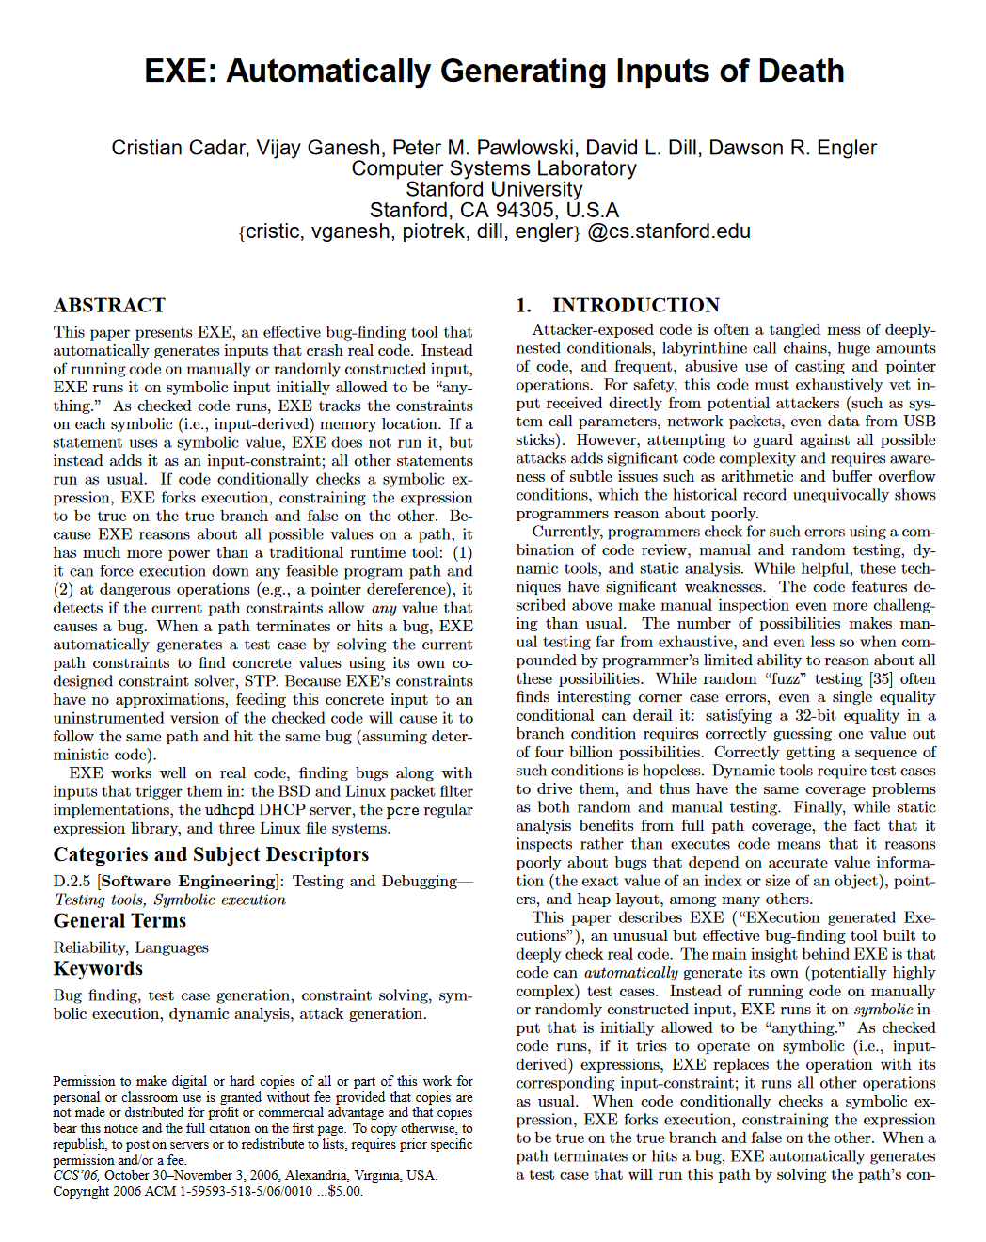
Concolic Execution beyond the solver
Outline / Overview
Automatically determine crash values

Slide 25
Analysis Scope / Limits
Outline / Overview
Overburdening the solver
At some point, the path constraint becomes unwieldly
There may be code outside the analysis engine
What happens on a network call?
1: #include "stdio.h"
2: int main(int argc, const char * argv){
3: int i = networkRead(argv[1]);
4: if(i = 7){
5: return i / 0;
6: }
7: }

Slide 26
Concolic Execution: Beyond the Solver
Outline / Overview
At some point, maybe we just guess
Pick a random value
1: #include "stdio.h"
2: int main(int argc, const char * argv){
3: int i = networkRead(argv[1]);
4: if(i = 7){
5: return i / 0;
6: }
7: }

Slide 27
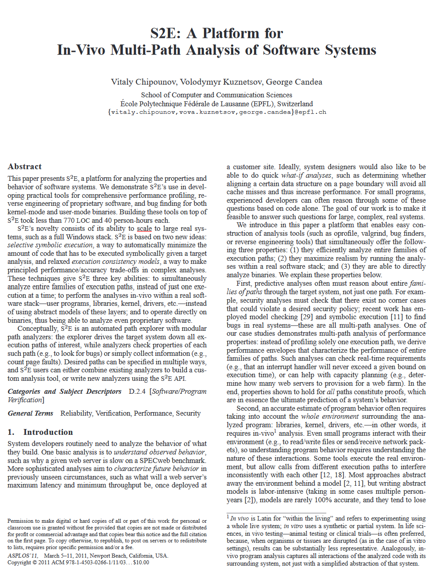
S2E: Whole-System Symbolic Execution!
Outline / Overview
Big Idea: use the real system
Back out assumptions

Slide 28
Wrap-up
Symbolic execution
Exercise each feasible program path

Slide 29
Next Time…
SAT Solvers
Peeking inside the magic box that determines if an equation is feasible

