Slide 1
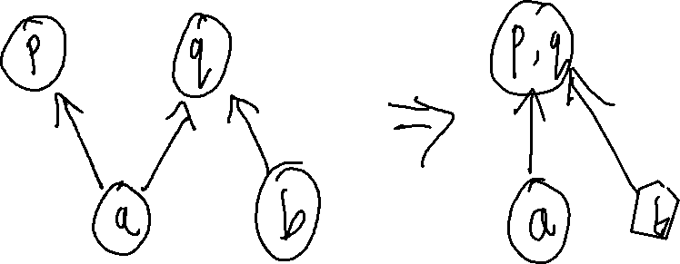
Exercise
Program Instrumentation Review
Write your name and answer the following on a piece of paper
Give an example of a program where Steensgard’s analysis will indicate a false-positive points-to relationship that Andersen’s would avoid

Slide 2
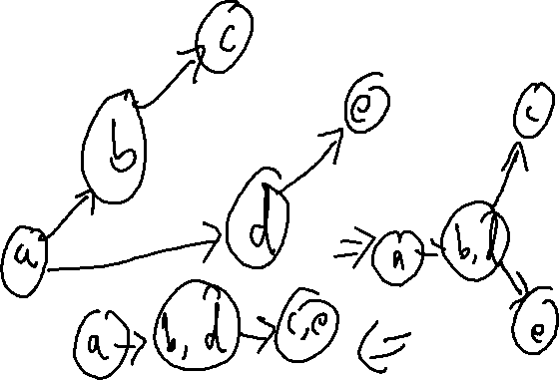
Exercise solution
Program Instrumentation Review

Slide 3
Administrivia and
Announcements
Hope you weren’t expecting the quiz today!

Slide 4
Static Instrumentation
EECS 677: Software Security Evaluation
Drew Davidson

Slide 5
Previously: Program Instrumentation
Review: Last Lecture
Alter the program to gain more information out of dynamic analysis
Uses
Diagnostics: Figure out what the program is doing
Static analysis refinement: Determine if a bug is real?

Slide 6
This Lesson: Static Instrumentation
Review: Last Lecture
Inserting measurement probes into a program Before it is run
More closely associated with proactive software evaluation – (why?)
Two forms of instrumentation
Static instrumentation – Alter the program statically, to gain information at runtime
Dynamic instrumentation – Alter the program at runtime, potentially leveraging runtime info

Slide 7

Static Instrumentation Tools
Program Instrumentation: Approach
Often built right into compiler
LLVM Coverage tools
GCC Coverage tools
Sometimes built upon optimizer
Google’s closure compiler
https://github.com/google/closure-compiler

Slide 8
Lecture Outline
Example: Test Coverage
Using LLVM Instrumentation
Developing LLVM Instrumentation

Slide 9

Test Coverage
Example: Test Coverage
How do we know if our test suite is sufficient?
Line/branch/path coverage – How many lines/branches/paths of the program does suite exercise?

Slide 10
Test Coverage
Example: Test Coverage
How do we know if our test suite is sufficient?
1: int f(bool b) {
2: Obj * o = null;
3: int v = 2;
4: if (b) {
5: o = new Obj ();
6: v = rand_int();
7: }
8: if (v == 2){
9: o->setInvalid();
10: }
11: return o->property();
12: }
Line/branch/path coverage – How many lines/branches/paths of the program does suite exercise?
Test Case 1
Test Case 2
Test Case 3
true → b
true → b
false → b
3 → v
2 → v
- → v

Slide 11
Assessing Coverage
Program Instrumentation: Approach
1: int f(bool b) {
2: Obj * o = null;
3: int v = 2;
4: if (b) {
5: o = new Obj ();
6: v = rand_int();
7: }
8: if (v == 2){
9: o->setInvalid();
10: }
11: return o->property();
12: }
13:
Big Idea: Inject Counters
Simple: Add a counter at every instruction
Better: Add a counter at every basic block
What coverage information does this give us?
Instruction: Yes!
Branch: Yes!
Path: No!

Slide 12
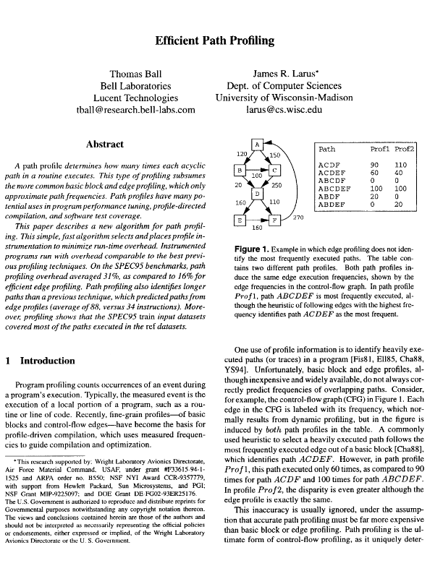
Efficient Path and Branch Counters
Program Instrumentation: Approach
Ball and Larus ‘96
Intuition:
Assign integer values to edges such that no two paths compute the same path sum (Section 3.2).
Select edges to instrument using a spanning tree

Slide 13
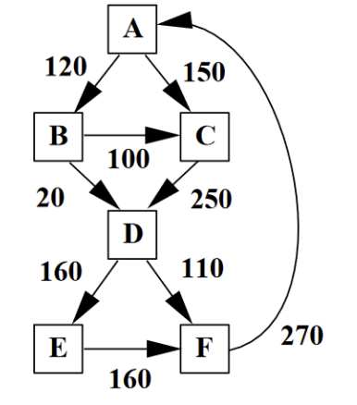
Branch Frequency
Program Instrumentation: Approach
Naïve Approach: Instrument probes at each edge
Inefficient!
We don’t really need an A -> B counter
(it’s the sum of the B-> C and B -> D counters)

Slide 14
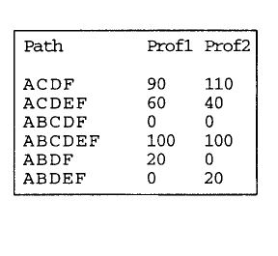
Path Frequency
Review: The Problem

Slide 15
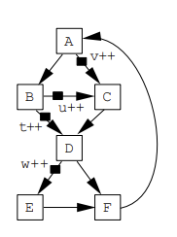
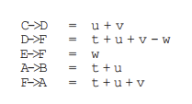
Example: Coverage / Frequency
Program Instrumentation: Approach
example of instrumentation: Counting Execution Frequency
(Placing sanitizers)
Why is this useful?
Let’s first consider inserting edge counters
Inefficient!
We don’t really need an A -> B counter
(it’s the sum of the B-> C and B -> D counters)

Slide 16
Lecture Outline
Example: Test Coverage
Using LLVM Instrumentation
Developing LLVM Instrumentation

Slide 17
Setup / Assumptions
LLVm Built-In Instrumentation
This portion of the lecture uses a clang++ installation.
Should work for many versions of LLVM (tested on clang++-18)
Works on clang++14 (which is installed on the cycle servers)
Installation (on a local machine)
sudo apt install clang++ llvm-dev

Slide 18
LLVM Coverage Instrumentation
LLVm Built-In Instrumentation
Goal: Assess the coverage of a test suite
Approach: use LLVM’s built-in Instruction instrumentation
Piggyback on LLVM’s PGO facilities
Profile-guided optimization
1) Insert PGO probes
2) Interpret probes as coverage measurements

Slide 19
LLVM: Inserting PGO Probes
LLVm Built-In Instrumentation
-fcoverage-mapping
Map instrumentation results to source code
-fprofile-instr-generate
Generate profile information at the source instruction level
-fprofile-generate
Generate profile information at the IR level

Slide 20
LLVM: Inserting PGO Probes
LLVm Built-In Instrumentation
Let’s write a simple LLVM program, then observe the probes…
clang++ prog.c –o prog -fprofile-instr-generate –emit-llvm -fcoverage-mapping
This will cause the program to output an additional coverage file in the location of the environment variable LLVM_PROFILE_FILE
export LLVM_PROFILE_FILE=test1.prof

Slide 21
LLVM Coverage Instrumentation
LLVm Built-In Instrumentation
Goal: Assess the coverage of a test suite
Approach: use LLVM’s built-in Instruction instrumentation
Piggyback on LLVM’s PGO facilities
1) Insert PGO probes
2) Interpret probes as coverage measurements

Slide 22
LLVM: Coverage Report
LLVm Built-In Instrumentation
The profile file is useful for a variety of things (i.e. PGO). As such, it is not (immediately) human-readable
We’ll use some extra tools to generate a readable report
llvm-profdata merge -sparse test1.prof -o final.profdata
llvm-cov show prog -instr-profile=final.profdata >& profile.report

Slide 23
Putting it All together
Review: Last Lecture
These commands work fine for 1 test run, but we care about test SUITES
clang++-18 prog.ll –o prog -fprofile-instr-generate -fcoverage-mapping
export LLVM_PROFILE_FILE=test1.prof
./prog
export LLVM_PROFILE_FILE=test2.prof
./prog
llvm-profdata merge -sparse test*.prof -o final.profdata
llvm-cov-18 show prog -instr-profile=final.profdata >& profile.report

Slide 24

Example: LLVM Coverage Instrumentation
Program Instrumentation: Approach
Demo: Let’s consider a calculator App
Attempt to achieve full line coverage

Slide 25
Custom Instrumentation
Developing LLVM Instrumentation
The Previous Example took advantage of pre-existing instrumentation
What if we wanted to make our own custom instrumentation?

Slide 26
Lecture Outline
Example: Test Coverage
Using LLVM Instrumentation
Developing LLVM Instrumentation

Slide 27

Custom Instrumentation
Developing LLVM Instrumentation
Big Idea: rewrite the program to tattle on itself
Getting started
Everyone
1) Reference the LLVM API
2) Build our own (trivial) analysis pass
3) Hook into the LLVM opt infrastructure
4) Run our analysis pass
Going Further
Insert more full-featured functionality
(https://llvm.org/doxygen/classllvm_1_1IRBuilder.html)

Slide 28
Example: LLVM Custom Instrumentation
Developing LLVM Instrumentation
Let’s remove and Add some instructions!
Consider a simple “add2” program:
#include <stdio.h>
int main(int argc, const char** argv) {
int num;
scanf("%i", &num);
printf("%i\n", num + 2);
return 0;
}
Let’s insert another printf here

Slide 29
Example: LLVM CUSTOM Instrumentation
Developing LLVM Instrumentation
Let’s take it to the terminal!

Slide 30
Wrap-up
We’ve Described The theory and practice of program instrumentation
Next time: Consider how we generate test cases

