Slide 1
Exercise 15
Review: Information Flow
Write your name and answer the following on a piece of paper
Provide an instance of a program with an information flow from a confidential (high-security) source to an untrusted (low-security) sink that a static analysis is likely to catch but a dynamic analysis is unlikely to catch

Slide 2
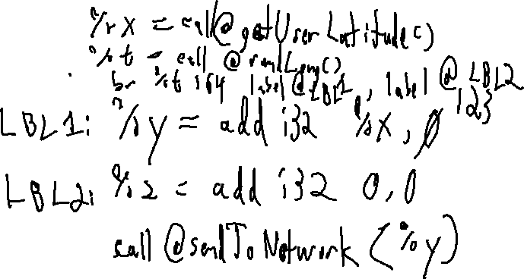
Exercise 15 Solution
Review: Information Flow
Provide an instance of a program with an information flow from a confidential (high-security) source to an untrusted (low-security) sink that a static analysis is likely to catch but a dynamic analysis is unlikely to catch

Slide 3
Administrivia and
Announcements

Slide 4
Class Progress
Showing some applications of Static Dataflow

Slide 5

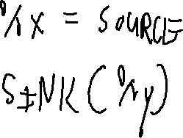
Last Time: Dataflow Deployment
Previously: Information Flow
Using Dataflow in practical contexts
- Ex. - Looking for secret-holding variables

Slide 6
Implicit Flow
Previously: Information Flow
X = SOURCE();
Y = 0;
if (X == 1){
Y = 1;
}
if (X == 2){
Y = 2;
}
…
SINK(Y)

Slide 7
Side Channels
EECS 677: Software Security Evaluation
Drew Davidson

Slide 8
Overview
Contemplate other ways that Sneaky data flows can occur

Slide 9
Lecture Outline
Threat Models
Side Channels - Overview
Timing
A dataflow approach

Slide 10
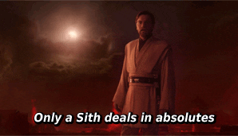
Thinking About Attacks
Recall: Threat Models
There’s no such thing as “Absolute Security”
It’s always possible to come up with SOME (potentially wacky) scenario where the adversary can subvert a system
Consider the various attack classes
Denial of Service: Availability is compromised
Exfiltration: Confidentiality policy is compromised
Compromise: Integrity policy is compromised

Slide 11
Thinking About Attacks
Recall: Threat Models
There’s no such thing as “Absolute Security”
It’s always possible to come up with SOME (potentially wacky) scenario where the adversary can subvert a system
These assumptions are captured by a threat model
Consider the various attack classes
Denial of Service: Availability is compromised
Exfiltration: Confidentiality policy is compromised
Compromise: Integrity policy is compromised

Slide 12
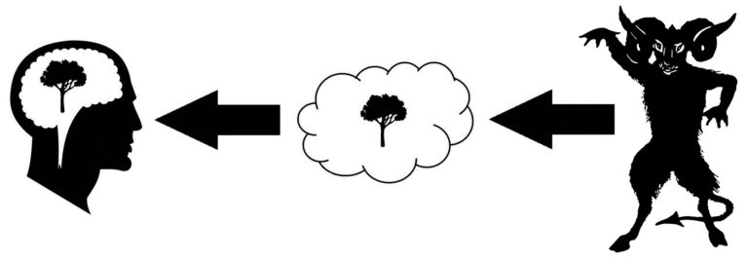
Unconventional Adversaries
Recall: Threat Models
Our notions of completeness are ultimately tied to our assumptions
Deus Deceptor (Game over)

Slide 13
Unconventional Adversaries
Recall: Threat Models
Our notions of completeness are ultimately tied to our assumptions
An adversary may have the ability to influence (or observe) phenomena that are outside of the threat model
Anecdote: sensor input spoofing attacks
Side-channels: Extra-semantic observation
SISA: Extra-semantic influence

Slide 14
Lecture Outline
Threat Models
Side Channels - Overview
Timing
A dataflow approach

Slide 15
The Basic Idea of Side Channels
Side Channels
Abstraction is a key principle of Computer Science!
As a programmer, you shouldn’t need to know underlying details
As a security expert, these details might end up being important!
The way a program accomplishes its tasks are important, especially from a security aspect
- How long does it take for the program to do X ?
- How hot does it make the processor when X happens?
- How much power does it draw when X happens?

Slide 16
Unconventional Adversaries
Recall: Threat Models
(Sadly) our software needs to be manifested in hardware

Slide 17
Side Channels – The Big Idea
Side Channels - Instances
Computation may have effects outside of program semantics
Some operations (internally) take longer based on aspects of the data

Slide 18
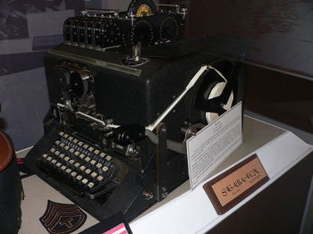
TEMPEST
Side Channels – History
Electromagnetic Leakage of keys
WWII: Bell Telephone discovers electromagnetic leakage in one-time pad teleprinters, detectable at 100-ft radius
1951: CIA rediscovers leakage, detectable at 200-ft radius
1964: TEMPEST shielding protocol established

Slide 19
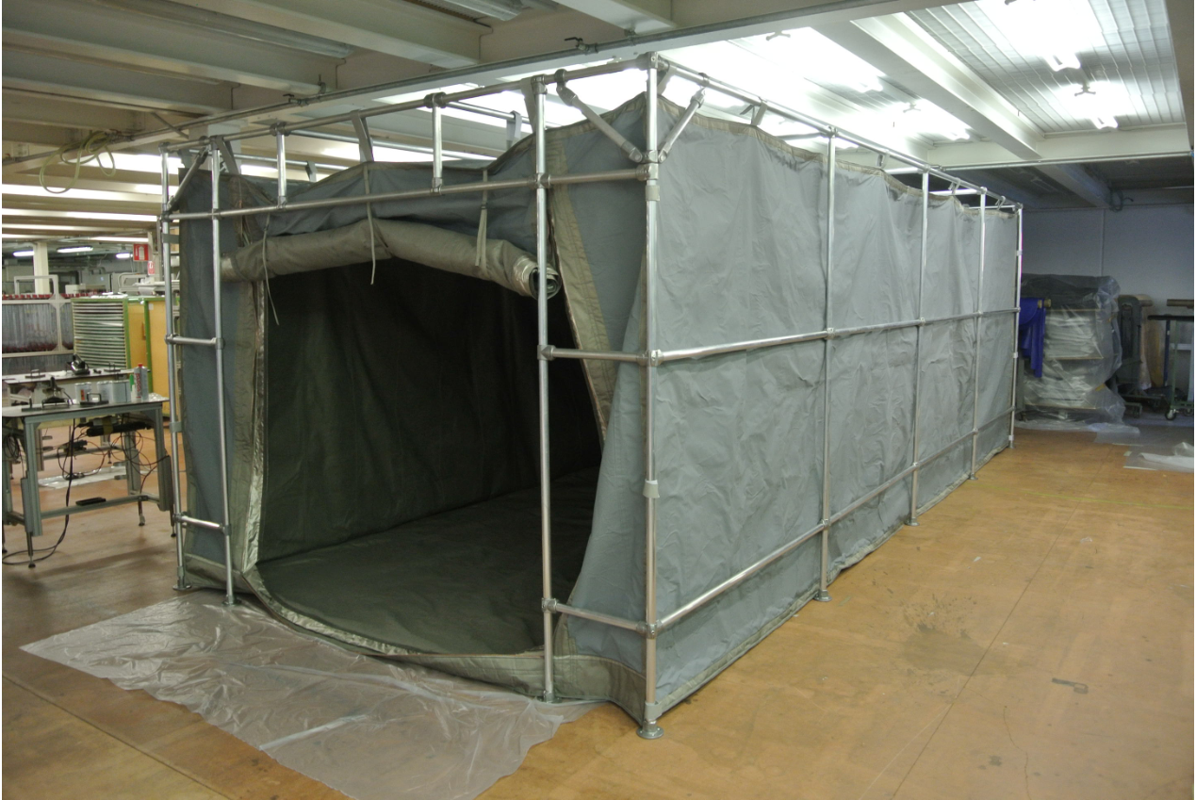
TEMPEST
Side Channels – History
Electromagnetic Leakage of keys
WWII: Bell Telephone discovers electromagnetic leakage in one-time pad teleprinters, detectable at 100-ft radius
1951: CIA rediscovers leakage, detectable at 200-ft radius
1964: TEMPEST shielding protocol established

Slide 20
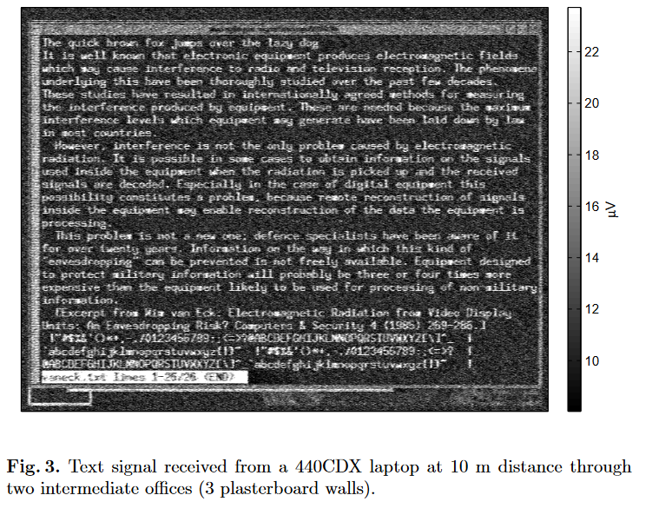
Van Eck Phreaking
Side Channels – History
Electromagnetic Leakage of Monitors
Pick up the monitor’s electromagnetic emanations that differ depending on how the screen lights up
Originally determined for CRT (1985), also discovered for LCD monitors (2004)

Slide 21

Side Channels – Partial Credit
Side Channels - Instances
Even “Hints” about secret data can be problematic
Assume you’re trying to guess a password
– knowing even 1 character massively reduces the search space
– knowing the length of the password reduces the search space

Slide 22
Covert Channels
Side Channels
Sometimes a Program Wants to Leak data
Exfiltration !

Slide 23

Lecture Outline
Threat Models
Side Channels - Overview
Timing
A dataflow approach

Slide 24
Timing Side Channels
Side Channels - Instances
Some computations take longer than others
Some operations (internally) take longer based on aspects of the data
bool checkPW(const char * given){
const char * expected = “12345”;
int gLen = strlen(given);
int eLen = strlen(expected);
if (gLen != eLen){ return false; }
for (int i = 0; i < eLen; i++){
if (given[i] != expected[i]){
return false;
}
}
return true;
}

Slide 25
Timing Side Channels
Side Channels - Instances
Some computations take longer than others
Some operations (internally) take longer based on aspects of the data
Threat Model
Interactive, low-latency*, black-box access to the program, precise timer
Password attempts
Program
Adversary
timing
*: May be overcome with more samples

Slide 26
Timing Side Channels - Fix
Side Channels - Instances
bool checkPW(const char * given){
const char * expected = “12345”;
int gLen = strlen(given);
int eLen = strlen(expected);
if (gLen != eLen){ return false; }
for (int i = 0; i < eLen; i++){
if (given[i] != expected[i]){
return false;
}
}
return true;
}
bool checkPW(const char * given){
const char * expected = “12345”;
int gLen = strlen(given);
int eLen = strlen(expected);
bool ok = true;
if (gLen != eLen){ ok = false; }
for (int i = 0; i < eLen; i++){
int gIdx = math.min(gLen - 1, i);
if (given[gIdx] != expected[i]){
ok = false;
}
}
return ok;
}

Slide 27
Timing Side Channels - Fix
Side Channels - Instances
Limitations of Uniform Execution
- Necessarily slow down your computation to the worst case
- May require some pretty precise understanding of timing
- May not always be obvious what the worst-case even is

Slide 28
Lecture Outline
Threat Models
Side Channels - Overview
Instances
A dataflow approach

Slide 29
Timing Side Channels - Fix
Side Channels - Instances
Can we fix this issue with our dataflow approach?
- Instruction transformers: how much time that instruction takes
- Block composition: the sum total of instruction times
- Merge operation: some sort of check that all paths are of comparable time?

Slide 30
Wrap-up

