Slide 1
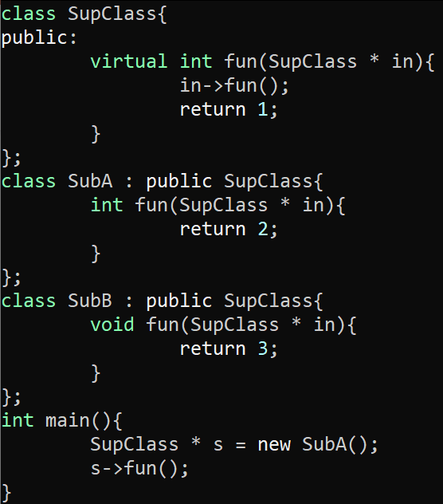
Exercise
Call Target Review
Write your name and answer the following on a piece of paper
Draw the exploded supergraph for the following program:

Slide 2
Exercise
Call Target Analysis Review
Write your name and answer the following on a piece of paper
Draw the call graph of the following program
according to CHA
1: class SupClass{
2: public:
3: virtual int fun(SupClass * in){
4: in->fun(in);
5: }
6: };
7:
8: class SubA : public SupClass {
9: virtual int fun(SupClass * in){
10: in->fun(in);
11: }
12: };
13: class SubB : public SupClass {
14: virtual int fun(SupClass * in){
15: in->fun(in);
16: }
17: };
18: int main(){
19: SupClass * s = new SubA();
20: s->fun(s);
21: }

Slide 3
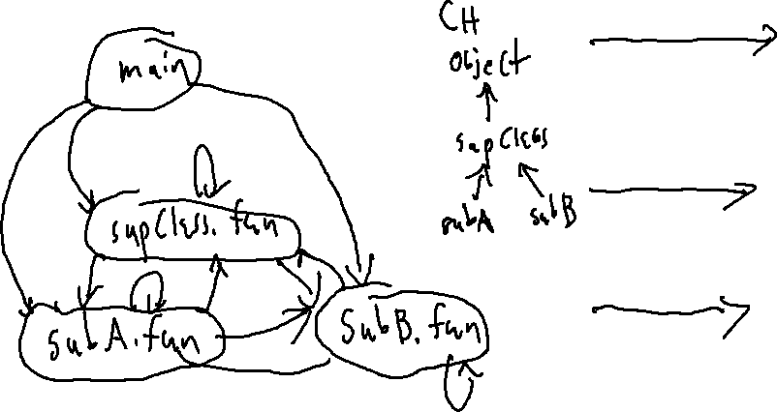
Exercise SOLUTION
Call Target Analysis Review

Slide 4
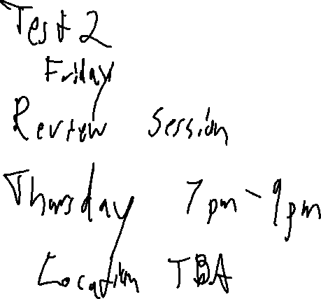
Administrivia and
Announcements

Slide 5
Points-To Analysis
EECS 677: Software Security Evaluation
Drew Davidson

Slide 6
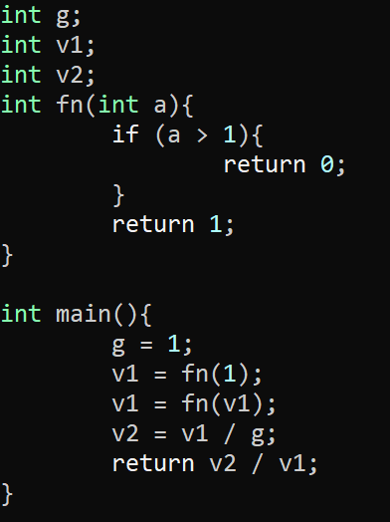
Last Time: Interprocedural Analysis
Review: Last Lecture
Consider the effect of multiple functions
Simplistic
Function overturn all global / aliased facts
Supergraph / Context String
1-CFA (use a call-chain of 1)
Summary Information
- Use GMOD and GREF to cut down on imprecision

Slide 7
Vibe Check
We’re Building a fully-operational Static Analysis

Slide 8
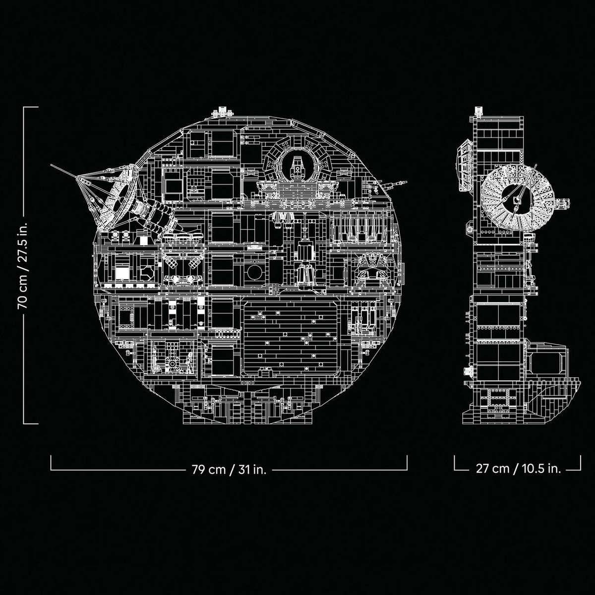
Vibe Check
We’re Building a fully-operational Static Analysis
A tool capable of answering a host of questions about programs

Slide 9
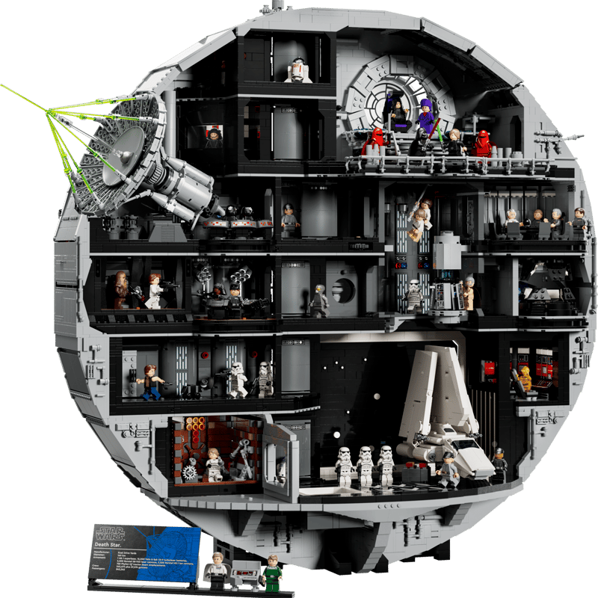
Vibe Check
We’re Building a fully-operational Static Analysis
A tool capable of answering a host of questions about programs
Build UP our analysis to Encapsulate features of non-toy programs

Slide 10
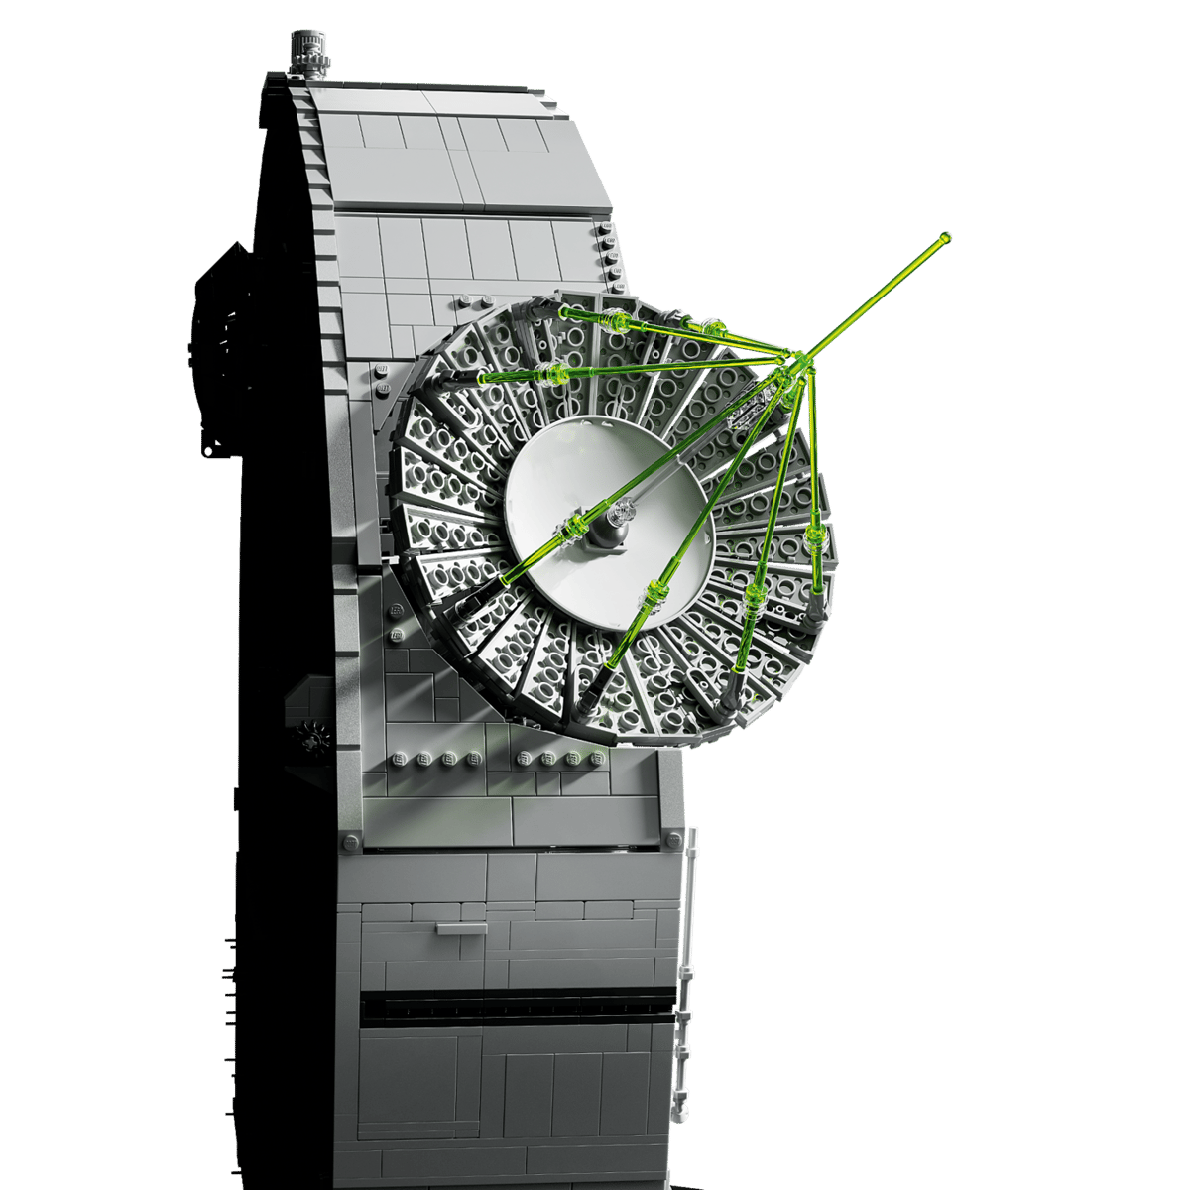



Extending Dataflow
Control-Flow Graphs
Call Graphs
Call Targets
Pointer Analysis

Slide 11
Lecture Outline
Aliasing Relationships
Representing Points-To
Analyses

Slide 12

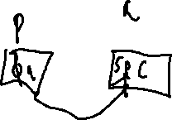
Aliases
Aliasing Relationships
Many References, One entity
Machine Code (and many source languages) allow data values that address other locations (it’s all integers, after all)
Awareness Needed in Dataflow Facts!
Pseudocode
p = &a;
*p = SOURCE();
SINK(a);

Slide 13
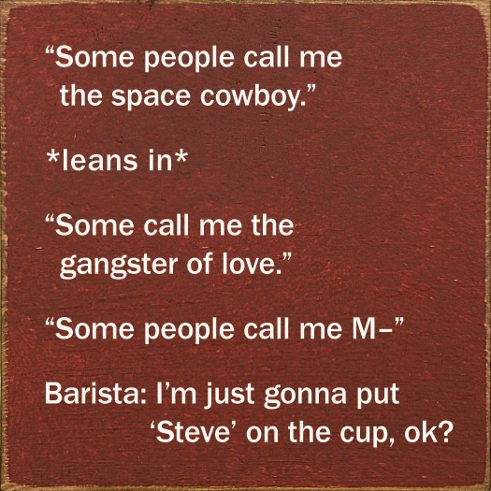
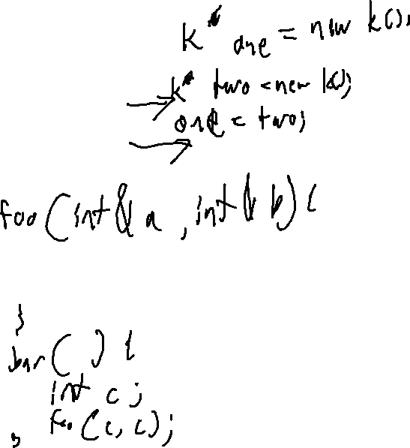
Many forms of Aliasing
Aliasing Relationships
There’s Lots of ways that aliasing happens
Pass-by-reference
Object References
Credit

Slide 14
aliases and Safe Analysis
Aliasing Relationships
May-Point(P)
The set of locations to which P might refer (i.e. point-to)
Must-Point(P)
The set of locations to which P definitely refers (i.e. points-to)
p = &a;
q = p;
p = &b;
r = p;

Slide 15
Lecture Outline
Aliasing Relationships
Representing Points-To
Analyses

Slide 16
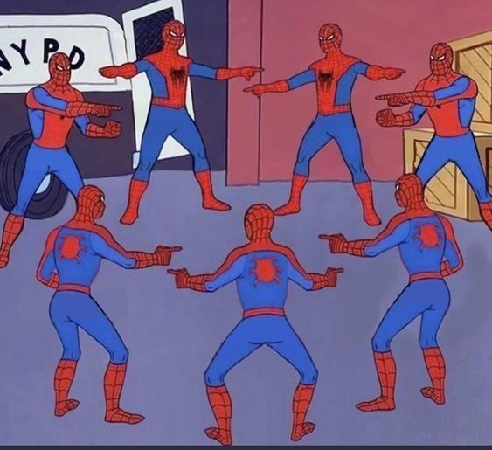
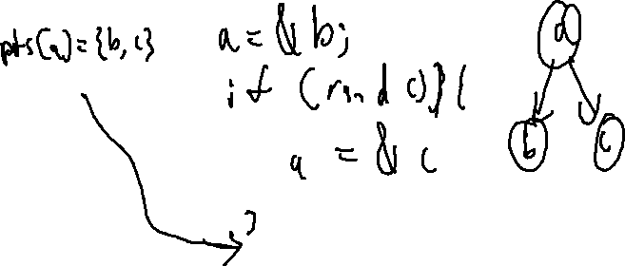
Representing Points-to Relationships
Representing Points-TO
Approach #1: Constraint Sets
Constraint sets
loc(X): the memory location of X itself
pts(X): the memory location X may address
Approach #2: Points-To Graph
A node-and-edge representation of the may-point relationship

Slide 17

Issues Computing Points-to
Representing Points-TO
Problems
Mutual Dependence
Dataflow needed to compute points-to
Points to needed to compute dataflow
Scalability
A program spanning graph at each instruction point?!
Mitigation
A flow-insensitive, context-insensitive analysis

Slide 18
Lecture Outline
Aliasing Relationships
Representing Points-To
Analyses

Slide 19
Two algorithms
Points-To Analysis
Andersen’s Analysis and Steensgard’s Analysis
Both flow-insensitive
Both saturation algorithms
Both translate operations into constraints, solve system of constraints
Steensgard’s is a coarser approximation
(less granularity means faster saturation)

Slide 20
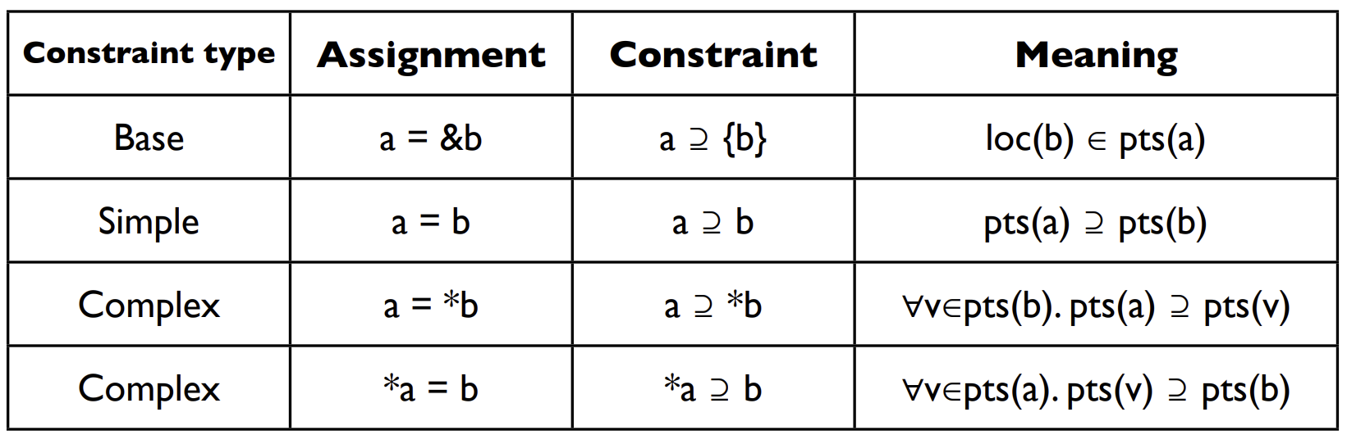
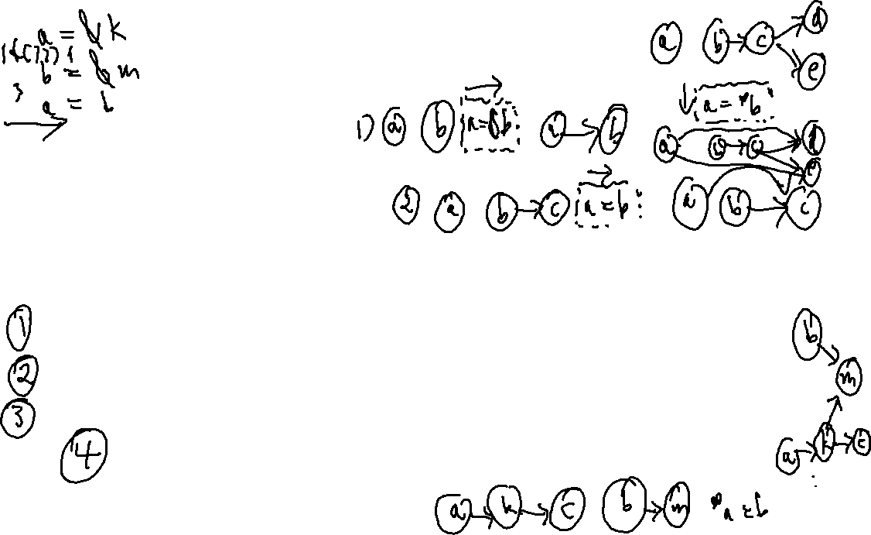
Subset Constraints
Andersen’s Analysis
A Flow-insensitive Algorithm
Each statement adds a constraint over the points-to sets
End up with a (solvable) system of constraints

Slide 21
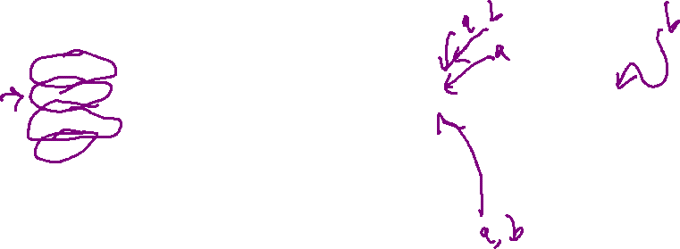
Subset Constraints
Andersen’s Analysis
A Flow-insensitive Algorithm
Each statement adds a constraint over the points-to sets
End up with a (solvable) system of constraints
Program
Constraints
Initial
Pass One
Pass Two
p = &a;
q = p;
p = &b;
r = p;
p ⊇ {a}
q ⊇ p
p ⊇ {b}
r ⊇ p
pts(p) = { }
pts(q) = { }
pts(r) = { }
pts(a) = { }
pts(b) = { }
pts(p) = { a,b }
pts(q) = { a }
pts(r) = { a,b }
pts(a) = { }
pts(b) = { }
pts(p) = { a,b }
pts(q) = { a,b }
pts(r) = { a,b }
pts(a) = { }
pts(b) = { }

Slide 22
Another Example
Andersen’s Analysis
A Flow-insensitive Algorithm
Each statement adds a constraint over the points-to sets
End up with a (solvable) system of constraints
Program
Constraints
Pass one
p = &a
q = &b
*p = q;
r = &c;
s = p;
t = *p;
*s = r;
p ⊇ {a}
q ⊇ {b}
*p ⊇ q
r ⊇ {c}
s ⊇ p
t ⊇ *p
*s ⊇ r
pts(p) = { }
pts(q) = { }
pts(r) = { }
pts(s) = { }
pts(t) = { } pts(a) = { }
pts(b) = { }
pts(c) = { }
a
b
c
a
b
b
,c

Slide 23
Another Example
Andersen’s Analysis
A Flow-insensitive Algorithm
Each statement adds a constraint over the points-to sets
End up with a (solvable) system of constraints
Program
Constraints
Pass one
Pass two
p = &a
q = &b
*p = q;
r = &c;
s = p;
t = *p;
*s = r;
p ⊇ {a}
q ⊇ {b}
*p ⊇ q
r ⊇ {c}
s ⊇ p
t ⊇ *p
*s ⊇ r
pts(p) = { }
pts(q) = { }
pts(r) = { }
pts(s) = { }
pts(t) = { } pts(a) = { }
pts(b) = { }
pts(c) = { }
pts(p) = { }
pts(q) = { }
pts(r) = { }
pts(s) = { }
pts(t) = { } pts(a) = { }
pts(b) = { }
pts(c) = { }
a
a
b
b
c
c
a
a
b
b
,c
b
,c
b
,c

Slide 24
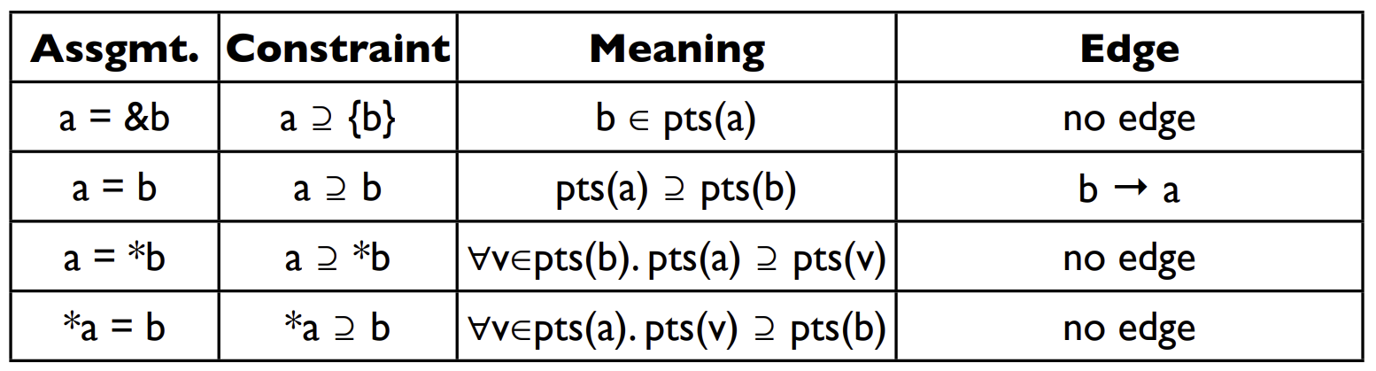
Solving Constraints
Andersen’s Analysis
Graph closure on the subset relation

Slide 25
Overhead
Andersen’s Analysis
Worst Case: Cubic Time
That’s not great!
Optimization: Cycle elimination
Detect and collapse SCCs in the points-to relation

Slide 26
An alternative Approach
STeensGard’s Analysis
Aim for Near-Linear-time points-to Analysis
Going to require us to reduce our search-space somewhat
Intuition: Equality constraints
Do away with the notion of subsets

Slide 27
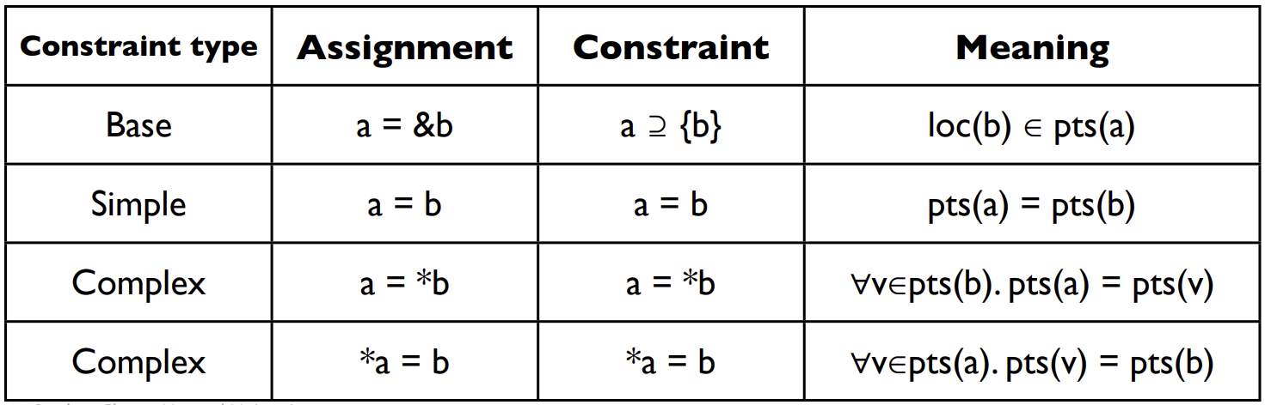
Equality Constraints
Steensgard’s Analysis

Slide 28
Equality Constraints
Steensgard’s Analysis
p = &a
p
a
p = &b
p
a,b
m = &p
m
p
a,b
r = *m
m
p
a,b
r
q = &c
m
p
a,b
r
q
c
m = &q
m
p,q
a,b,c
r

Slide 29
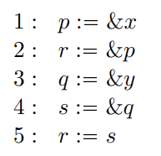
Comparing Analysis Results
Steensgard’s Analysis
Andersen’s
Steensgard’s
x
y
x
y
x
y
x,y
p
q
p
q
p,q
p,q
r
s
r
s
r
s
r
s

Slide 30
Wrap-up

Slide 31


Extending Dataflow
Control-Flow Graphs
Call Graphs
Call Targets
Pointer Analysis

Slide 32

Vibe Check
We’re Building a fully-operational Static Analysis
A tool capable of answering a host of questions about programs
Extend our analysis to Encapsulate features of non-toy programs

Slide 33
Extending Dataflow
We’re Building a fully-operational Static Analysis
A tool capable of answering a host of questions about programs
Extend our analysis to Encapsulate features of non-toy programs

Slide 34


Extending Dataflow

Slide 35
Extending Dataflow

Slide 36

Extending Dataflow
Control-Flow Graphs
Call Graphs
Call Targets
Pointer Analysis

Slide 37
Vibe Check
We’re Building a fully-operational Static Analysis

Slide 38
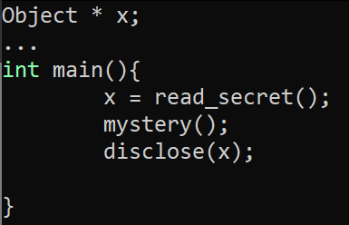
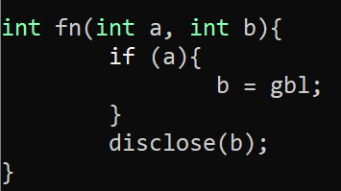

Back to Dataflow
Interprocedural Analysis
What are the (possible) values of a and gbl?
What is the effect of mystery on x’s taintedness?

