Slide 1
Exercise
Consider the CFG to the right, roughly equivalent to the C code below.
Indicate the value-set computed for *varJ at the entrance to L4 using the flow-sensitive saturation algorithm described in the last lecture
L1:
%varI = alloca i2
%varJ = alloca i2
store i2 -1, ptr %varI
store i2 0, ptr %varJ
br label %L2
%v1 = load i2, i2* %varI
%c = icmp slt i2 %v1, 1
br i1 %c, label %L3, label %L4
L2:
int2 i = -1;
int2 j = 0;
while (i < 1){
i++;
j = 1;
}
return i/j;
T
L3:
F
%v4 = load i2, ptr %varI
%v5 = add i2 %v4, 1
store i2 %v5, ptr %varI
br label %L2
L4:
%resJ = load i2, ptr %varJ
%resI = load i2, ptr %varI
%res = sdiv i2 %resI, %resJ
ret i2 %res

Slide 2
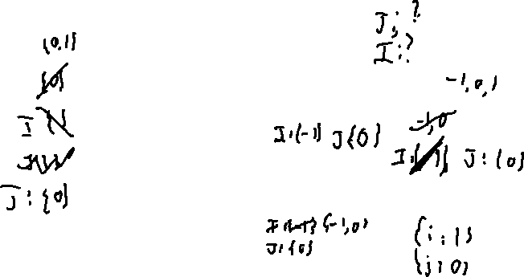
Exercise: Solution

Slide 3
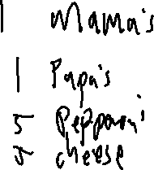
Administrivia and
Announcements
Test 1 is Friday!
Review Session tomorrow, 7 – 9, LEEP2 2420

Slide 4
Abstract interpretation
EECS 677: Software Security Evaluation
Drew Davidson

Slide 5

Last Time: Handling Loops
Review: Static Analysis
Extending our basic dataflow to loops
Problems
Circular data dependence
No obvious end-point (will the analysis halt?)
Introduce a TBD Value - ??? or ¯\_(ツ)_/¯
Ran analysis until fact-set saturation
Guaranteeing Saturation
Applying a transform is constant-time
The fact sets are finite
The fact sets never shrink
Perform an operation until it
stops making progress

Slide 6
Lecture Outline
Formalizing Saturation
Exploring Larger Programs
Abstract Domains

Slide 7
Fact Set Monotonicity
Dataflow Frameworks
{ 0, 1,-1,-2 }
What does it mean that a fact set
“Never Shrinks”?
Implicitly, partial ordering by set inclusion…
{1,-1,-2}
{0,-1,-2}
{0,1,-2}
{0,1,-1}
Merge operation (here, union) never moves down the partial ordering
Connecting to formal properties provides the guarantees we crave
{0,1}
{1,-1}
{0,-1}
{0,-2}
{1,-2}
{-1,-2}
{0}
{1}
{-1}
{-2}
{}

Slide 8

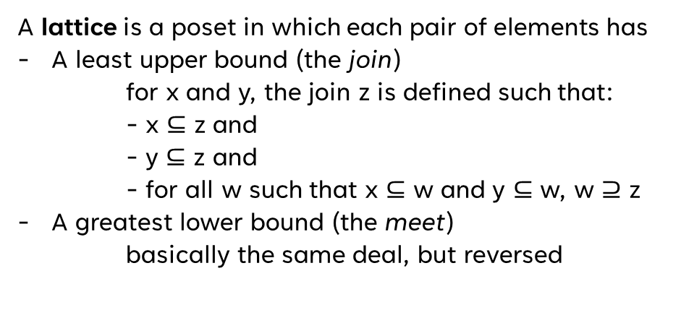

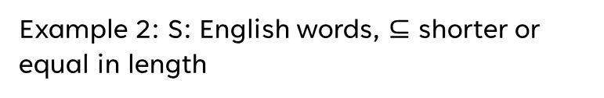

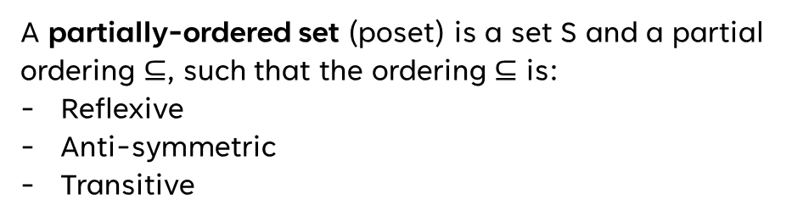
Domain Needs
Dataflow Frameworks
Some Basic Definitions
A partially-ordered set (poset) is a set S and a partial ordering $⊆$, such that the ordering $⊆$ is:
Reflexive
Anti-symmetric
Transitive
Example 1: S: English words, $⊆$ substring
Poset:
Lattice:
Example 2: S: English words, $⊆$ shorter or equal in length
A lattice is a poset in which each pair of elements has
A least upper bound (the join)
  for x and y, the join z is defined such that:
  - x $⊆$ z and
  - y $⊆$ z and
  - for all w such that x $⊆$ w and y $⊆$ w, w $⊇$ z
A greatest lower bound (the meet)
basically the same deal, but reversed
Poset:
Lattice:
Example 3: S: integers, $⊆$ as lte
Poset:
Lattice:
No upper bound
lower than z
z is actually an upper bound
Example 4: S: integers, $⊆$ as lt
Poset:
Lattice:
A complete lattice is a lattice in which all subsets have a meet and join
Example 5: S: set of all sets of letters, $⊆$ is subset
Poset:
Lattice:

Slide 9

Fact datatype NEEDs
Dataflow Frameworks
Formal(ish) requirements
poset
A fact datatype (ideally of unbounded size)
An ordering that indicates progress
Unique solution
A guarantee of a finite number of steps to hit the maximum value
An update step that never loses progress
Try-outs
poset
Lattice
Complete lattice

Slide 10
Fact datatype NEEDs
Dataflow Frameworks
Formal(ish) requirements
Lattice
A fact datatype (ideally of unbounded size)
Poset with a least upper bound and a greatest lower bound
An ordering that indicates progress
Unique solution
A guarantee of a finite number of steps to hit the maximum value
An update step that never loses progress
Try-outs
poset
Lattice
Complete lattice

Slide 11

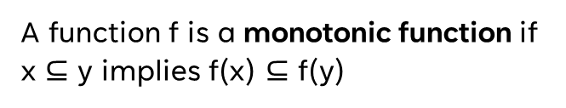
Function NEEDs
Dataflow Frameworks
Some Basic Definitions
A function f is a monotonic function if x $⊆$ y implies f(x) $⊆$ f(y)
An element z is a fixpoint of f iff z = f(z)

Slide 12
Function NEEDs
Dataflow Frameworks
Example
$$f\left(x\right)=x ∪\{ b \}$$
Some Basic Definitions
$\{b\}$ is a fixpoint of f
$$f\left(\{b\}\right)=\{ b \}$$
A function f is a monotonic function if x $⊆$ y implies f(x) $⊆$ f(y)
$$f\left(\{a\}\right)=\{ a, b \}$$
$\{a\}$ is not a fixpoint of f
$$f\left(\{a,b\}\right)=\{ a,b \}$$
$\{a,b\}$ is a fixpoint of f
An element z is a fixpoint of f iff z = f(z)
$f(f\left(\left\{a\right\}\right))$ is a fixpoint of f
$f(f\left(any set\right))$ is a fixpoint of f

Slide 13
Lecture Outline
Formalizing Saturation
Exploring Larger Programs
Abstract Domains

Slide 14
Example
Consider the CFG to the right, roughly equivalent to the C code below.
Indicate the value-set computed for *varJ at the end of L6 using the flow-sensitive saturation algorithm described in the last lecture
L1:
%varI = alloca i32
%varJ = alloca i32
store i32 -1, ptr %varI
store i32 0, ptr %varJ
br label %L2
%v1 = load i32, i2* %varI
%c = icmp slt i32 %v1, 12345678
br i1 %c, label %L3, label %L4
L2:
int32 i = -1;
int32 j = 0;
while (i > 12345678){
i++;
}
return 1/j;
T
L3:
F
%v4 = load i32, ptr %varI
%v5 = add i32 %v4, 1
store i32 %v5, ptr %varI
br label %L2
L4:
%iX = load i32, ptr %varI
%jX = load i32, ptr %varJ
%res = sdiv i32 %iX, %jX
ret i2 %res

Slide 15


Example
L1:
%varI = alloca i32
%varJ = alloca i32
store i32 -1, ptr %varI
store i32 0, ptr %varJ
br label %L2
%v1 = load i32, i2* %varI
%c = icmp slt i32 %v1, 12345678
br i1 %c, label %L3, label %L4
L2:
T
L3:
F
%v4 = load i32, ptr %varI
%v5 = add i32 %v4, 1
store i32 %v5, ptr %varI
br label %L2
L4:
%iX = load i32, ptr %varI
%jX = load i32, ptr %varJ
%res = sdiv i32 %iX, %jX
ret i2 %res

Slide 16

Tmi – Too much Information!
Abstract Interpretation
L1:
%varI = alloca i32
%varJ = alloca i32
store i2 -1, ptr %varI
store i2 0, ptr %varJ
br label %L2
Eventually we’ll reach saturation…
By the time we’re all old and withered!
%v1 = load i2, i2* %varI
%c = icmp slt i2 %v1, 12345678
br i1 %c, label %L3, label %L4
L2:
T
L3:
F
%v4 = load i2, ptr %varI
%v5 = add i2 %v4, 1
store i2 %v5, ptr %varI
br label %L2
L4:
%res = load i2, ptr %varJ
ret i2 %res

Slide 17
Tmi – Too much Information!
Abstract Interpretation
L1:
%varI = alloca i32
%varJ = alloca i32
store i2 -1, ptr %varI
store i2 0, ptr %varJ
br label %L2
Eventually we’ll reach saturation…
By the time we’re all old and withered!
%v1 = load i2, i2* %varI
%c = icmp slt i2 %v1, 12345678
br i1 %c, label %L3, label %L4
L2:
T
L3:
F
%v4 = load i2, ptr %varI
%v5 = add i2 %v4, 1
store i2 %v5, ptr %varI
br label %L2
L4:
%res = load i2, ptr %varJ
ret i2 %res

Slide 18
Lecture Outline
Formalizing Saturation
Exploring Larger Programs
Abstract Domains

Slide 19

Using the formalisms
Dataflow Frameworks
{ 0, 1,-1,-2 }
What does it mean that a fact set
“Never Shrinks”?
Implicitly, partial ordering by set inclusion…
{1,-1,-2}
{0,-1,-2}
{0,1,-2}
{0,1,-1}
Merge operation (here, union) never moves down the partial ordering
Connecting to formal properties provides the guarantees we crave
{0,1}
{1,-1}
{0,-1}
{0,-2}
{1,-2}
{-1,-2}
{0}
{1}
{-1}
{-2}
{}

Slide 20

A Very Approximate Lattice
Abstract Interpretation
Abstract Domain of Signs
{-2, -1, 0, 1}
num
{-2, 0, 1}
{-2, -1, 0}
{-1, 0, 1}
{-2, -1, 1}
pos
zero
neg
{-2, -1}
{-2, 0}
{-1, 0}
{-2, 1}
{-1, 1}
{0, 1}
$$∅$$
{-2}
{-1}
{0}
{1}

Slide 21
Analysis With Abstract Domain of signs
Abstract Interpretation
L1:
%varI = alloca i32
%varJ = alloca i32
store i2 -1, ptr %varI
store i2 0, ptr %varJ
br label %L2
%v1 = load i2, i2* %varI
%c = icmp slt i2 %v1, 12345678
br i1 %c, label %L3, label %L4
L2:
T
L3:
F
%v4 = load i2, ptr %varI
%v5 = add i2 %v4, 1
store i2 %v5, ptr %varI
br label %L2
L4:
%res = load i2, ptr %varJ
ret i2 %res

Slide 22
A LESS-Approximate Lattice
Abstract Interpretation
Abstract Domain of Signs
{-2, -1, 0, 1}
num
{-2, 0, 1}
{-2, -1, 0}
{-1, 0, 1}
{-2, -1, 1}
≥ zero
≤ zero
pos
zero
neg
{-2, -1}
{-2, 0}
{-1, 0}
{-2, 1}
{-1, 1}
{0, 1}
$$∅$$
{-2}
{-1}
{0}
{1}

Slide 23
Abstract Domains in Practice
Static Analysis
Intervals
Property Existence
“Singleton Integer Sets”
You know the number, or you don’t
You know a concrete range
A property does or does not hold

Slide 24
Lecture Outline
Enhancing Dataflow analysis
Lattices
Abstract Interpretation

Slide 25
Section Summary
Static Analysis
Static Analysis gives us an important guarantee
Anything that isn’t crystal clear to a static analysis tool probably isn’t clear to your fellow programmers, either. The classic hacker disdain for “bondage and discipline languages” is short-sighted – the needs of large, long-lived, multi-programmer projects are just different than the quick work you do for yourself.
- John Carmack's Static Code Analysis post
Completeness of bug finding / Soundness of verification

