Slide 1
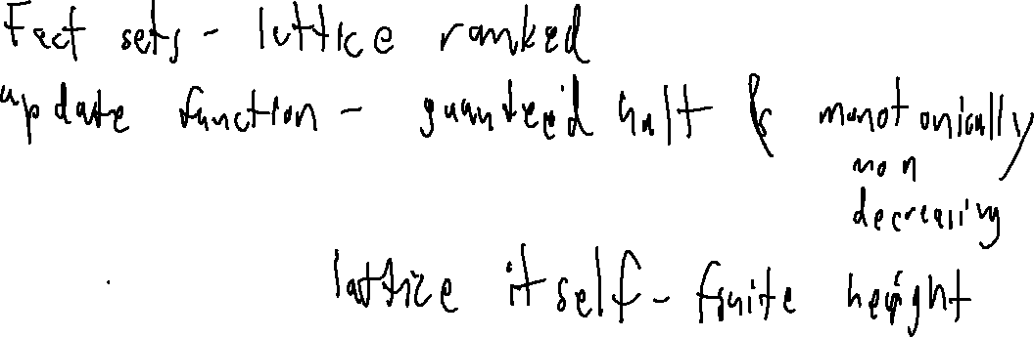
Exercise
Abstract Interpretation Review
We formalized dataflow analysis by ensuring mathematical properties of our dataflow fact sets and our dataflow update procedure. What property of the fact sets and what property of the update function guaranteed termination?

Slide 2
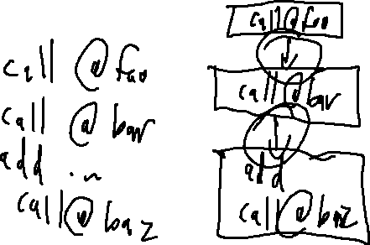
Administrivia and
Announcements
P2 Clarifications
Calls DO break blocks
Calls DO NOT have edges to the callee
Calls DO have a successor to the return site
Comments DO NOT need to be parsed

Slide 3
Administrivia and
Announcements
Q1 Clarifications
Grades incoming

Slide 4
Administrivia and
Announcements
P2 delayed – now due WEDNESDAY

Slide 5
Formalizing Dataflow
Review: Abstract Interpretation
Guarantees we’d like to extract from our analysis Engine
Termination
Completeness (in the analysis sense)
Precision
Sufficient Conditions
Overapproximate, monotonic update functions
A finite-height, complete lattice

Slide 6

Practical Considerations
Review: Abstract Interpretation
Guarantees we’d like to extract from our analysis Engine
Termination
Completeness (in the analysis sense)
Precision
Problem: lattice may be very tall!
Sufficient Conditions
Overapproximate, monotonic update functions
A finite-height, complete lattice
Note: finiteness NOT implied by a complete lattice

Slide 7

The Abstract Domain
Review: Abstract Interpretation
Sufficient Conditions
Overapproximate, monotonic update functions
A finite-height, complete lattice
num
Track “properties” of the data, instead of concrete values
neg
zero
pos
More workable lattice
unk

Slide 8
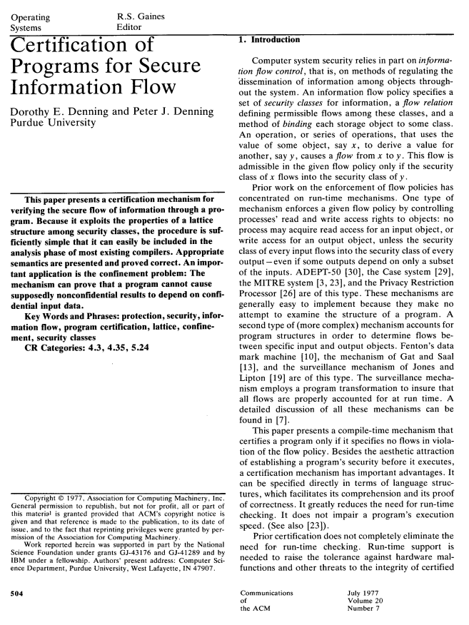
Administrivia and
Announcements
Let’s read a paper!

Slide 9
Class Progress
We have a good form of analysis!
Let’s actually apply it

Slide 10
Implementing Transformers
information Flow
From Concept to Code
Facts are altered at the instruction level
class AddInstr : public AbstractInstruction {
public:
Operand lhsOp;
Operand rhsOp;
virtual Fact apply(FactSet fs, Analysis * a){
auto lhsFact = fs.get(lhsOp->address));
auto rhsFact = fs.get(rhsOp->address);
auto lattice = a.getTypeLattice(lhsOp.type);
if (lhsFact == lattice->pos){
if (rhsFact == lattice->zero){
return lattice->pos;
}
}
}
};

Slide 11
Implementing Transformers
information Flow
From Concept to Code
Dealing with Conditionals

Slide 12
Information Flow
EECS 677: Software Security Evaluation
Drew Davidson

Slide 13
Lecture Outline
Application Analysis
Information Flow
Practical Deployment

Slide 14

The semantic Gap
information Flow
For Computer Science, our objects of interest are programs
Generic Definition
Semantic gap: “The difference between descriptions of an object by different linguistic representations”
For Computer Science, our focus is on different symbolic / abstract representations

Slide 15
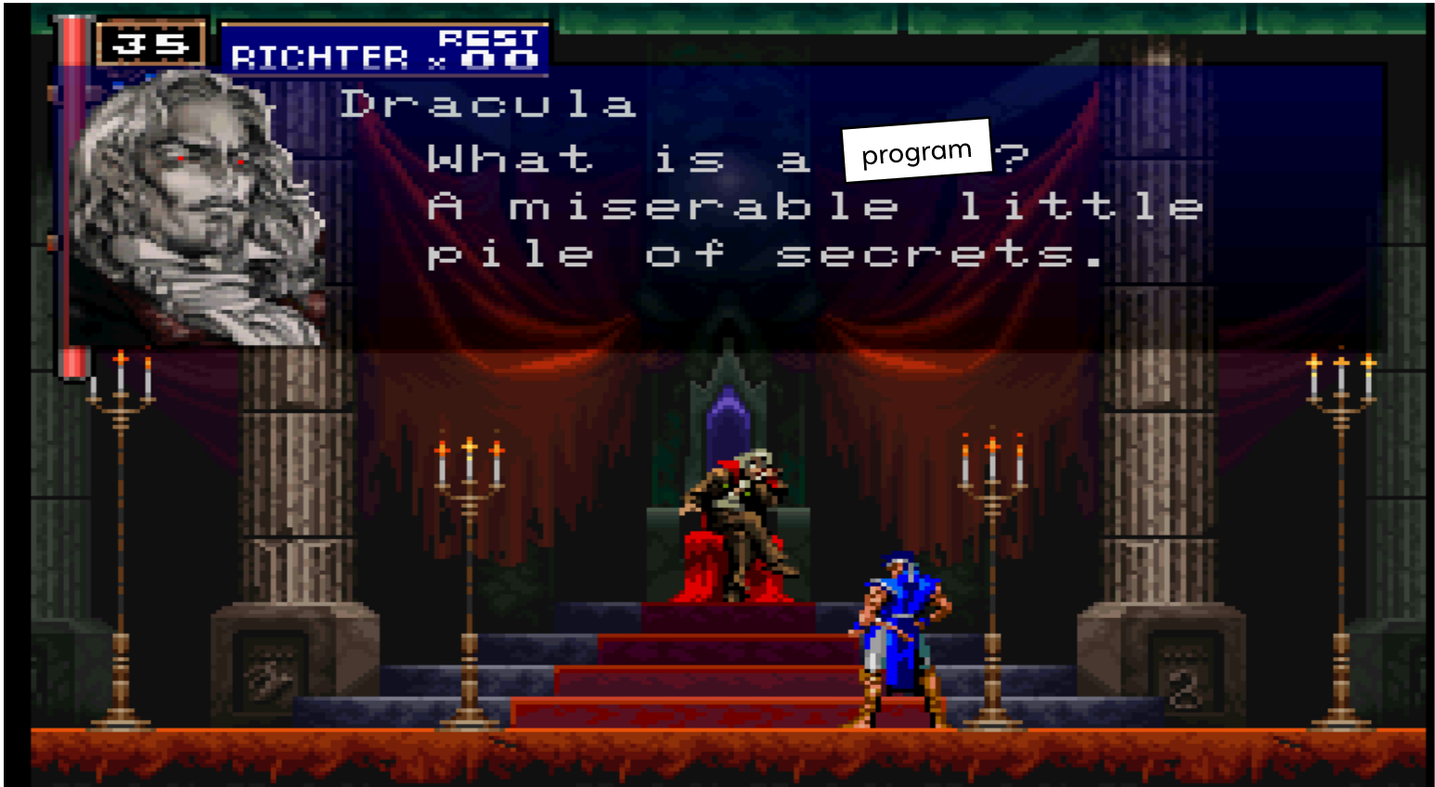
The semantic Gap
information Flow
Semantic gap: “The difference between descriptions of an object by different linguistic representations”
What Is a program?

Slide 16
The Semantic Gap
information Flow
Semantic gap: “The difference between descriptions of an object by different linguistic representations”
What Is a program?
A miserable little pile of secrets
- Dracula
A sequence of transformations
over memory configurations
- Hardware
A memory region, system calls, and a set of privileges
- Operating system

Slide 17
Application-Level Analysis
information Flow
Focus on the behavior / Semantics of the program
Hopefully the right level of granularity for understanding a program’s security
Language-Based Security
Definition - a set of techniques to strengthen
the security of applications by using the properties of
programming languages
“Hey, we’ve got all of these great tools to understand programs
for the sake of correctness / optimization, they’d work for
security too!”

Slide 18
Lecture Outline
Application Analysis
Information Flow
Practical Deployment

Slide 19

Recall: The CIA Triad
Practical Considerations
“The primary focus of information security” - Wikipedia
Confidentiality – The control of access to data
Integrity – The consistency, accuracy and trustworthiness
of data over its entire lifecycle
Availability – The degree of consistent accessibility of data

Slide 20
Recall: The CIA Triad
Practical Considerations
“The primary focus of information security” - Wikipedia
Confidentiality – The control of access to data
(imperfect) formulations
As dataflow properties
Integrity – The consistency, accuracy and trustworthiness
of data over its entire lifecycle
Availability – The degree of consistent accessibility of data

Slide 21
Recall: The CIA Triad
Practical Considerations
Sensitive information in the program
touches an untrusted destination
Confidentiality – The control of access to data
(imperfect) formulations
As dataflow properties
Integrity – The consistency, accuracy and trustworthiness
of data over its entire lifecycle
Availability – The degree of consistent accessibility of data
Untrusted data coming into the program
reaches a sensitive computation

Slide 22
Towards formalizing C and I
information Flow
Simple information “classes”
Divide program data and functionality into “high security” and “low security”
Confidentiality: high security data should not influence low security functionality
Integrity: low security data should not influence high security functionality

Slide 23
Towards formalizing C and I
information Flow
Simple information “classes”
Divide program data and functionality into “high security” and “low security”
Confidentiality: high security data should not influence low security functionality
string loc = getUserLocation();
if (inKansas(loc)){
print “Watch out for tornados!”;
}
writeToNetwork(loc);
Integrity: low security data should not influence high security functionality
string netVal = readFromNetwork();
setPassword(“root”, netVal);

Slide 24
Sources and Sinks
information Flow
Simple information “classes”
Divide program data and functionality into “high security” and “low security”
Confidentiality: high security data should not influence low security functionality
string loc = getUserLocation();
if (inKansas(loc)){
print “Watch out for tornados!”;
}
writeToNetwork(loc);
Integrity: low security data should not influence high security functionality
string netVal = readFromNetwork();
setPassword(“root”, netVal);

Slide 25
Sources and sinks
information Flow
A source operation – an operation that generates data
A sink operation – an operation that consumes data
A flow – a program path segment that begins at a source and ends at a sink
Confidentiality: high security data should not influence low security functionality
High-security source
string loc = getUserLocation();
if (inKansas(loc)){
print “Watch out for tornados!”;
}
writeToNetwork(loc);
Low-security sink
Integrity: low security data should not influence high security functionality
Low-security source
string netVal = readFromNetwork();
setPassword(“root”, netVal);
High-security sink

Slide 26
Find the Dataflow!
information Flow
A source operation – an operation that generates data
A sink operation – an operation that consumes data
A flow – a program path segment that begins at a source and ends at a sink
Confidentiality: high security data should not influence low security functionality
High-security source
string loc = getUserLocation();
if (inKansas(loc)){
print “Watch out for tornados!”;
}
writeToNetwork(loc);
Low-security sink
Integrity: low security data should not influence high security functionality
Low-security source
string netVal = readFromNetwork();
setPassword(“root”, netVal);
High-security sink

Slide 27
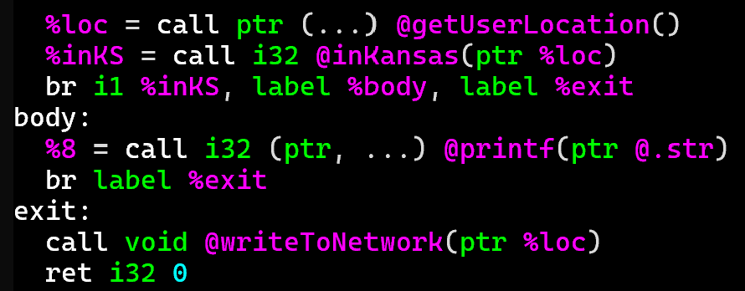
Find the Dataflow!
information Flow
High-security source
string loc = getUserLocation();
if (inKansas(loc)){
print “Watch out for tornados!”;
}
writeToNetwork(loc);
Low-security sink

Slide 28
Find the Dataflow!
information Flow
High-security source
Fact Lattice (confidentiality)
string loc = getUserLocation();
if (inKansas(loc)){
print “Watch out for tornados!”;
}
writeToNetwork(loc);
┬
Secret
Low-security sink
Public
┴
Loc: Public, inKS: Public
Loc: Secret, inKS: Secret
Loc: Secret, inKS: Secret
Loc: Secret, inKS: Secret

Slide 29
Lecture Outline
Application Analysis
Information Flow
Practical Deployment

Slide 30
Source/Sink Identification
practical Considerations
How do we know what should be a source and a sink?
Mind that semantic gap!
Idea #1 – Programmer annotations
Idea #2 – Build annotations into the system
Idea #3 – something something inferencing handwave

Slide 31
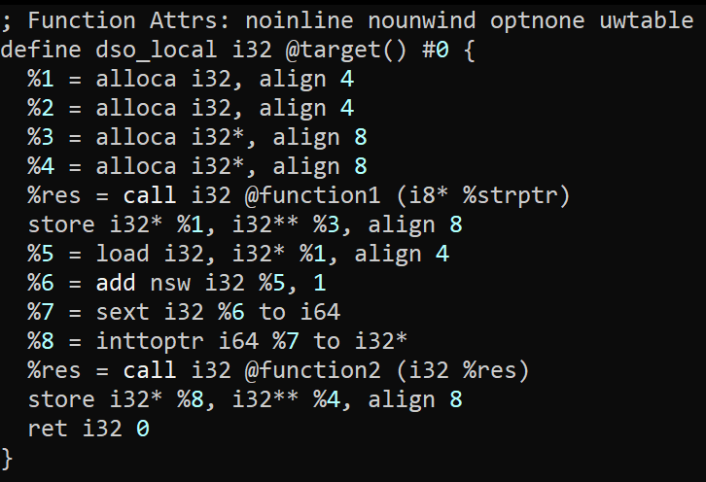
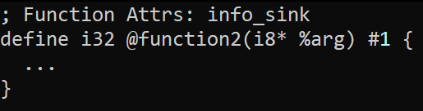
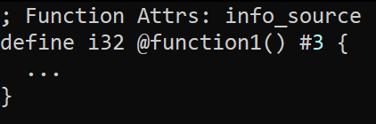
Programmer Annotations
practical Considerations – source/Sink Identification
Basic Idea
Ask the programmer to say what’s a source and sink
Auxiliary file of information
Inline annotations within the program

Slide 32
Programmer Annotations
practical Considerations – source/Sink Identification
The utility of programmer effort
A frequent struggle in analysis
Issues of human intervention
Ultimately, we’re trying to solve a limitation of human behavior
Analysis Utility
Incorrect annotations
Laziness
Reactive SSE goes out the window
Analyst Effort
A totally-made-up conceptual graph

Slide 33
Built-In “Annotations”
practical Considerations – source/Sink Identification
Enrich the system with notions of behavior
Platform developer bakes capabilities into the system
Analysis developer retrofits annotations into the analysis engine
Issues of Semantic Gap again
Can be quite hard to predict what becomes security-relevant
Analysis engine needs to be kept in lockstep with the system

Slide 34
Inferencing
practical Considerations – source/Sink Identification
You could try to automatically discover “Sourcelike” and “Sinklike” functions
Maybe we can detect UI asking for credit card?
Maybe we can write an analysis that looks for even more fundamental core behavior?
Machine learning??
?!?!
?!?!?!?!?!?!?!?!?!?!?!?!?!?!?!?!?!?!

Slide 35

Case Study: Android Permissions
practical Considerations – source/Sink Identification
Mobile phones sure collect a lot of private information!
Maybe that information rises to the level of confidentiality?
Maybe this is a good application of an information flow analysis?

Slide 36
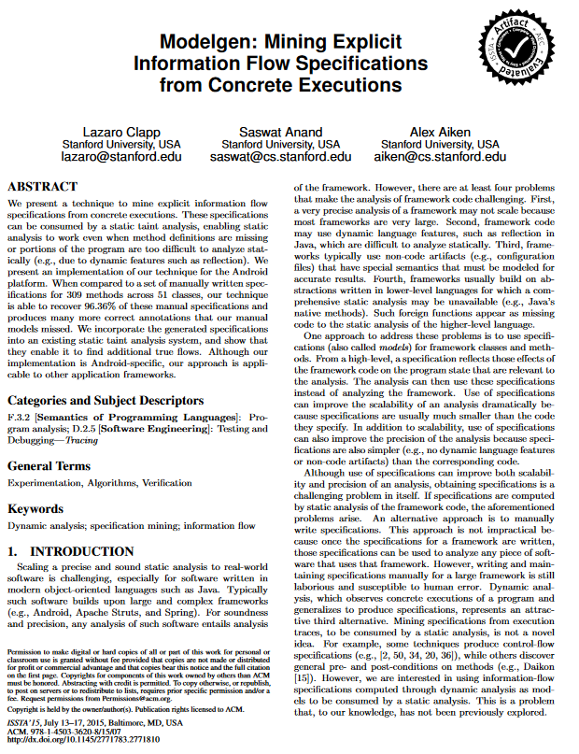
Case Study: Android Permissions
practical Considerations – source/Sink Identification
Hybrid case of Built-In annotations
System has a built-in capability model
Surprisingly hard to map those capabilities to system functions
Modelgen
- Manually annotate capabilities as sources or sinks
- Do a dynamic analysis of the Android system to discover capabilities uses
- Do a static dataflow analysis of the Android system to discover capabilities uses

Slide 37
Granularity of analysis
Practical Considerations – Precision/Sanitization
Data is Complex!
What happens when a field of a struct is tainted?
What happens when an index of an array is tainted?

Slide 38
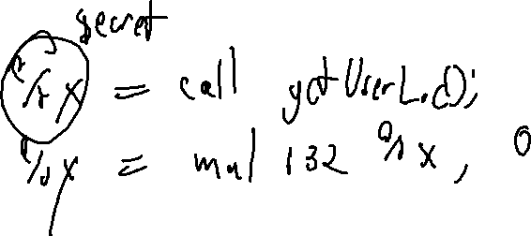
Sanitization
Practical Considerations – Precision/Sanitization
We also want to provide some exceptions to the flow rules
i.e. tainted data is encrypted

Slide 39
Wrap-up

Slide 40
Next Time
Evading analysis

