Slide 1
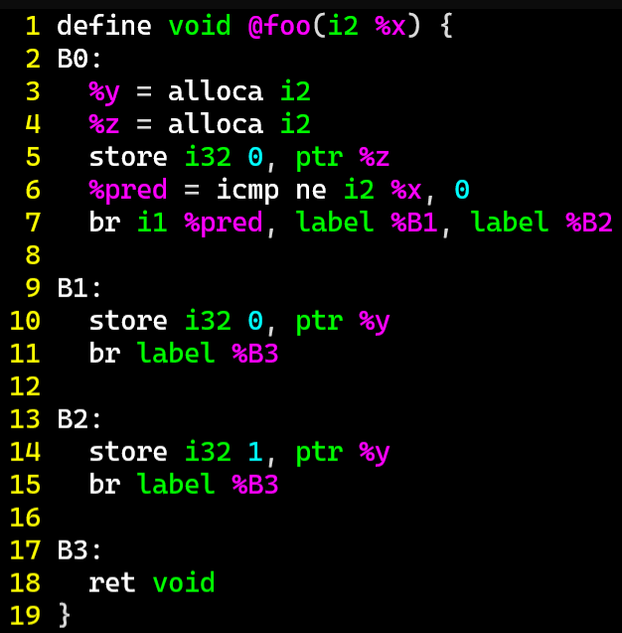
Exercise
DataFlow Review
Fill out the value sets that a flow-sensitive dataflow analysis would assign
 | x | *y | *z
B0 | {0,1,2,3} | {0,1,2,3} | {0,1,2,3}
B0→B1 | {1,2,3} | {0,1,2,3} | {0}
B0→B2 | {0} | {0,1,2,3} | {0}
B1 | {1,2,3} | {0,1,2,3} | {0}
B2 | {0} | {0,1,2,3} | {0}
B1→B3 | {1,2,3} | {0} | {0}
B2→B3 | {0} | {1} | {0}
B3 | {0,1,2,3} | {0,1} | {0}
exit | {0,1,2,3} | {0,1} | {0}

Slide 2
Exercise Solution
DataFlow Review
 | x | *y | *z
B0
B0→B1
B0→B2
B1
B2
B1→B3
B2→B3
B3
exit

Slide 3
Administrivia and
Announcements
Test 1 next Friday
- Review Session TBA

Slide 4
Dataflow Fixpoints
EECS 677: Software Security Evaluation
Drew Davidson

Slide 5
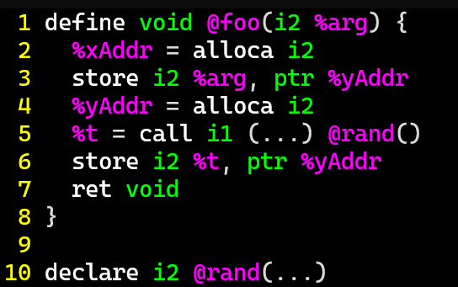
Last Time: Value Set Analysis
Review: Dataflow
Conservatively Track the Possible set of values taken
*xAddr = {0,1,2,3}
*yAddr = {0,1,2,3}
,
This approach is a complete over-approximation

Slide 6
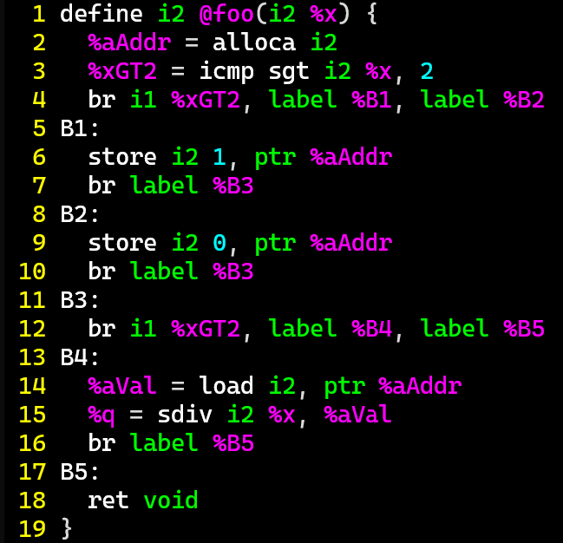
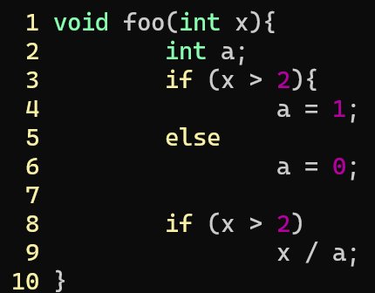
Last Time: Flow Sensitivity
Review: Dataflow
Account for Program Flow, not paths
: When control flow merges, merge the value sets
 | x | xGT2 | *aAddr
Entry
E→B1
B1
E→B2
B2
B1→B3
B2→B3
B3
B3→B4
B4
B3→B5
B4→B5
B5
exit
{0,1,2,3}
{0,1,2,3}
{3}
{1}
{0,1,2,3}
{3}
{1}
{0,1,2,3}
{0,1,2}
{0}
{0,1,2,3}
{0,1,2}
{0}
{0,1,2,3}
{3}
{1}
{1}
{0,1,2}
{0}
{0}
{0,1,2,3}
{0,1}
{0,1}
{0,1,2,3}
{1}
{0,1}
{0,1,2,3}
{1}
{0,1}
{0,1,2,3}
{0}
{0,1}
{0,1,2,3}
{1}
{1}
{0,1,2,3}
{0,1}
{1}
{0,1,2,3}
{0,1}
{0,1}

Slide 7

Loops Are Tough to Handle!
Review: Dataflow Analysis
Issues with Loops
Generate lots of paths
Cyclic data dependency

Slide 8
Lecture Outline
Handling cyclic dependency
Termination
Handling large value sets

Slide 9

A word of Caution
Dataflow Analysis
We need to build up a lot of interlocking machinery for a “real” flow-sensitive analysis
I’ll present a simplified algorithm here with some subtle problems, which we’ll fix up next time

Slide 10
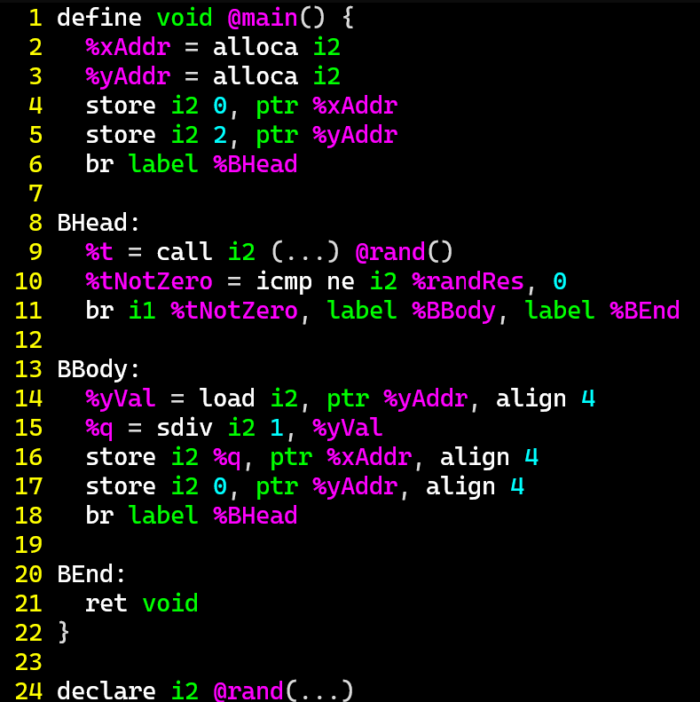
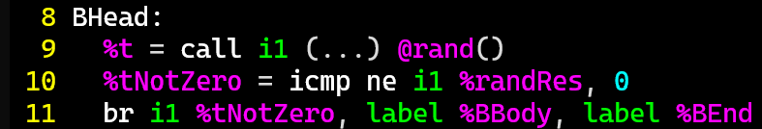
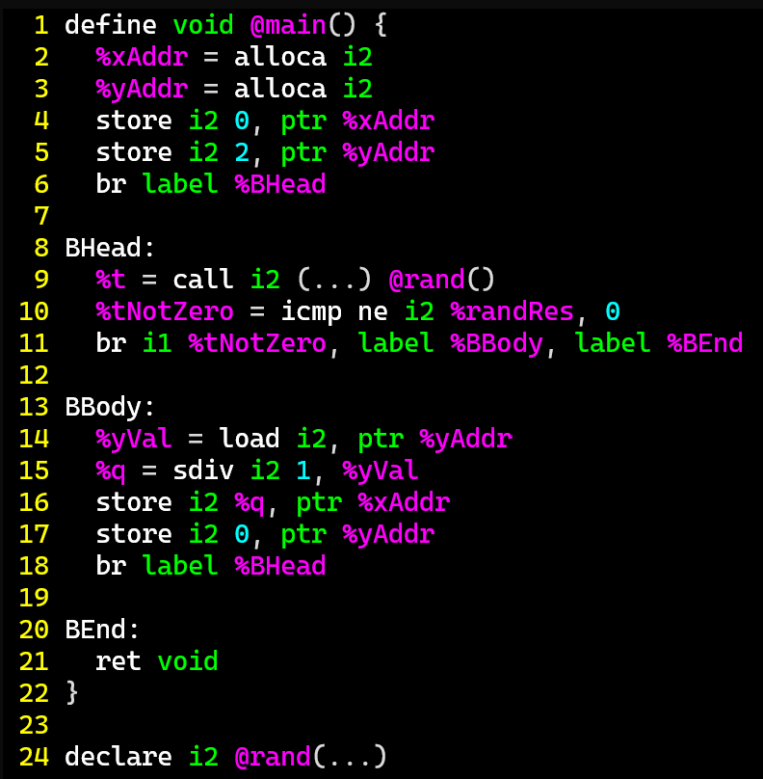
Cyclic Analysis
Dataflow Analysis
 | *x | *y | t
(entry)
(entry)→BHead
BHead
BHead→BBody
BHead→BEnd
BBody
BBody→BHead
BEnd
(exit)
{0,1,2,3}
{0,1,2,3}
{0}
{2}
{0}
{2}
{0,2}
{0}
{2}
{1}
{0,2}
{0}
{2}
{0}
1. int2 x = 0;
2. int2 y = 2;
3. int1 t;
4. while (t=rand()){
5. x = 1 / y;
6. y = 0;
7. }
8. return;
{0,2}
{0}
{2}
{1}
{0,2}
???
{ }
???
{ }
{ }
{0}
{0}
{1}
{0}
{2}
{0}
{0,2}

Slide 11
Cyclic Analysis: Initialization
Dataflow Analysis
Start every Value-Set with the “empty” value
Value will eventually be updated
Is exploring every edge enough?
No!

Slide 12
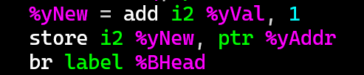
Cyclic Analysis
Dataflow Analysis
 | *x | *y | t
(entry)
(entry)→BHead
BHead
BHead→BBody
BHead→BEnd
BBody
BBody→BHead
BEnd
(exit)
{0,1,2,3}
{0,1,2,3}
{0}
{2}
{0}
{2}
{2,3}
{2,3,0}
{0}
{2}
{1}
{2,3}
{2,3,0}
{0}
{2}
{0}
{2,3}
1. int2 x = 0;
2. int2 y = 2;
3. int1 t;
4. while (t=rand()){
5. x = 1 / y;
6. y = 0;
7. }
8. return;
{0}
{2}
{1}
{2,3}
{2,3,0}
???
{ }
???
{ }
{ }
{0}
{3}
{3,0}
{1}
{0}
{2}
{0}
y+1;
{2,3}

Slide 13

Cyclic Analysis
Dataflow Analysis
 | *x | *y | t
(entry)
(entry)→BHead
BHead
BHead→BBody
BHead→BEnd
BBody
BBody→BHead
BEnd
(exit)
{0,1,2,3}
{0,1,2,3}
{0}
{2}
{0}
{2}
{2,3}
{0}
{2}
{1}
{2,3}
{0}
{2}
{0}
{2,3}
1. int2 x = 0;
2. int2 y = 2;
3. int1 t;
4. while (t=rand()){
5. x = 1 / y;
6. y = 0;
7. }
8. return;
{0}
{2}
{1}
{2,3}
???
{ }
???
{ }
{ }
{0}
{3}
{1}
{0}
{0}
{0}
y+1;
{2,3}

Slide 14
Lecture Outline
Handling cyclic dependency
Termination
Handling large value sets

Slide 15
When to Stop?
Dataflow Analysis
 | *x | *y | t
(entry)
(entry)→BHead
BHead
BHead→BBody
BHead→BEnd
BBody
BBody→BHead
BEnd
(exit)
{0,1,2,3}
{0,1,2,3}
{0}
{2}
{0}
{2}
{0}
{2}
{1}
{0}
{2}
{0}
1. int2 x = 0;
2. int2 y = 2;
3. int1 t;
4. while (t=rand()){
5. x = 1 / y;
6. y = y+1;
7. }
8. return;
{0}
{2}
{1}
???
{ }
???
{ }
{3}
{ }
{0}
{1}
{0}
{2}
{0}

Slide 16
When to Stop?
Dataflow Analysis
 | *x | *y | t
(entry)
(entry)→BHead
BHead
BHead→BBody
BHead→BEnd
BBody
BBody→BHead
BEnd
(exit)
{0,1,2,3}
{0,1,2,3}
{0}
{2}
{0}
{2}
{2,3}
{2,3,0}
{1}
{2,3,0,1}
{0}
{2}
{2,3}
{2,3,0}
{1}
{2,3,0,1}
{0}
{2}
{2,3}
{2,3,0}
{0}
{2,3,0,1}
1. int2 x = 0;
2. int2 y = 2;
3. int1 t;
4. while (t=rand()){
5. x = 1 / y;
6. y = y+1;
7. }
8. return;
{0}
{2}
{2,3}
{2,3,0}
{1}
{2,3,0,1}
???
{ }
???
{ }
{3}
{3,0}
{ }
{0}
{3,0,1}
{3,0,1,2}
{1}
{0}
{2}
{2,3}
{2,3,0}
{0}
{2,3,0,1}

Slide 17

Analysis Progress
Static Analysis: Control Flow Graphs
Analysis Ends when the fact sets reach saturation
No additional elements will ever be added
When your fact sets couldn’t
possibly hold any more data

Slide 18
FixED-Points
Static Analysis: Control Flow Graphs
A Fixed-Point (AKA fixpoint, fixed point)
A value that does not change under a given transformation
Our value-set analysis WILL have Facts that reach a Fixed-point
Why?
Finite set of configurations over INT32s
Data transforms only add data to fact sets

Slide 19
Lecture Outline
Breaking cyclic dependency
Termination
Handling large value sets

Slide 20
When to Stop?
Dataflow Analysis
 | *x | *y | t
(entry)
(entry)→BHead
BHead
BHead→BBody
BHead→BEnd
BBody
BBody→BHead
BEnd
(exit)
{0,1,2,3}
{0,1,2,3}
{0}
{2}
{0}
{2}
{2,3}
{2,3,0}
{0}
{2}
{1}
{2,3}
{2,3,0}
{0}
{2}
{0}
{2,3}
1. int2 x = 0;
2. int2 y = 2;
3. int1 t;
4. while (t=rand()){
5. x = 1 / y;
6. y = y+1;
7. }
8. return;
{0}
{2}
{1}
{2,3}
{2,3,0}
???
{ }
???
{ }
{ }
{0}
{3}
{3,0}
{1}
{0}
{0}
{0}
{2,3}

Slide 21
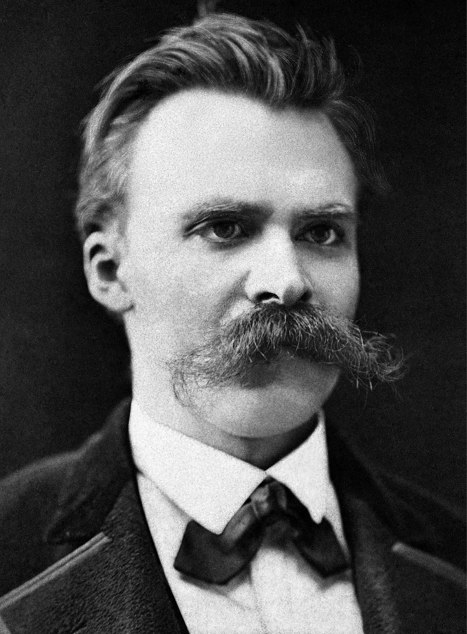
Does our Analysis Terminate?
Abstract Interpretation
We’ve spent some time on some uncomfortable truths:
Programs are often full of subtle bugs / vulnerabilities
It is effectively impossible to tell if an arbitrary program terminates
Bad news: our analysis engine in a program
What assurance do we have that our algorithm terminates as it analyzes an unknown / untrusted program?
“Whoever fights monsters should see to it that in the process he does not become a monster. And when you look long into an abyss, the abyss also looks into you.”
- Friedrich Nietzsche

Slide 22

Guaranteeing halting
Fixpoints
terminate when we all value sets saturate
Guarantee Saturation
Ensure the abstract values never shrink
Ensure the set of abstract values is finite

Slide 23
Summary
Abstract Interpretation
terminate when we all value sets saturate
Guarantee Saturation
Ensure the abstract values never shrink
Ensure the set of abstract values is finite

Slide 24
Next Time
Abstract Interpretation
terminate when we all value sets saturate
Guarantee Saturation
Ensure the abstract values never shrink
Ensure the set of abstract values is finite
Dealing with reality
Keeping abstract value domains manageable
Getting to saturation faster

Slide 25
Next Time
Wrap Up
Dealing with reality
Getting to saturation faster
Ensure the set of abstract values is finite

Slide 26
Formalizing Termination
Dataflow Frameworks
{00,01,10,11}
Value-Set “Rank”
(2-bit computer)
{01,10,11}
{00,10,11}
{00,01,11}
{00,01,10}
{00,01}
{01,10}
{00,10}
{00,11}
{01,11}
{10,11}
{00}
{01}
{10}
{11}
?

Slide 27
Lecture END!
Described some of the issues and Fixes for dataflow in the presence of loops

