Slide 1
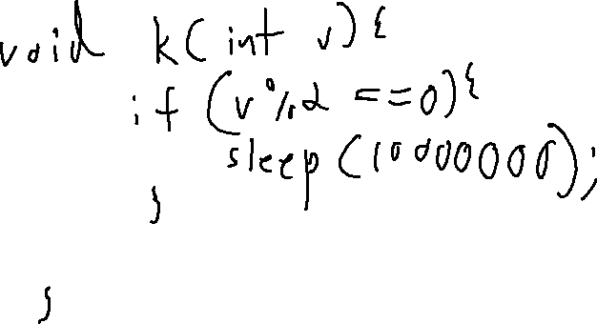
Exercise
SIDE Channel Review
Write your name and answer the following on a piece of paper
Provide an instance of a function that has a sensitive argument v and leaks a bit of v via a timing side channel

Slide 2
Exercise Solution
SIDE Channel Review

Slide 3
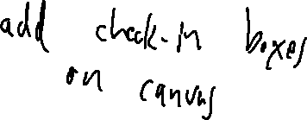
Administrivia and
Announcements

Slide 4
Dependence Relations
EECS 677: Software Security Evaluation
Drew Davidson

Slide 5
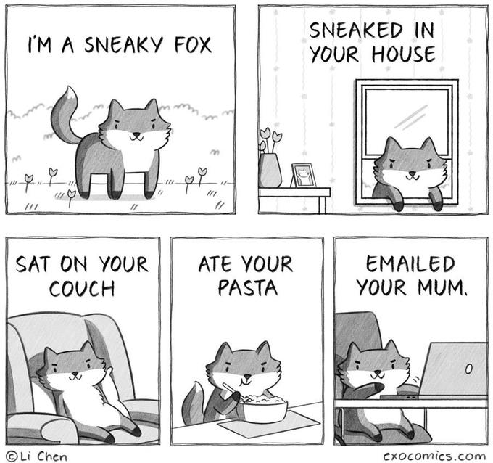
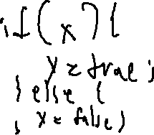
Previously: Sneaky Dataflow
Review: Side Channels
General Side-Channel
General side-channel: using a predictable phenomenon outside of the semantics of the program
Covert channel: special instance of a side channel that is used intentionally by the program
Either case: subverts the guarantee of a (naïve) static dataflow
EXFILTRATED
YOUR DATA
Implicit Flow
Launder a data dependency through a control dependency
With apologies to

Slide 6
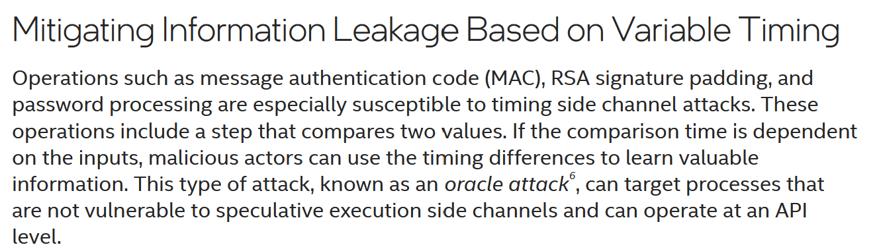
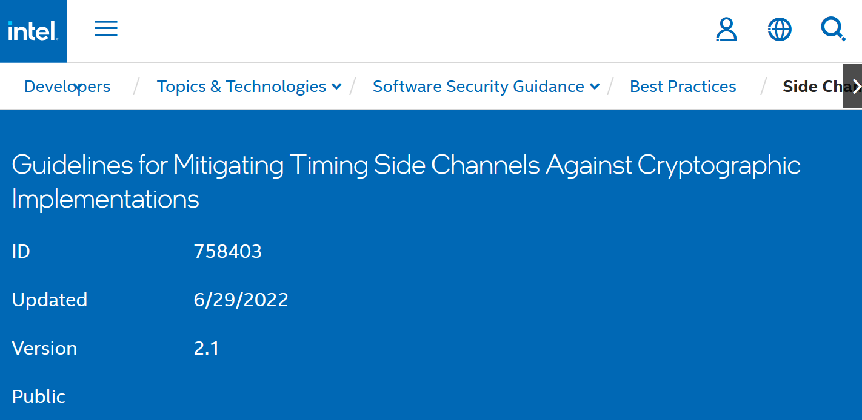
Previously: Timing side Channels
Review: Side Channels
A real-world Threat!

Slide 7

previously: Timing side Channels
Review: Side Channels
A real-world Threat!
How to fix (in software)?
Best idea (that I know of): an elaboration on the dataflow facts
Ensure uniform operation between flows

Slide 8
Previously: Timing side Channels
Review: Side Channels
A real-world Threat!
How to fix (in software)?
Best idea (that I know of): an elaboration on the dataflow facts
Ensure uniform operation between flows
bool checkPW(const char * given){
const char * expected = “12345”;
int gLen = strlen(given);
int eLen = strlen(expected);
if (gLen != eLen){ return false; }
for (int i = 0; i < eLen; i++){
if (given[i] != expected[i]){
return false;
}
}
return true;
}
bool checkPW(const char * given){
const char * expected = “12345”;
int gLen = strlen(given);
int eLen = strlen(expected);
bool ok = true;
if (gLen != eLen){ ok = false; }
for (int i = 0; i < eLen; i++){
int gIdx = math.min(gLen - 1, i);
if (given[gIdx] != expected[i]){
ok = false;
}
}
return ok;
}

Slide 9
Last Time: Sneaky Dataflow
Review: Side Channels
General Side-Channel
General side-channel: using a predictable phenomenon outside of the semantics of the program
Covert channel: special instance of a side channel that is used intentionally by the program
Either case: subverts the guarantee of a (naïve) static dataflow
EXFILTRATED
YOUR DATA
Implicit Flow
Launder a data dependency through a control dependency
With apologies to

Slide 10
Last Time: Sneaky Dataflow
Review: Side Channels
General Side-Channel
General side-channel: using a predictable phenomenon outside of the semantics of the program
Covert channel: special instance of a side channel that is used intentionally by the program
Either case: subverts the guarantee of a (naïve) static dataflow
Commonality: we don’t care about particular values, we care about dependency
Implicit Flow
Launder a data dependency through a control dependency

Slide 11
This Lecture
Delving into data abstractions that indicate dependency

Slide 12
Lecture Outline
Dependence relations
Control Dependence
Data Dependence

Slide 13

Why does statement X Do Thing Y?
Dependence Relations
Often interested in a subset of program behavior
What “influenced” statement X?
What did statement X “influence”?
Useful in a variety of contexts
Consider a pointer… what might make it null?
Assisting Scalability
Don’t get lost in details unrelated to my pointer / bug

Slide 14

Applications
Dependence Relations
Proactive
What causes my program to crashing?
Does this statement leak data?
Reactive
Zoom in on a suspicious operation

Slide 15

Lecture Outline
Dependence relations
Control Dependence
Data Dependence

Slide 16
“Control Reliance” Intuition
Dependence Relations
Consider the following procedure…
What other statements decide whether a given statement executes?
void foo(){
1: i = getc();
2: if ( i == 1)
3: putc(‘a’);
else
4: i = 1;
5: putc(i);
6: return;
}
The outcome of Line 2 decides on whether Line 3 is executed
The outcome of Line 2 decides on whether Line 4 is executed
The outcome of Line 1 does not decide on whether Line 2 is executed
The outcome of Line 2 does not decide on whether Line 5 is executed

Slide 17
“Control Reliance” Intuition: Immediacy
Dependence Relations
Many instructions may cause a skip-over
Line 5 relies on Line 1 and Line 2 and Line 3!
void foo(){
1: if ( i == 1){
2: if (j == 1) {
3: if (k == 1){
4: printf(“hi ”);
5: printf(“there!”);
6: }
7: }
8: }
Also convenient to say that every line in a procedure relies on the
entry to that procedure
We’d say Line 4 “most closely” relies on Line 3 because there is
no instruction between line 3 and 4 that decides if Line 4 executes
Control Dependence
Informally, an instruction X has a control dependence on Y if:
Statement Y decides whether X executes with no intervening decider
Related concept: MUST a statement A be executed for B to execute?

Slide 18
“Control Reliance” Intuition: Immediacy
Dependence Relations
Many instructions may cause a skip-over
Line 5 relies on Line 1 and Line 2 and Line 3!
void foo(){
1: if ( i == 1){
2: if (j == 1) {
3: if (k == 1){
4: printf(“hi ”);
5: printf(“there!”);
6: }
7: }
8: }
Also convenient to say that every line in a procedure relies on the
entry to that procedure
We’d say Line 4 “most closely” relies on Line 3 because there is
no instruction between line 3 and 4 that decides if Line 4 executes
Control Dependence
Informally, an instruction X has a control dependence on Y if:
Statement Y decides whether X executes with no intervening decider

Slide 19
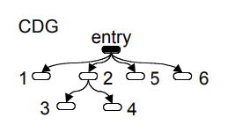
Control Dependence
Dependence Relations
void foo(){
1: i = getc();
2: if ( i == 1)
3: putc(‘a’);
else
4: i = 1;
5: putc(i);
6: return;
}
Capture Control Dependence in a Data structure
The control dependence graph
Related concept: MUST a statement A be executed for B to execute?

Slide 20

Domination

Slide 21
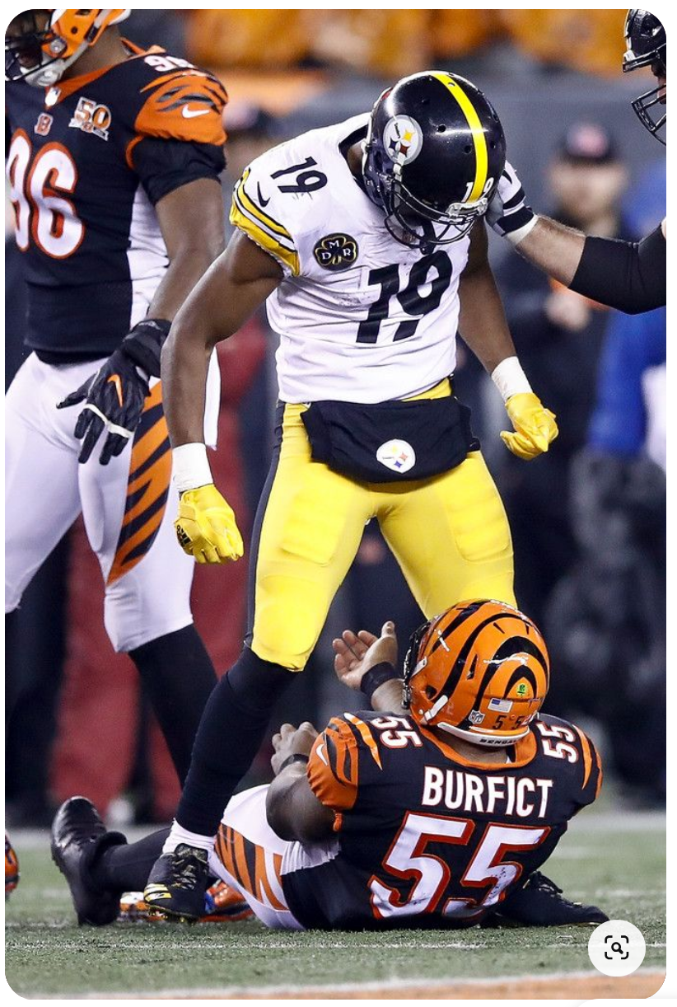
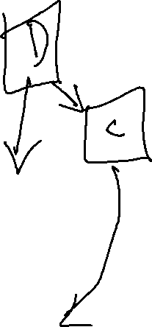
Dominators
Dependence Relations
You can’t get to the endzone
without going through me FIRST!
A
B

Slide 22
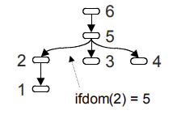
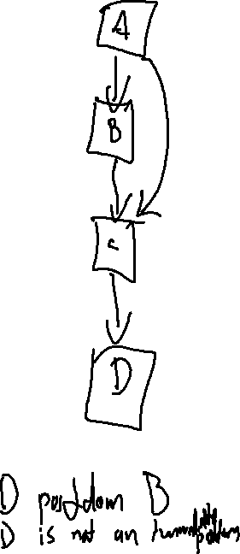
PostDomination
Dependence Relations
Intuition on Control Dependence
void foo(){
1: i = getc();
2: if ( i == 1)
3: putc(‘a’);
else
4: i = 1;
5: putc(i);
6: return;
}
What is the closest statement are you guaranteed to execute?
Postdomination
A Statement Y postdominates X ⇔ every path from X is guaranteed to go through Y, denoted X in PDOM(Y)
Intuitively, X is “destined” to meet Y
Postdom Tree
A Statement Y immediately postdominates X ⇔ X in PDOM(Y) and there is no intervening postdominator, denoted X in IPDOM(Y)

Slide 23
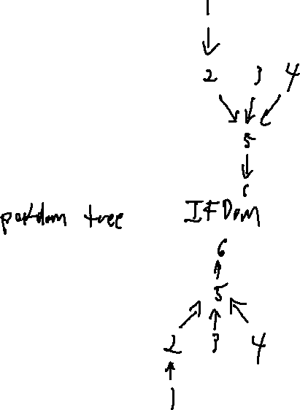
Building the CDG
Dependence Relations
(Immediate) Forward Dominators
1: READ i;
2: if ( i == 1)
3: PRINT “hi!”
else
4: i = 1;
5: PRINT i;
6: end
X IN IPDOM(Y) ⇔ Y in IFDOM(X)
2 in IPDOM 5
5 in IFDOM 2

Slide 24
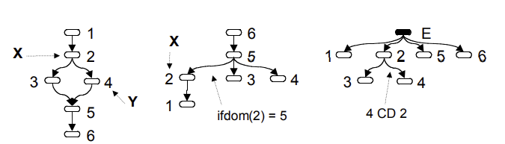
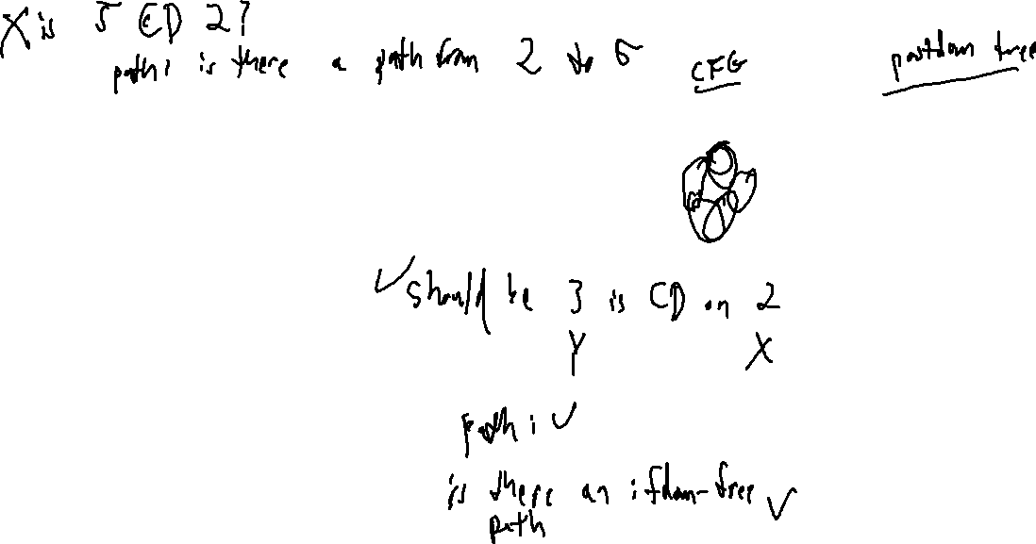
Building the CDG
Dependence Relations
Y is control dependent on X ⇔ there is a path in the CFG from X to Y that doesn’t contain the immediate forward dominator of X
1: READ i;
2: if ( i == 1)
3: PRINT “hi!”
else
4: i = 1;
5: PRINT i;
6: end

Slide 25
Lecture Outline
Dependence relations
Control Dependence
Data Dependence

Slide 26

Data Dependence
Dependence Relations
Influence is more than control, it’s also what values mattered to your behavior
1: READ i;
2: if ( i == 1)
3: PRINT “hi!”
else
4: i = 1;
5: PRINT i;
6: end
Note here: 1 might have set 5, but it’s not control dependent!

Slide 27
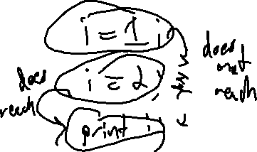
The Data Dependence Graph
Dependence Relations
Depiction of the reaching definitions of each statement
1: READ i;
2: if ( i == 1)
3: PRINT “hi!”
else
4: i = 1;
5: PRINT i;
6: end

Slide 28
Coming Up…
Dependence Relations
Sensor input spoofing
Consider data flow from sensors to actions in autonomous systems
Consider the Program Slice
Forward Slice: the portions of the program a given statement influences
Backwards Slice: the portions of the program influenced by a give statement

Slide 29
Wrap-up

Slide 30
