Slide 1
ExerCise
Lattices Review
Write your name and answer the following on a piece of paper
Recall that the set of English words, ranked by substring inclusion, forms a poset but NOT a lattice. Explain why and give an example

Slide 2
Administrivia and
Announcements

Slide 3
Dataflow Frameworks
EECS 677: Software Security Evaluation
Drew Davidson

Slide 4
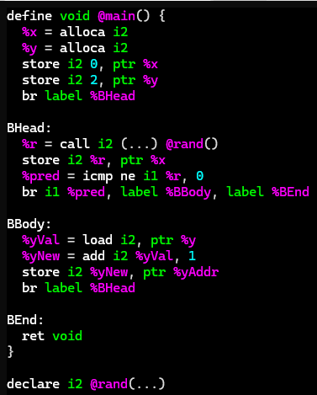
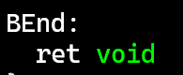
Dataflow: The Big Ideas
Dataflow Frameworks
Flow-sensitive Analysis
Annotate each block with facts about data at entry to the block
Annotate each edge with facts about data flowing on that edge
*x: {0}
*y: {2}
Propagate facts until saturation
*x: {-2,-1,1}
*y: {-2,-1,0,1}
Lattices
If …
*x: {-2,-1,0,1}
*y: {-2,-1,0,1}
Domain of facts form a complete lattice
Merges use the lattice join operation
Facts over-approximate concrete values
… Then
*x: {-2,-1,1}
*y: {-2,-1,0,1}
Guaranteed termination and completeness
*x: {0}
*y: {-2,-1,0,1}
*x: {0}
*y: {-2,-1,0,-1}

Slide 5
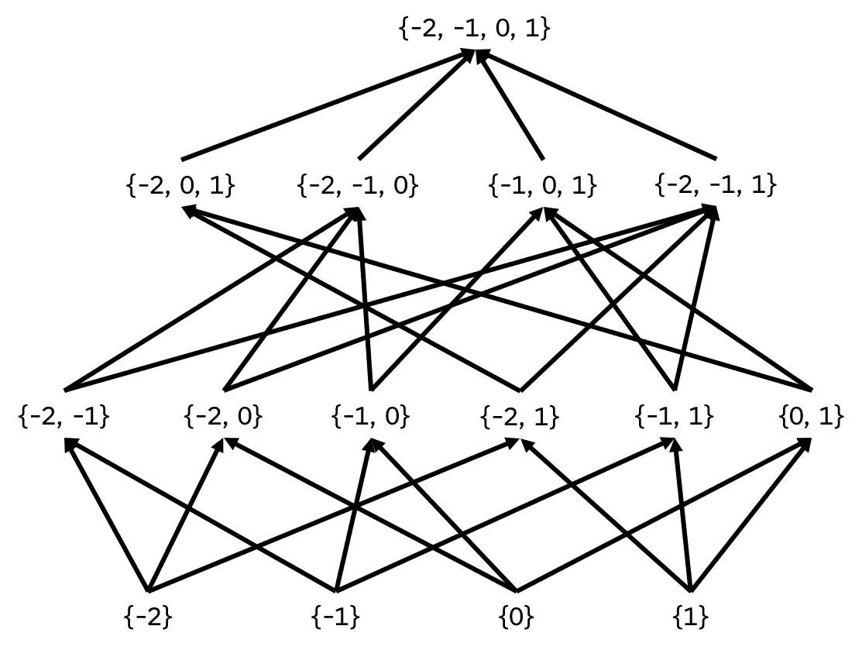

Dataflow: The Big Ideas
Dataflow Frameworks
Lattices
If …
Domain of facts form a complete lattice
Merges use the lattice join operation
Facts over-approximate concrete values
*x: {0}
*y: {2}
*x: {-2,-1,1}
*y: {-2,-1,0,1}
… Then
Guaranteed termination and completeness
*x: {-2,-1,0,1}
*y: {-2,-1,0,1}
*x: {-2,-1,1}
*y: {-2,-1,0,1}
*x: {0}
*y: {-2,-1,0,1}
*x: {0}
*y: {-2,-1,0,-1}

Slide 6

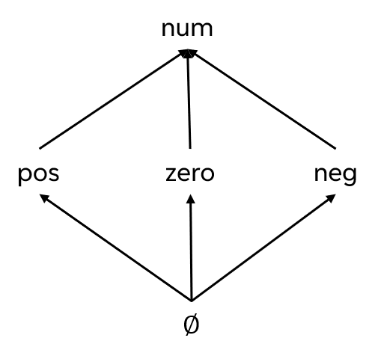
Dataflow: The Big Ideas
Dataflow Frameworks
Lattices
If …
Domain of facts form a complete lattice
Merges use the lattice join operation
Facts over-approximate concrete values
… Then
Guaranteed termination and completeness
Abstract interpretation
Use a coarse-grained domain of facts
Maintain analysis guarantees
Reach saturation faster

Slide 7



Dataflow: The Big Ideas
Dataflow Frameworks
Lattices
If …
Domain of facts form a complete lattice
Merges use the lattice join operation
Facts over-approximate concrete values
*x: zero
*y: pos
$$∅$$
*x:
*y:
*x: num
*y: num
… Then
$$∅$$
Guaranteed termination and completeness
*x: zero
*y: pos
Abstract interpretation
*x: num
*y: num
Use a coarse-grained domain of facts
Maintain analysis guarantees
Reach saturation faster
*x: zero
*y: num
*x: zero
*y: pos
*x: num
*y: pos
*x: num
*y: num

Slide 8
Lecture Outline
Formalizing dataflow
Implementation

Slide 9
abstract DomainS
Dataflow Frameworks
BIG IDEA:
Operate over abstract values that represent sets of concrete values
From the Concrete Domain to the Abstract
α({0}) = | zero
α(S) = | if all values in S are greater than 0 then pos
 | else if all values in S are less than 0 then neg
 | else num
From the Abstract Domain to the Concrete
γ(zero) = {0}
γ(pos) = {all positive ints}
γ(neg) = {all negative ints}
γ(num) = Int (i.e., all ints)

Slide 10

Why Does this Matter?
Dataflow Frameworks
Every finite lattice
is a complete lattice
Practical Upshot
If L is a complete lattice and f is monotonic, then f has a greatest fixpoint and a least fixpoint
If L has no infinite ascending chains, the least fixpoint can be computed by iterative application of f
So the analysis will terminate

Slide 11


Chaotic Iteration
Static Analysis: Control Flow Graphs
A Worklist algorithm
Chaotic
Iteration
Select the next worklist item in any order
Necessarily assumes progress towards some goal
Dealing with “uncomputed” sets
Assume a reasonable “initial” value
Surprisingly, not a band with merch at Hot Topic

Slide 12

Analysis Precision
Abstract Interpretation
Precision / Efficiency Tradeoff
With a complete lattice we can, in theory, eventually terminate
The shallower the lattice, the faster the fixpoint
That’s not a very strong guarantee!
Choose to approximate the lattice

Slide 13

Analysis Precision
Abstract Interpretation
Precision / Efficiency Tradeoff
With a complete lattice we can, in theory, eventually terminate
The shallower the lattice, the faster the fixpoint
That’s not a very strong guarantee!
Choose to approximate the lattice

Slide 14
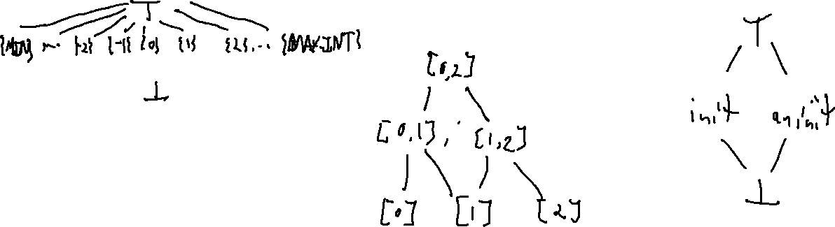
Abstract Domains in Practice
Static Analysis
Intervals
Property Existence
“Singleton Integer Sets”
You know the number, or you don’t
You know a concrete range
A property does or does not hold

Slide 15
Lecture Outline
Formalizing dataflow
Implementation

Slide 16
Computation within a Block
Static Analysis
Each instruction is a fact transformer
Define as a function with domain and range in the fact space

Slide 17
Dealing with conditionals
Static Analysis
Consider the following snippet

