Slide 1
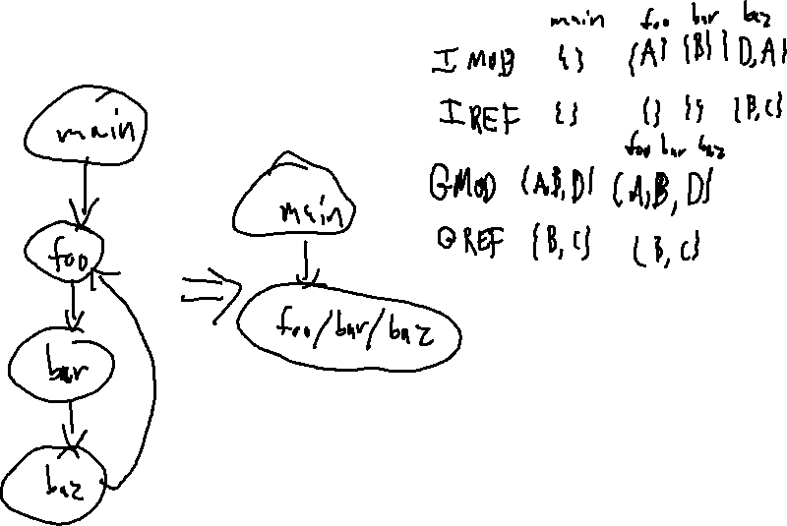
Exercise
Summary Function Review
Write your name and answer the following on a piece of paper
Compute GMOD / GREF for the below program
1: int A,B,C,D;
2: void baz(){
3: D = B;
4: A = C;
5: foo();
6: }
7: void bar(){
8: B = 2;
9: baz();
10: }
11: void foo(){
12: A = 1;
13: bar();
14: }
15: int main(){
16: foo();
17: foo();
18: }

Slide 2
Exercise Solution
Summary Function Review

Slide 3
Administrivia and
Announcements

Slide 4
Call Targets
EECS 677: Software Security Evaluation
Drew Davidson

Slide 5
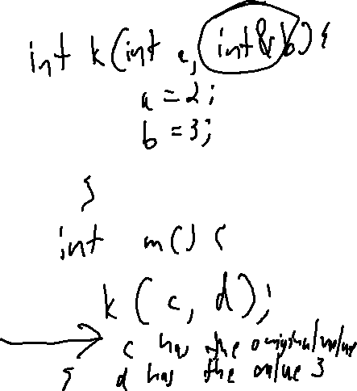
Last Time: Summary Functions
Review: Last Lecture
Can we over-Approximate a function’s effect without building the supergraph?
Motivation
Allows “quick”, modular analysis
Manifestations
GMOD/GREF (what variables are touched?)
Abstract transfer functions

Slide 6
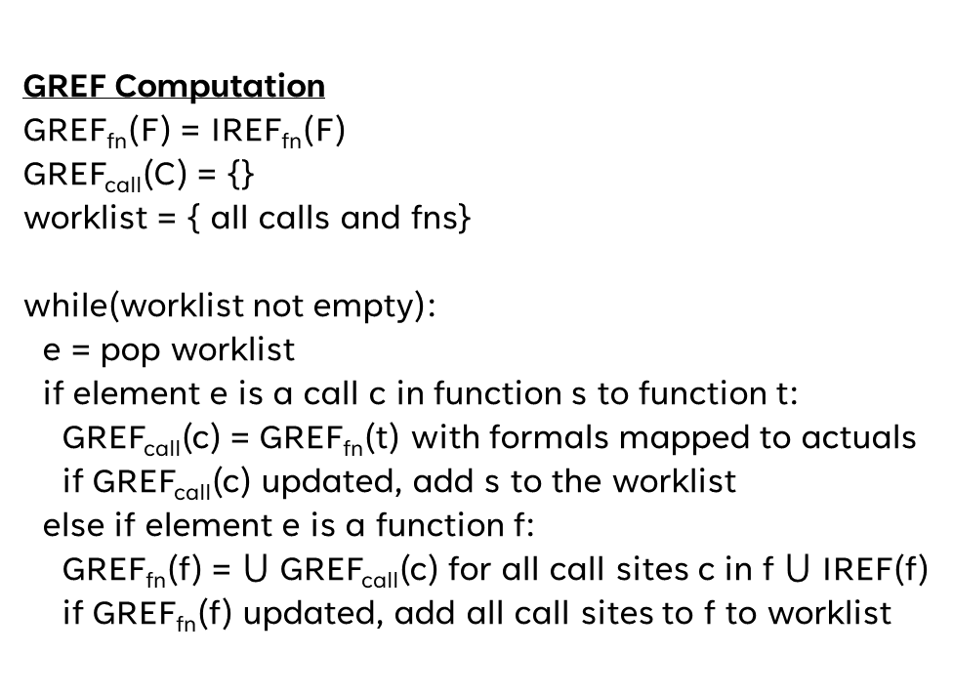
Last Time: Summary Functions
Review: Last Lecture
Operate on the “complex” callgraph (i.e. sub-nodes for call sites)
GREF Computation
GREF_{fn}(F) = IREF_{fn}(F)
GREF_{call}(C) = {}
worklist = { all calls and fns}
while(worklist not empty):
e = pop worklist
if element e is a call c in function s to function t:
GREF_{call}(c) = GREF_{fn}(t) with formals mapped to actuals
if GREF_{call}(c) updated, add s to the worklist
else if element e is a function f:
GREF_{fn}(f) = $⋃$ GREF_{call}(c) for all call sites c in f $⋃$ IREF(f)
if GREF_{fn}(f) updated, add all call sites to f to worklist
main
IREF = { }
03
01: int g1,g2, p3;
02: void main() {
03: a(v1);
04: }
05: void a( int f1){
06: b(v2, v3);
07: b(v4, v5);
08: }
09: void b( int f2, int f3){
10: print(f3);
11: b(g1, g2);
12: }
a
IREF = { }
06 07
b
IREF = {f3}
10

Slide 7
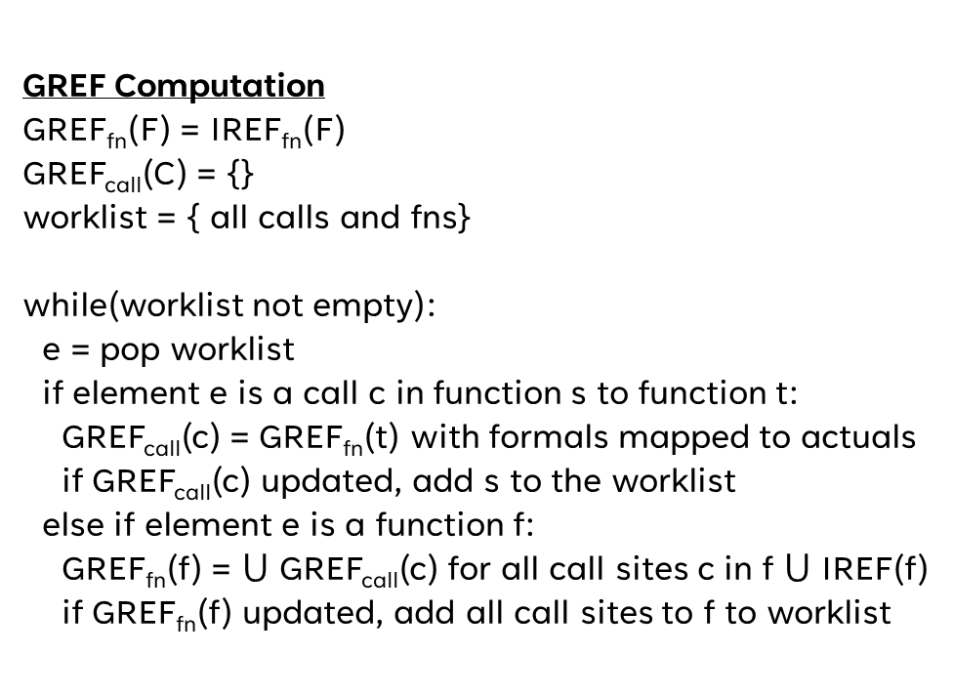
Last Time: Summary Functions
Review: Last Lecture
GREF Computation
GREF_{fn}(F) = IREF_{fn}(F)
GREF_{call}(C) = {}
worklist = { all calls and fns}
while(worklist not empty):
e = pop worklist
if element e is a call c in function s to function t:
GREF_{call}(c) = GREF_{fn}(t) with formals mapped to actuals
if GREF_{call}(c) updated, add s to the worklist
else if element e is a function f:
GREF_{fn}(f) = $⋃$ GREF_{call}(c) for all call sites c in f $⋃$ IREF(f)
if GREF_{fn}(f) updated, add all call sites to f to worklist
main
IREF = { }
03
01: int g1,g2, p3;
02: void main() {
03: a(v1);
04: }
05: void a( int f1){
06: b(v2, v3);
07: b(v4, v5);
08: }
09: void b( int f2, int f3){
10: print(f3);
11: b(g1, g2);
12: }
a
IREF = { }
06 07
b
IREF = {f3}
10
Worklist:
{
b
11
main
a
03
06
07
}
main
a
b
03
06
07
11
GREF
{ }
{ }
{f3}
{ }
{ }
{ }
{ }

Slide 8


Last Time: Summary Functions
Review: Last Lecture
GREF Computation
GREF_{fn}(F) = IREF_{fn}(F)
GREF_{call}(C) = {}
worklist = { all calls and fns}
while(worklist not empty):
e = pop worklist
if element e is a call c in function s to function t:
GREF_{call}(c) = GREF_{fn}(t) with formals mapped to actuals
if GREF_{call}(c) updated, add s to the worklist
else if element e is a function f:
GREF_{fn}(f) = $⋃$ GREF_{call}(c) for all call sites c in f $⋃$ IREF(f)
if GREF_{fn}(f) updated, add all call sites to f to worklist
main
IREF = { }
03
01: int g1,g2, p3;
02: void main() {
03: a(v1);
04: }
05: void a( int f1){
06: b(v2, v3);
07: b(v4, v5);
08: }
09: void b( int f2, int f3){
10: print(f3);
11: b(g1, g2);
12: }
a
IREF = { }
06 07
b
IREF = {f3}
10
Process
b
GREF_{fn}(b) = $⋃$ GREF_{call}(11) $⋃$ IREF(b)
Worklist:
{
11
main
a
03
06
07
}
=
{ }
$$⋃$$
{f3}
main
a
b
03
06
07
11
=
{f3}
(no update, don’t change worklist)
GREF
{ }
{ }
{f3}
{ }
{ }
{ }
{ }

Slide 9
Last Time: Summary Functions
Review: Last Lecture
GREF Computation
GREF_{fn}(F) = IREF_{fn}(F)
GREF_{call}(C) = {}
worklist = { all calls and fns}
while(worklist not empty):
e = pop worklist
if element e is a call c in function s to function t:
GREF_{call}(c) = GREF_{fn}(t) with formals mapped to actuals
if GREF_{call}(c) updated, add s to the worklist
else if element e is a function f:
GREF_{fn}(f) = $⋃$ GREF_{call}(c) for all call sites c in f $⋃$ IREF(f)
if GREF_{fn}(f) updated, add all call sites to f to worklist
main
IREF = { }
03
01: int g1,g2, p3;
02: void main() {
03: a(v1);
04: }
05: void a( int f1){
06: b(v2, v3);
07: b(v4, v5);
08: }
09: void b( int f2, int f3){
10: print(f3);
11: b(g1, g2);
12: }
a
IREF = { }
06 07
b
IREF = {f3}
10
Worklist:
{
11
main
a
03
06
07
}
main
a
b
03
06
07
11
GREF
{ }
{ }
{f3}
{ }
{ }
{ }
{ }

Slide 10
Last Time: Summary Functions
Review: Last Lecture
GREF Computation
GREF_{fn}(F) = IREF_{fn}(F)
GREF_{call}(C) = {}
worklist = { all calls and fns}
while(worklist not empty):
e = pop worklist
if element e is a call c in function s to function t:
GREF_{call}(c) = GREF_{fn}(t) with formals mapped to actuals
if GREF_{call}(c) updated, add s to the worklist
else if element e is a function f:
GREF_{fn}(f) = $⋃$ GREF_{call}(c) for all call sites c in f $⋃$ IREF(f)
if GREF_{fn}(f) updated, add all call sites to f to worklist
main
IREF = { }
03
01: int g1,g2, p3;
02: void main() {
03: a(v1);
04: }
05: void a( int f1){
06: b(v2, v3);
07: b(v4, v5);
08: }
09: void b( int f2, int f3){
10: print(f3);
11: b(g1, g2);
12: }
a
IREF = { }
06 07
b
IREF = {f3}
10
Process
11
GREF_{call}(11) = GREF_{fn}(b) with g1/f2 and g2/f3
Worklist:
b
{
main
a
03
06
07
}
=
{f3}
g2
main
a
b
03
06
07
11
=
{g2}
(update, add b add worklist)
GREF
{ }
{ }
{f3}
{ }
{ }
{ }
{ }
{ g2 }

Slide 11
Last Time: Summary Functions
Review: Last Lecture
GREF Computation
GREF_{fn}(F) = IREF_{fn}(F)
GREF_{call}(C) = {}
worklist = { all calls and fns}
while(worklist not empty):
e = pop worklist
if element e is a call c in function s to function t:
GREF_{call}(c) = GREF_{fn}(t) with formals mapped to actuals
if GREF_{call}(c) updated, add s to the worklist
else if element e is a function f:
GREF_{fn}(f) = $⋃$ GREF_{call}(c) for all call sites c in f $⋃$ IREF(f)
if GREF_{fn}(f) updated, add all call sites to f to worklist
main
IREF = { }
03
01: int g1,g2, p3;
02: void main() {
03: a(v1);
04: }
05: void a( int f1){
06: b(v2, v3);
07: b(v4, v5);
08: }
09: void b( int f2, int f3){
10: print(f3);
11: b(g1, g2);
12: }
a
IREF = { }
06 07
b
IREF = {f3}
10
Worklist:
b
{
main
a
03
06
07
}
main
a
b
03
06
07
11
GREF
{ }
{ }
{f3}
{ }
{ }
{ }
{ g2 }

Slide 12


Last Time: Summary Functions
Review: Last Lecture
GREF Computation
GREF_{fn}(F) = IREF_{fn}(F)
GREF_{call}(C) = {}
worklist = { all calls and fns}
while(worklist not empty):
e = pop worklist
if element e is a call c in function s to function t:
GREF_{call}(c) = GREF_{fn}(t) with formals mapped to actuals
if GREF_{call}(c) updated, add s to the worklist
else if element e is a function f:
GREF_{fn}(f) = $⋃$ GREF_{call}(c) for all call sites c in f $⋃$ IREF(f)
if GREF_{fn}(f) updated, add all call sites to f to worklist
main
IREF = { }
03
01: int g1,g2, p3;
02: void main() {
03: a(v1);
04: }
05: void a( int f1){
06: b(v2, v3);
07: b(v4, v5);
08: }
09: void b( int f2, int f3){
10: print(f3);
11: b(g1, g2);
12: }
a
IREF = { }
06 07
b
IREF = {f3}
10
Process
main
GREF_{fn}(main) = $⋃$ GREF_{call}(03) $⋃$ IREF(main)
Worklist:
b
{
a
03
06
07
}
= { } $⋃$ { }
main
a
b
03
06
07
11
(no update)
GREF
{ }
{ }
{f3}
{ }
{ }
{ }
{ g2 }

Slide 13
Last Time: Summary Functions
Review: Last Lecture
GREF Computation
GREF_{fn}(F) = IREF_{fn}(F)
GREF_{call}(C) = {}
worklist = { all calls and fns}
while(worklist not empty):
e = pop worklist
if element e is a call c in function s to function t:
GREF_{call}(c) = GREF_{fn}(t) with formals mapped to actuals
if GREF_{call}(c) updated, add s to the worklist
else if element e is a function f:
GREF_{fn}(f) = $⋃$ GREF_{call}(c) for all call sites c in f $⋃$ IREF(f)
if GREF_{fn}(f) updated, add all call sites to f to worklist
main
IREF = { }
03
01: int g1,g2, p3;
02: void main() {
03: a(v1);
04: }
05: void a( int f1){
06: b(v2, v3);
07: b(v4, v5);
08: }
09: void b( int f2, int f3){
10: print(f3);
11: b(g1, g2);
12: }
a
IREF = { }
06 07
b
IREF = {f3}
10
Worklist:
b
{
a
03
06
07
}
main
a
b
03
06
07
11
GREF
{ }
{ }
{f3}
{ }
{ }
{ }
{ g2 }

Slide 14

Last Time: Summary Functions
Review: Last Lecture
GREF Computation
GREF_{fn}(F) = IREF_{fn}(F)
GREF_{call}(C) = {}
worklist = { all calls and fns}
while(worklist not empty):
e = pop worklist
if element e is a call c in function s to function t:
GREF_{call}(c) = GREF_{fn}(t) with formals mapped to actuals
if GREF_{call}(c) updated, add s to the worklist
else if element e is a function f:
GREF_{fn}(f) = $⋃$ GREF_{call}(c) for all call sites c in f $⋃$ IREF(f)
if GREF_{fn}(f) updated, add all call sites to f to worklist
main
IREF = { }
03
01: int g1,g2, p3;
02: void main() {
03: a(v1);
04: }
05: void a( int f1){
06: b(v2, v3);
07: b(v4, v5);
08: }
09: void b( int f2, int f3){
10: print(f3);
11: b(g1, g2);
12: }
a
IREF = { }
06 07
b
IREF = {f3}
10
Process
a
GREF_{fn}(a) = GREF_{call}(06) $⋃$ GREF_{call}(07) $⋃$IREF(a)
Worklist:
b
{
03
06
07
}
= { } $⋃$ { } $⋃$ { }
main
a
b
03
06
07
11
No update
GREF
{ }
{ }
{f3}
{ }
{ }
{ }
{ g2 }

Slide 15
Last Time: Summary Functions
Review: Last Lecture
GREF Computation
GREF_{fn}(F) = IREF_{fn}(F)
GREF_{call}(C) = {}
worklist = { all calls and fns}
while(worklist not empty):
e = pop worklist
if element e is a call c in function s to function t:
GREF_{call}(c) = GREF_{fn}(t) with formals mapped to actuals
if GREF_{call}(c) updated, add s to the worklist
else if element e is a function f:
GREF_{fn}(f) = $⋃$ GREF_{call}(c) for all call sites c in f $⋃$ IREF(f)
if GREF_{fn}(f) updated, add all call sites to f to worklist
main
IREF = { }
03
01: int g1,g2, p3;
02: void main() {
03: a(v1);
04: }
05: void a( int f1){
06: b(v2, v3);
07: b(v4, v5);
08: }
09: void b( int f2, int f3){
10: print(f3);
11: b(g1, g2);
12: }
a
IREF = { }
06 07
b
IREF = {f3}
10
Worklist:
b
{
03
06
07
}
main
a
b
03
06
07
11
GREF
{ }
{ }
{f3}
{ }
{ }
{ }
{ g2 }

Slide 16
Last Time: Summary Functions
Review: Last Lecture
GREF Computation
GREF_{fn}(F) = IREF_{fn}(F)
GREF_{call}(C) = {}
worklist = { all calls and fns}
while(worklist not empty):
e = pop worklist
if element e is a call c in function s to function t:
GREF_{call}(c) = GREF_{fn}(t) with formals mapped to actuals
if GREF_{call}(c) updated, add s to the worklist
else if element e is a function f:
GREF_{fn}(f) = $⋃$ GREF_{call}(c) for all call sites c in f $⋃$ IREF(f)
if GREF_{fn}(f) updated, add all call sites to f to worklist
main
IREF = { }
03
01: int g1,g2, p3;
02: void main() {
03: a(v1);
04: }
05: void a( int f1){
06: b(v2, v3);
07: b(v4, v5);
08: }
09: void b( int f2, int f3){
10: print(f3);
11: b(g1, g2);
12: }
a
IREF = { }
06 07
b
IREF = {f3}
10
Process
03
GREF_{call}(03) = GREF_{fn}(a) with v1/f1
Worklist:
b
{
06
07
}
= { }
main
a
b
03
06
07
11
(no update)
GREF
{ }
{ }
{f3}
{ }
{ }
{ }
{ g2 }

Slide 17
Last Time: Summary Functions
Review: Last Lecture
GREF Computation
GREF_{fn}(F) = IREF_{fn}(F)
GREF_{call}(C) = {}
worklist = { all calls and fns}
while(worklist not empty):
e = pop worklist
if element e is a call c in function s to function t:
GREF_{call}(c) = GREF_{fn}(t) with formals mapped to actuals
if GREF_{call}(c) updated, add s to the worklist
else if element e is a function f:
GREF_{fn}(f) = $⋃$ GREF_{call}(c) for all call sites c in f $⋃$ IREF(f)
if GREF_{fn}(f) updated, add all call sites to f to worklist
main
IREF = { }
03
01: int g1,g2, p3;
02: void main() {
03: a(v1);
04: }
05: void a( int f1){
06: b(v2, v3);
07: b(v4, v5);
08: }
09: void b( int f2, int f3){
10: print(f3);
11: b(g1, g2);
12: }
a
IREF = { }
06 07
b
IREF = {f3}
10
Worklist:
b
{
06
07
}
main
a
b
03
06
07
11
GREF
{ }
{ }
{f3}
{ }
{ }
{ }
{ g2 }

Slide 18
Last Time: Summary Functions
Review: Last Lecture
GREF Computation
GREF_{fn}(F) = IREF_{fn}(F)
GREF_{call}(C) = {}
worklist = { all calls and fns}
while(worklist not empty):
e = pop worklist
if element e is a call c in function s to function t:
GREF_{call}(c) = GREF_{fn}(t) with formals mapped to actuals
if GREF_{call}(c) updated, add s to the worklist
else if element e is a function f:
GREF_{fn}(f) = $⋃$ GREF_{call}(c) for all call sites c in f $⋃$ IREF(f)
if GREF_{fn}(f) updated, add all call sites to f to worklist
main
IREF = { }
03
01: int g1,g2, p3;
02: void main() {
03: a(v1);
04: }
05: void a( int f1){
06: b(v2, v3);
07: b(v4, v5);
08: }
09: void b( int f2, int f3){
10: print(f3);
11: b(g1, g2);
12: }
a
IREF = { }
06 07
b
IREF = {f3}
10
Process
06
GREF_{call}(06) = GREF_{fn}(b) with v2/f2 and v3/f3
Worklist:
b
{
07
a
}
= { f3 }
v3
main
a
b
03
06
07
11
=
{v3}
GREF
{ }
{ }
{f3}
{ }
{ }
{ }
{ g2 }
(update, add a to worklist)
{v3}

Slide 19
Last Time: Summary Functions
Review: Last Lecture
GREF Computation
GREF_{fn}(F) = IREF_{fn}(F)
GREF_{call}(C) = {}
worklist = { all calls and fns}
while(worklist not empty):
e = pop worklist
if element e is a call c in function s to function t:
GREF_{call}(c) = GREF_{fn}(t) with formals mapped to actuals
if GREF_{call}(c) updated, add s to the worklist
else if element e is a function f:
GREF_{fn}(f) = $⋃$ GREF_{call}(c) for all call sites c in f $⋃$ IREF(f)
if GREF_{fn}(f) updated, add all call sites to f to worklist
main
IREF = { }
03
01: int g1,g2, p3;
02: void main() {
03: a(v1);
04: }
05: void a( int f1){
06: b(v2, v3);
07: b(v4, v5);
08: }
09: void b( int f2, int f3){
10: print(f3);
11: b(g1, g2);
12: }
a
IREF = { }
06 07
b
IREF = {f3}
10
Worklist:
b
{
07
a
}
main
a
b
03
06
07
11
GREF
{ }
{ }
{f3}
{ }
{v3}
{ }
{ g2 }

Slide 20
Last Time: Summary Functions
Review: Last Lecture
GREF Computation
GREF_{fn}(F) = IREF_{fn}(F)
GREF_{call}(C) = {}
worklist = { all calls and fns}
while(worklist not empty):
e = pop worklist
if element e is a call c in function s to function t:
GREF_{call}(c) = GREF_{fn}(t) with formals mapped to actuals
if GREF_{call}(c) updated, add s to the worklist
else if element e is a function f:
GREF_{fn}(f) = $⋃$ GREF_{call}(c) for all call sites c in f $⋃$ IREF(f)
if GREF_{fn}(f) updated, add all call sites to f to worklist
main
IREF = { }
03
01: int g1,g2, p3;
02: void main() {
03: a(v1);
04: }
05: void a( int f1){
06: b(v2, v3);
07: b(v4, v5);
08: }
09: void b( int f2, int f3){
10: print(f3);
11: b(g1, g2);
12: }
a
IREF = { }
06 07
b
IREF = {f3}
10
Process
07
GREF_{call}(07) = GREF_{fn}(b) with v4/f2 and v5/f3
Worklist:
b
{
a
}
= { f3 }
v5
main
a
b
03
06
07
11
=
{v5}
GREF
{ }
{ }
{f3}
{ }
{v3}
{ }
{ g2 }
(update, add a to worklist, already there)
{v5}

Slide 21
Last Time: Summary Functions
Review: Last Lecture
GREF Computation
GREF_{fn}(F) = IREF_{fn}(F)
GREF_{call}(C) = {}
worklist = { all calls and fns}
while(worklist not empty):
e = pop worklist
if element e is a call c in function s to function t:
GREF_{call}(c) = GREF_{fn}(t) with formals mapped to actuals
if GREF_{call}(c) updated, add s to the worklist
else if element e is a function f:
GREF_{fn}(f) = $⋃$ GREF_{call}(c) for all call sites c in f $⋃$ IREF(f)
if GREF_{fn}(f) updated, add all call sites to f to worklist
main
IREF = { }
03
01: int g1,g2, p3;
02: void main() {
03: a(v1);
04: }
05: void a( int f1){
06: b(v2, v3);
07: b(v4, v5);
08: }
09: void b( int f2, int f3){
10: print(f3);
11: b(g1, g2);
12: }
a
IREF = { }
06 07
b
IREF = {f3}
10
Worklist:
b
{
a
}
main
a
b
03
06
07
11
GREF
{ }
{ }
{f3}
{ }
{v3}
{v5}
{ g2 }

Slide 22


Last Time: Summary Functions
Review: Last Lecture
GREF Computation
GREF_{fn}(F) = IREF_{fn}(F)
GREF_{call}(C) = {}
worklist = { all calls and fns}
while(worklist not empty):
e = pop worklist
if element e is a call c in function s to function t:
GREF_{call}(c) = GREF_{fn}(t) with formals mapped to actuals
if GREF_{call}(c) updated, add s to the worklist
else if element e is a function f:
GREF_{fn}(f) = $⋃$ GREF_{call}(c) for all call sites c in f $⋃$ IREF(f)
if GREF_{fn}(f) updated, add all call sites to f to worklist
main
IREF = { }
03
01: int g1,g2, p3;
02: void main() {
03: a(v1);
04: }
05: void a( int f1){
06: b(v2, v3);
07: b(v4, v5);
08: }
09: void b( int f2, int f3){
10: print(f3);
11: b(g1, g2);
12: }
a
IREF = { }
06 07
b
IREF = {f3}
10
Process
b
GREF_{fn}(b) = GREF_{call}(11) $⋃$IREF(b)
Worklist:
{
a
11
06
07
}
= { g2 } $⋃$ { f3 }
main
a
b
03
06
07
11
= { f3, g2 }
GREF
{ }
{ }
{f3}
{ }
{v3}
{v5}
{ g2 }
Updated add 11, 06, 07
{f3,g2}

Slide 23
Last Time: Summary Functions
Review: Last Lecture
GREF Computation
GREF_{fn}(F) = IREF_{fn}(F)
GREF_{call}(C) = {}
worklist = { all calls and fns}
while(worklist not empty):
e = pop worklist
if element e is a call c in function s to function t:
GREF_{call}(c) = GREF_{fn}(t) with formals mapped to actuals
if GREF_{call}(c) updated, add s to the worklist
else if element e is a function f:
GREF_{fn}(f) = $⋃$ GREF_{call}(c) for all call sites c in f $⋃$ IREF(f)
if GREF_{fn}(f) updated, add all call sites to f to worklist
main
IREF = { }
03
01: int g1,g2, p3;
02: void main() {
03: a(v1);
04: }
05: void a( int f1){
06: b(v2, v3);
07: b(v4, v5);
08: }
09: void b( int f2, int f3){
10: print(f3);
11: b(g1, g2);
12: }
a
IREF = { }
06 07
b
IREF = {f3}
10
Worklist:
{
a
11
06
07
}
main
a
b
03
06
07
11
GREF
{ }
{ }
{f3,g2}
{ }
{v3}
{v5}
{ g2 }

Slide 24

Last Time: Summary Functions
Review: Last Lecture
GREF Computation
GREF_{fn}(F) = IREF_{fn}(F)
GREF_{call}(C) = {}
worklist = { all calls and fns}
while(worklist not empty):
e = pop worklist
if element e is a call c in function s to function t:
GREF_{call}(c) = GREF_{fn}(t) with formals mapped to actuals
if GREF_{call}(c) updated, add s to the worklist
else if element e is a function f:
GREF_{fn}(f) = $⋃$ GREF_{call}(c) for all call sites c in f $⋃$ IREF(f)
if GREF_{fn}(f) updated, add all call sites to f to worklist
main
IREF = { }
03
01: int g1,g2, p3;
02: void main() {
03: a(v1);
04: }
05: void a( int f1){
06: b(v2, v3);
07: b(v4, v5);
08: }
09: void b( int f2, int f3){
10: print(f3);
11: b(g1, g2);
12: }
a
IREF = { }
06 07
b
IREF = {f3}
10
Process
a
GREF_{fn}(a) = GREF_{call}(06) $⋃$GREF_{call}(07) $⋃$IREF(a)
Worklist:
{
11
06
07
03
}
= { v3 } $⋃$ { v5 } $⋃$ { }
main
a
b
03
06
07
11
Updated add 03
GREF
{ }
{ }
{f3,g2}
{ }
{v3}
{v5}
{ g2 }
{v3,v5}

Slide 25

Last Time: Summary Functions
Review: Last Lecture

Slide 26
Last Time: Summary Functions
Review: Last Lecture
GREF Computation
GREF_{fn}(F) = IREF_{fn}(F)
GREF_{call}(C) = {}
worklist = { all calls and fns}
while(worklist not empty):
e = pop worklist
if element e is a call c in function s to function t:
GREF_{call}(c) = GREF_{fn}(t) with formals mapped to actuals
if GREF_{call}(c) updated, add s to the worklist
else if element e is a function f:
GREF_{fn}(f) = $⋃$ GREF_{call}(c) for all call sites c in f $⋃$ IREF(f)
if GREF_{fn}(f) updated, add all call sites to f to worklist
main
IREF = { }
03
01: int g1,g2, p3;
02: void main() {
03: a(v1);
04: }
05: void a( int f1){
06: b(v2, v3);
07: b(v4, v5);
08: }
09: void b( int f2, int f3){
10: print(f3);
11: b(g1, g2);
12: }
a
IREF = { }
06 07
b
IREF = {f3}
10
Worklist:
{
}
main
a
b
03
06
07
11
GREF
{g2}
{ g2,v3,v5 }
{f3,g2}
{g2}
{v3,g2}
{v5, g2}
{ g2 }

Slide 27





Abstract Transfer Functions
Review: Last Lecture
Can we over-Approximate a function’s effect without building the supergraph?
┬
foo( arg is ┬ ) $→$ return is ┬
foo( int a){
return a + 1;
}
foo( arg is + ) $→$ return is ┬
-
0
+
foo( arg is - ) $→$ return is ┬
foo( arg is 0 ) $→$ return is +
┴
foo( arg is ┴ ) $→$ return is ┬

Slide 28

Overview
How do we figure out control transfer targets in the first place?

Slide 29
Lecture Outline
Dynamic Dispatch
Algorithms

Slide 30

Dynamic Dispatch
A history of Computing
1: class A{
2: public A f(){ return new C(); }
3: public String g(){ return "A"; }
4: };
5: class B : public A{
6: public String g(){ return "B"; }
7: };
8: class C : public A{
9: public String g(){ return "C"; }
10: };
11: class D : public A{
12: public String g(){ return "D"; }
13: };
14: class Driver {
15: public void main(String[] args){
16: A[] aArr = {new A(), new B()};
17: for (A a : aArr){
18: A res = a.f();
19: print(a.g());
20: print(res.g());
21: }
22: }
23: };
A.init
A.f
Driver.main
A.g
16
B.init
18
19
B.g
20
C.init
C.g
C.init
D.g

Slide 31

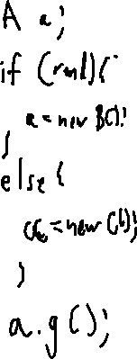
Dynamic Dispatch: Gets Complicated!
A history of Computing

Slide 32
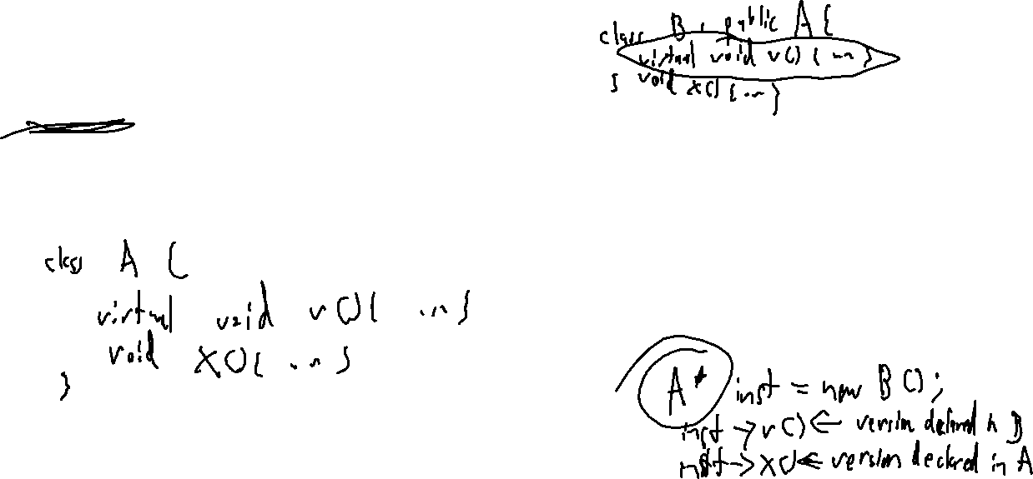
Dynamic Dispatch: Gets Complicated!
A history of Computing
Direct Calls
Not so bad
Indirect Calls
Quite a bit harder: multiple targets possible!

Slide 33
Dynamic Dispatch: Gets Complicated!
A history of Computing
1: class A{
2: public A f(){ return new C(); }
3: public String g(){ return "A"; }
4: };
5: class B : public A{
6: public String g(){ return "B"; }
7: };
8: class C : public A{
9: public String g(){ return "C"; }
10: };
11: class D : public A{
12: public String g(){ return "D"; }
13: };
14: class Driver {
15: public void main(String[] args){
16: A[] aArr = {new A(), new B()};
17: for (A a : aArr){
18: A res = a.f();
19: print(a.g());
20: print(res.g());
21: }
22: }
23: };
Direct Calls
Not so bad
Indirect Calls
Quite a bit harder: multiple targets possible!

Slide 34
Lecture Outline
Dynamic Dispatch
Algorithms

Slide 35
Class Hierarchy Analysis (CHA)
A history of Computing
1: class A{
2: public A f(){ return new C(); }
3: public String g(){ return "A"; }
4: };
5: class B : public A{
6: public String g(){ return "B"; }
7: };
8: class C : public A{
9: public String g(){ return "C"; }
10: };
11: class D : public A{
12: public String g(){ return "D"; }
13: };
14: class Driver {
15: public void main(String[] args){
16: A[] aArr = {new A(), new B()};
17: for (A a : aArr){
18: A res = a.f();
19: print(a.g());
20: print(res.g());
21: }
22: }
23: };
Consider the Safe over-approximation
Treat call as declared type, or any subtype
Object
Driver
A
main
f,g
B
C
D
g
g
g

Slide 36
CHA
A history of Computing
1: class A{
2: public A f(){ return new C(); }
3: public String g(){ return "A"; }
4: };
5: class B : public A{
6: public String g(){ return "B"; }
7: };
8: class C : public A{
9: public String g(){ return "C"; }
10: };
11: class D : public A{
12: public String g(){ return "D"; }
13: };
14: class Driver {
15: public void main(String[] args){
16: A[] aArr = {new A(), new B()};
17: for (A a : aArr){
18: A res = a.f();
19: print(a.g());
20: print(res.g());
21: }
22: }
23: };
Refinement over CHA
Consider only initialized classes
Consider only reachable code
Object
Driver
A
main
f,g
B
C
D
g
g
g

Slide 37
Rapid Type Analysis (RTA)
A history of Computing
1: class A{
2: public A f(){ return new C(); }
3: public String g(){ return "A"; }
4: };
5: class B : public A{
6: public String g(){ return "B"; }
7: };
8: class C : public A{
9: public String g(){ return "C"; }
10: };
11: class D : public A{
12: public String g(){ return "D"; }
13: };
14: class Driver {
15: public void main(String[] args){
16: A[] aArr = {new A(), new B()};
17: for (A a : aArr){
18: A res = a.f();
19: print(a.g());
20: print(res.g());
21: }
22: }
23: };
Refinement over CHA
Consider only initialized classes
Consider only reachable code
Object
Driver
A
main
f,g
B
C
D
g
g
g

Slide 38
Rapid Type Analysis (RTA)
A history of Computing
RTA = call graph of functions (initially edgeless)
CHA = call graph via class hierarchy analysis
W = worklist
W.push(main)
while not W.empty:
M = pop W
T = allocated types in M
T = T U allocated types in RTA callers of M
foreach callsite(C) in M
if C is statically-dispatched:
add edge C to C’s static target
else:
M’ = methods called from M in CHA
M’ = M’ intersect functions declared in T or T-supertypes
add edge from M to each M’
W.pushAll(M’)

Slide 39
Rapid Type Analysis (RTA)
A history of Computing
An unsound analysis!
1: public static Object gbl;
2:
3: public static void main(String[] args){
4: foo();
5: bar();
6: }
7:
8: public static void foo(){
9: Object o = new A();
10: gbl = o;
11: }
12:
13: public static void bar(){
14: gbl.toString();
15: }
RTA will not include an edge from bar to toString because neither bar or its callers (main) allocated any instance that toString could be called on

Slide 40
Rapid Type Analysis (RTA)
A history of Computing
An unsound analysis!
1: public static Object gbl;
2:
3: public static void main(String[] args){
4: Object o = foo();
5: bar(o);
6: }
7:
8: public static Object foo(){
9: return new A();
10: gbl = o;
11: }
12:
13: public static void bar(Object o){
14: o.toString();
15: }
Call edge to A’s toString missing!
Neither bar or its callers (main) allocated a type of A

Slide 41
Beyond RTA
A history of Computing
Assumptions to strengthen analysis
Type safety?
Might not be a safe assumption
FTA adds the constraint that any method that reads from a field can inherit the field-compatible allocated types of any method that could write to that field.
MTA adds the constraint that types allocated in a method and then passed to a method through a parameter should be compatible with the called method’s parameter types. MTA also adds the constraint that the return type of each called method be added to the set of allocated types.
XTA: add both the constraints of MTA an FTA

Slide 42
Comparing Call Graph Analyses
A history of Computing
CHA
Complete
Edge-finder
RTA
Precision
Efficiency
FTA
MTA
XTA

Slide 43
Wrap-up

